Slide 1
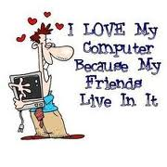
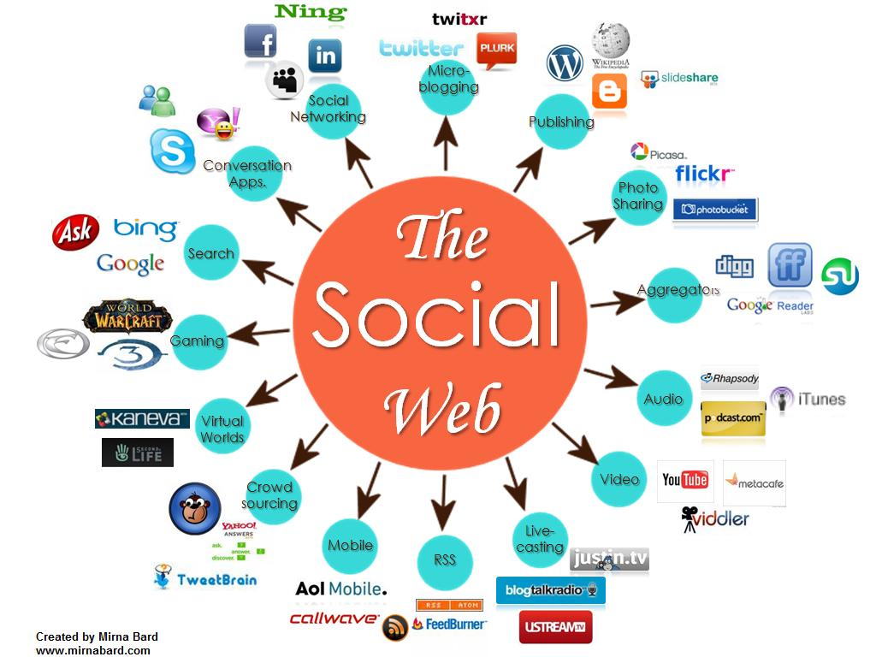
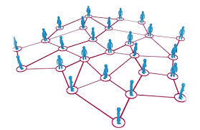
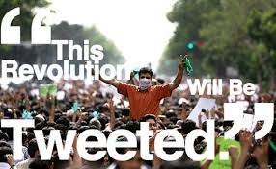
CS/MAS 115: Computing for The Socio-Techno Web
HISTORY OF THE Internet and the Web
Notes:
image source: http://www.igenii.com/blog/Social%20Media/social-media/
twitter.com
http://www.worthofweb.com/blog/case-study-this-revolution-will-be-tweeted/
http://foxwoodonlinemarketing.typepad.com/my-blog/social-media/

Slide 2
Today
What is the Internet?
What is the Web?
Internet vs. the Web
History of the Internet
History of the Web
How does the Internet work?

Slide 3
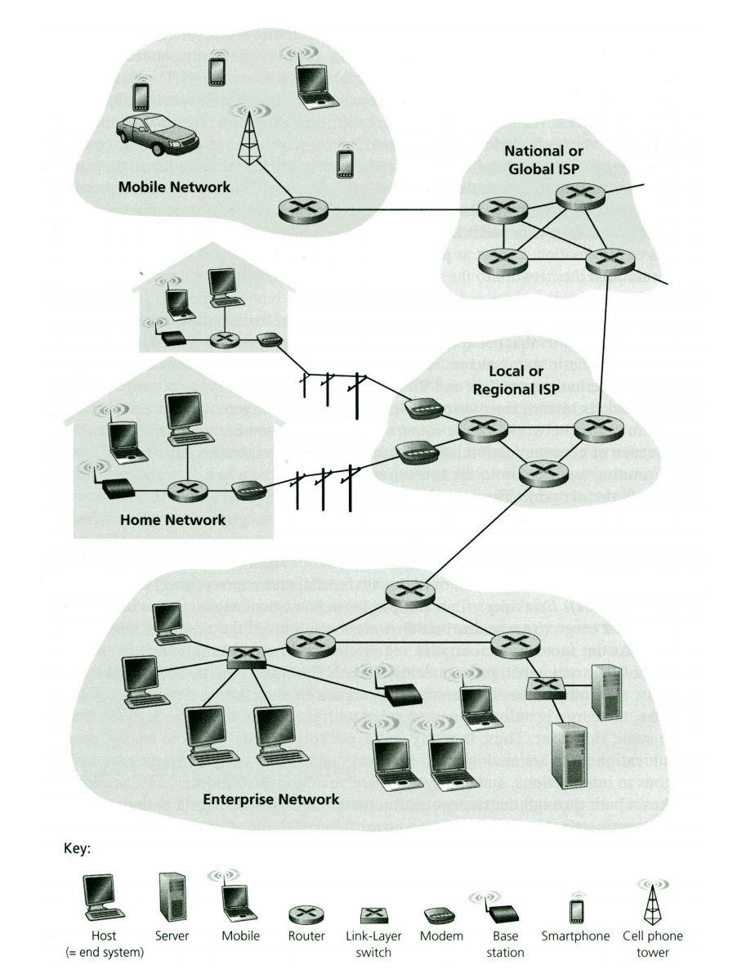
What is the Internet?
A system of interconnected computer networks that link together billion of devices using the TCP/IP communication protocols.
Notes:
Internet is a network of networks. It is a set of standardized protocols (conventions by which computers send data to each other). The data can be transmitted over various carriers.

Slide 4
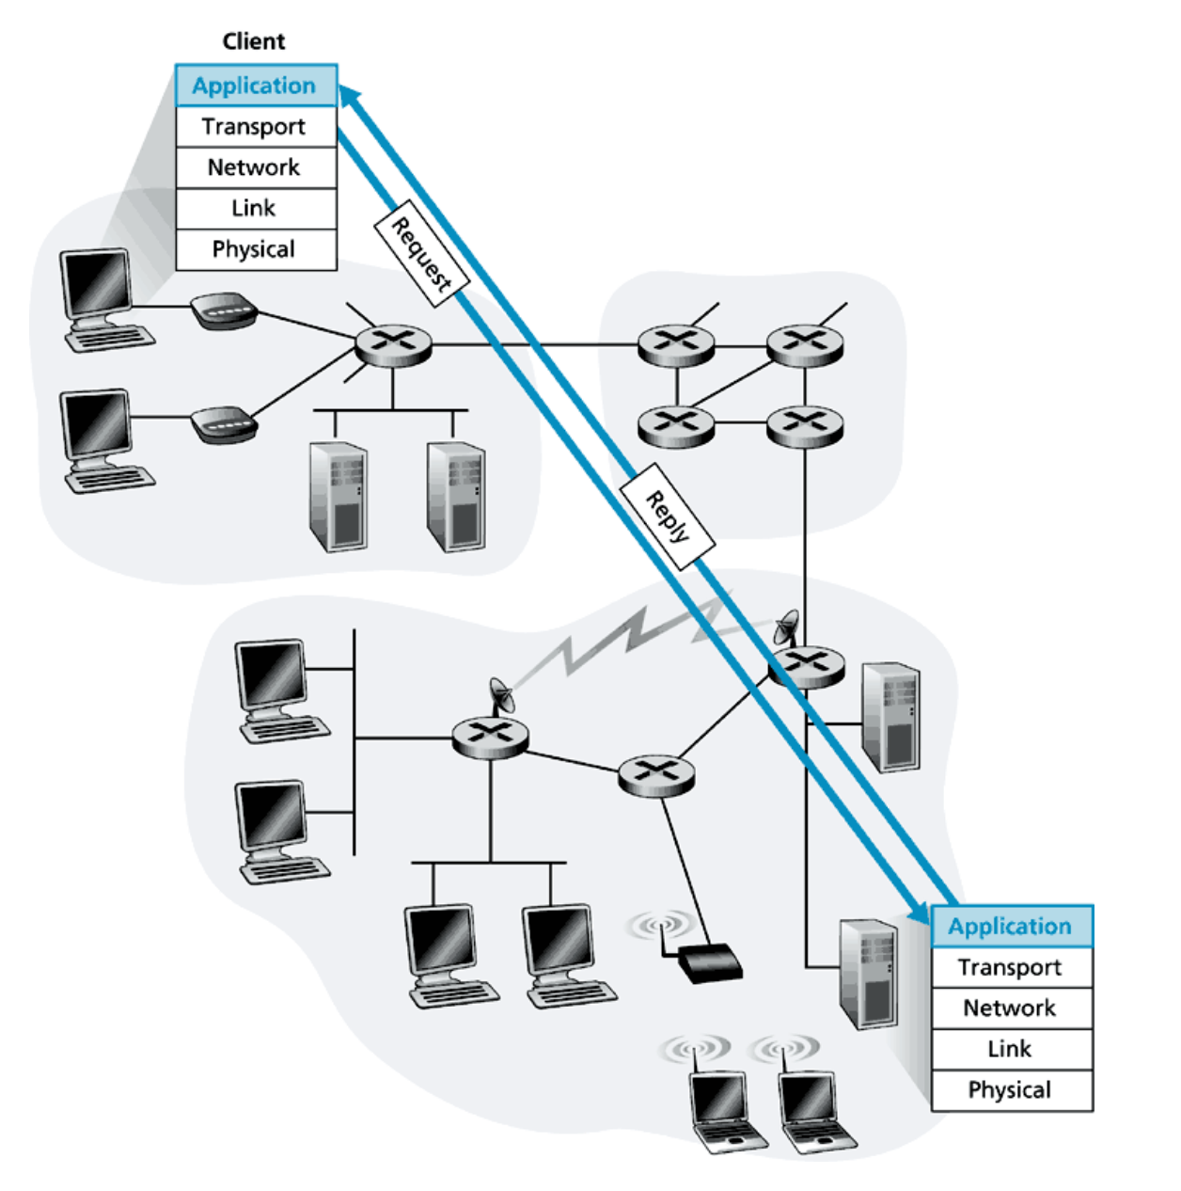
Clients and Servers
Client sends a request
Server sends a reply
Notes:
Powerful central computers store information such as emails, documents, music and videos or offer services such as file hosting, printing, game hosting and internet access; client computers fetch information and use services from these central servers.

Slide 5
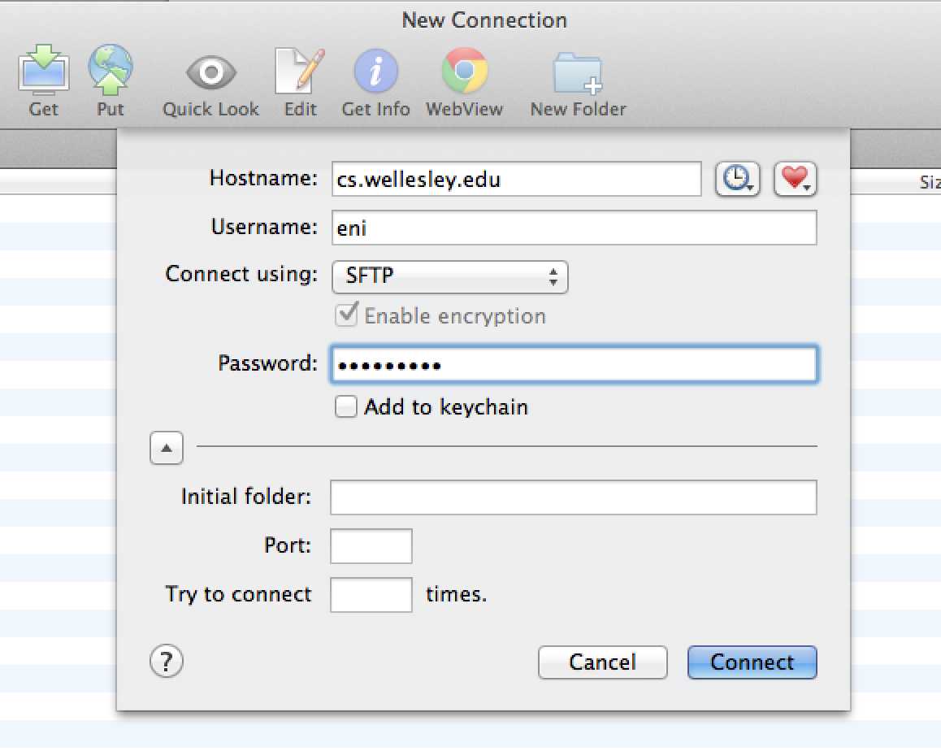
Example: File Transfer
Client: You and your Fetch application.
Server: cs.wellesley.edu
Request #1: Here is a file to save in my cs server account.
Response #1: Got it.
Request #2: Download my hw1 folder from my cs account.
Response #2: Here it is.

Slide 6
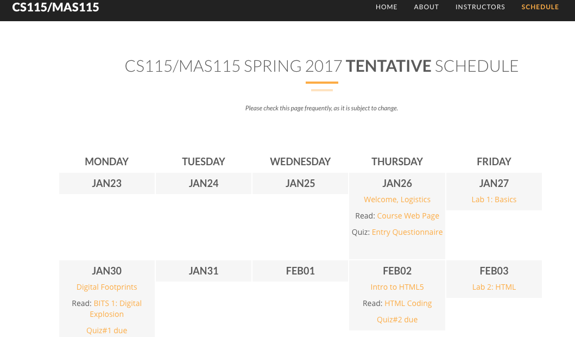
Example: WWW
Client: You and your web browser.
Server: cs.wellesley.edu
Request: Show me the schedule page.
Response: Here you go.

Slide 7
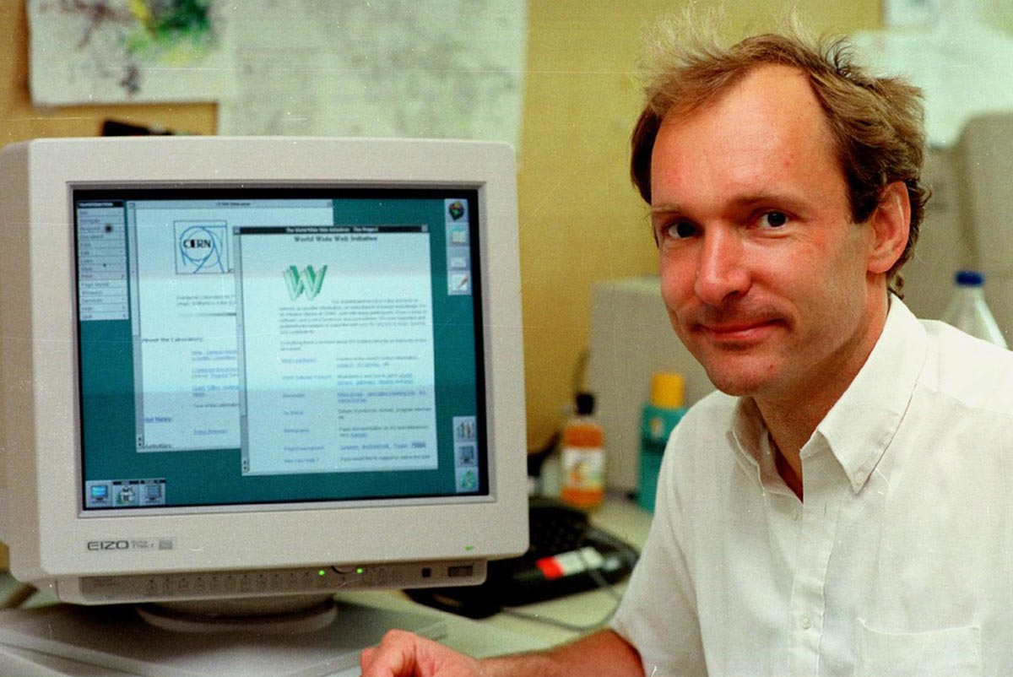
WWW = World Wide Web
Tim Berners-Lee is the inventor of the WWW (1989), an application that runs on the Internet.
He created:
URLs,
the HTTP protocol,
the HTML language
He didn’t patent his technology, he put it on the Internet for free, so that other people could build upon it.

Slide 8
Notes:
https://www.youtube.com/watch?v=OM6XIICm_qo
2016

Slide 9
Web – Design Principles
Decentralization
Bottom-up design
Universality
Consensus
Non-discrimination – Net Neutrality
Notes:
https://www.cnet.com/news/net-fix-8-burning-questions-about-net-neutrality/
https://www.theatlantic.com/technology/archive/2016/12/trump-net-neutrality-mystery/509564/
Decentralization: No permission is needed from a central authority to post anything on the web, there is no central controlling node, and so no single point of failure … and no “kill switch”! This also implies freedom from indiscriminate censorship and surveillance.
Non-discrimination: If I pay to connect to the internet with a certain quality of service, and you pay to connect with that or a greater quality of service, then we can both communicate at the same level. This principle of equity is also known as Net Neutrality. the principle that Internet service providers should enable access to all content and applications regardless of the source, and without favoring or blocking particular products or websites. the term refers to open-web principles aimed at curbing practices that give certain companies competitive advantages in how people access the internet. The FCC formally established rules last year that allow the agency to regulate broadband the way it oversees other public utilities. Those rules ban internet service providers from throttling—or slowing—connections to certain content online, and prohibit providers from offering faster connections to corporations that can afford to pay for premium web services. The rules also discourage zero-rating—in which an internet service provider subsidizes a consumer’s cost of going online but often does so in exchange for a competitive advantage.)
Bottom-up design: Instead of code being written and controlled by a small group of experts, it was developed in full view of everyone, encouraging maximum participation and experimentation.
Universality: For anyone to be able to publish anything on the web, all the computers involved have to speak the same languages to each other, no matter what different hardware people are using; where they live; or what cultural and political beliefs they have. In this way, the web breaks down silos while still allowing diversity to flourish.
Consensus: For universal standards to work, everyone had to agree to use them. Tim and others achieved this consensus by giving everyone a say in creating the standards, through a transparent, participatory process at W3C.
June 14, 2016: The U.S. Court of Appeals for the District of Columbia fully upheld the FCC’s net neutrality rules. Today’s ruling is a victory for the open, fair, and free Internet as we know it today -- one that remains open to innovation and economic growth, without service providers serving as paid gatekeepers. Feb 2015 – FCC (communication commission) vote for strong NN.
New permutations of these ideas are giving rise to exciting new approaches in fields as diverse as information (Open Data), politics (Open Government), scientific research (Open Access), education, and culture (Free Culture). But to date we have only scratched the surface of how these principles could change society and politics for the better.

Slide 10
Discussion – NET NEUTRALITY
” Internet service providers should enable access to all content and applications regardless of the source, and without favoring or blocking particular products or websites.”
Read: https://www.nytimes.com/2018/06/11/technology/net-neutrality-repeal.html
What are the rules?
What are the arguments?
Why does net neutrality matter to me?

Slide 11
Net Neutrality - Brief History
1996 - Internet service is an information service (delivered through telephone lines in U.S.)
2003 - Law professor, Tim Wu, coins the term “net neutrality” – a concept of non-discriminatory network management. Concern is with Internet Service Provider (ISP) market concentration.
2005 - Federal Communications Commission (FCC) publishes Four Freedoms in Policy Statement:
consumers are entitled to access the lawful Internet content of their choice;
consumers are entitled to run applications and services of their choice, subject to the needs of law enforcement;
consumers are entitled to connect their choice of legal devices that do not harm the network; and
consumers are entitled to competition among network providers, application and service providers, and content providers.
2008 - BitTorrent/Comcast case -- was the light-touch regulation of 2005 enough?
2010 - FCC issues Open Internet Order and applies some common carrier rules to Internet (no blocking, no throttling, transparency). Also codifies the Four Freedoms. Wireless services not included. Verizon appeals on grounds that FCC doesn’t have authority to regulate Internet as both information service and telecommunications service.
2014 - Verizon wins its appeal. Net neutrality becomes a popular issue: John Oliver does a segment on HBO’s Last Week Tonight. President Obama makes a statement. FCC decides that reclassifying the Internet is the only way.
2015 - FCC issues new Order reclassifying Internet as a telecommunications service (common carrier)
2017 - Repeal of 2015 rules with FCC Restoring Internet Freedom Order
Notes:
[1] Wu, Tim. 2003. “Network Neutrality, Broadband Discrimination.” SSRN Electronic Journal. https://doi.org/10.2139/ssrn.388863.
Today’s version of this morality play is the debate over “net neutrality.” Providers of Internet backbone services would benefit from providing different pricing and different service guarantees to preferred cus-tomers. But what if a movie studio buys an ISP, and then gets creative with its pricing and service structure? You might discover that your movie downloads are far cheaper to watch, or arrive at your home look ing and sounding much better, if they happen to be the product of the parent content company.
June 14, 2016: The U.S. Court of Appeals for the District of Columbia fully upheld the FCC’s net neutrality rules. Today’s ruling is a victory for the open, fair, and free Internet as we know it today -- one that remains open to innovation and economic growth, without service providers serving as paid gatekeepers. Feb 2015 – FCC (communication commission) vote for strong NN.

Slide 12
Internet vs. WWW
The Internet is the physical network of computers all over the world.
The World Wide Web is a virtual network of websites connected by hyperlinks (or links).
The Web is only one of the many applications that run on the Internet.
The Web uses the HTTP (Hyper Text Transfer Protocol) to allow clients and servers to communicate.
A client: Chrome, Safari, Firefox, Explorer.
Servers: nytimes.com, facebook.com, cs.wellesley.edu

Slide 13
What is Web 2.0?
Notes:
https://www.cnet.com/news/net-fix-8-burning-questions-about-net-neutrality/
https://www.theatlantic.com/technology/archive/2016/12/trump-net-neutrality-mystery/509564/
Decentralization: No permission is needed from a central authority to post anything on the web, there is no central controlling node, and so no single point of failure … and no “kill switch”! This also implies freedom from indiscriminate censorship and surveillance.
Non-discrimination: If I pay to connect to the internet with a certain quality of service, and you pay to connect with that or a greater quality of service, then we can both communicate at the same level. This principle of equity is also known as Net Neutrality. the principle that Internet service providers should enable access to all content and applications regardless of the source, and without favoring or blocking particular products or websites. the term refers to open-web principles aimed at curbing practices that give certain companies competitive advantages in how people access the internet. The FCC formally established rules last year that allow the agency to regulate broadband the way it oversees other public utilities. Those rules ban internet service providers from throttling—or slowing—connections to certain content online, and prohibit providers from offering faster connections to corporations that can afford to pay for premium web services. The rules also discourage zero-rating—in which an internet service provider subsidizes a consumer’s cost of going online but often does so in exchange for a competitive advantage.)
Bottom-up design: Instead of code being written and controlled by a small group of experts, it was developed in full view of everyone, encouraging maximum participation and experimentation.
Universality: For anyone to be able to publish anything on the web, all the computers involved have to speak the same languages to each other, no matter what different hardware people are using; where they live; or what cultural and political beliefs they have. In this way, the web breaks down silos while still allowing diversity to flourish.
Consensus: For universal standards to work, everyone had to agree to use them. Tim and others achieved this consensus by giving everyone a say in creating the standards, through a transparent, participatory process at W3C.
June 14, 2016: The U.S. Court of Appeals for the District of Columbia fully upheld the FCC’s net neutrality rules. Today’s ruling is a victory for the open, fair, and free Internet as we know it today -- one that remains open to innovation and economic growth, without service providers serving as paid gatekeepers. Feb 2015 – FCC (communication commission) vote for strong NN.
New permutations of these ideas are giving rise to exciting new approaches in fields as diverse as information (Open Data), politics (Open Government), scientific research (Open Access), education, and culture (Free Culture). But to date we have only scratched the surface of how these principles could change society and politics for the better.

Slide 14
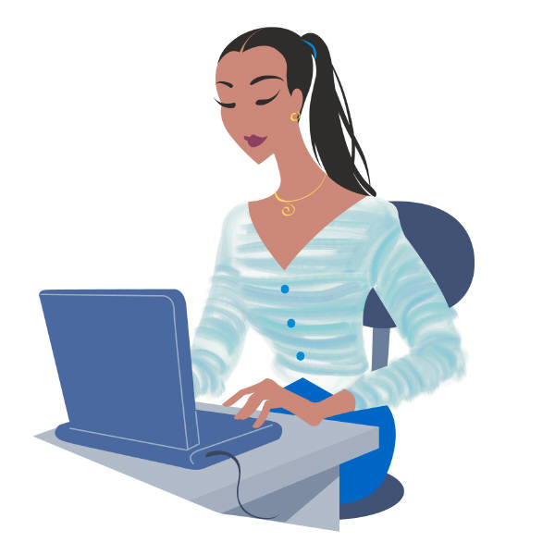
The Web: HTTP, URL, HTML
The three components that allowed Tim Berners-Lee to create the Web
URL: The unique name of every document
HTML: A simple language for documents
HTTP: How to request and receive any document
A User
URL of doc
HTTP request
The Web
Browser that
understands HTML
Notes:
http://puma.wellesley.edu/~cs110/lectures/L03-html/HTML.html

Slide 15
What is a URL?
URL = Universal Resource Locator
Specifies the location of a web resource (web page, image, sound file, movie, etc.) in a remote server on the Internet.
Also known as a web address.
http://cs.wellesley.edu/~cs115/notes/simple.html
protocol
domain name
host
server
path
file

Slide 16
U-R-L
Static URL
http://www.wellesley.edu/Resources/about/index.html
Access method
Server and domain
Path
Document
Uniform Resource Locator
T. B-L wanted URI: Universal Resource Identifier
It tells you where something is located, i.e., the name of the server that has it
It also tells you how you could get it
gov - Government agencies
edu - Educational institutions
org - Organizations (nonprofit)
mil - Military
com - commercial business
net - Network organizations
ca – Canada
kz–…
Notes:
https://www.godaddy.com/?isc=gofdc022&ci=
Specifies the location of a web resource (web page, image, sound file, movie, etc.) in a remote server on the Internet.
Also known as a web address.

Slide 17
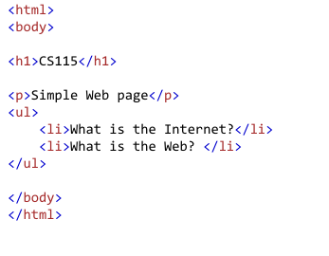
HTML – Language of Web Pages
HTML = HyperText Markup Language
Notes:
In creating the Web, TBL designed HTML (not because it was needed, but so that will even the field of the people who could use the web immediately, was the language to be used with his pages.
HTML is a very simple tagging language that one can learn to read and write easily, (at least the initial version; today it is meant to be read mainly by computers, not humans). The initial HTML enabled point-and-click interface inside the browser. It also allowed images to be displayed inside the browser (a little later). That's it. Later on it was expanded to handle video, sound, and invocation of applications inside the browser.

Slide 18
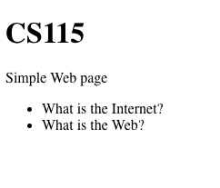
Web Browsers Render HTML

Slide 19
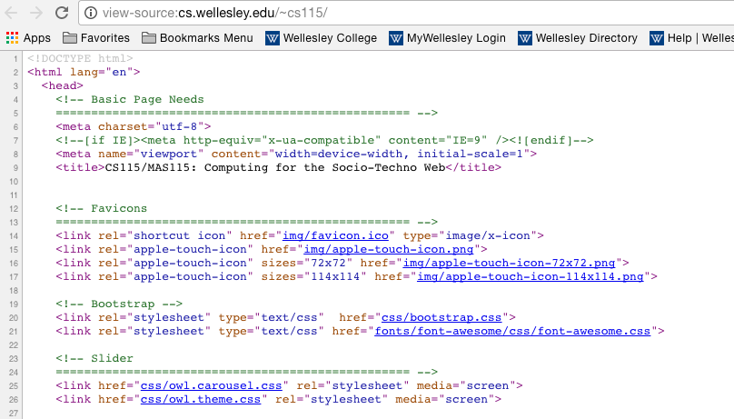
“View Source” Shows Underlying HTML

Slide 20
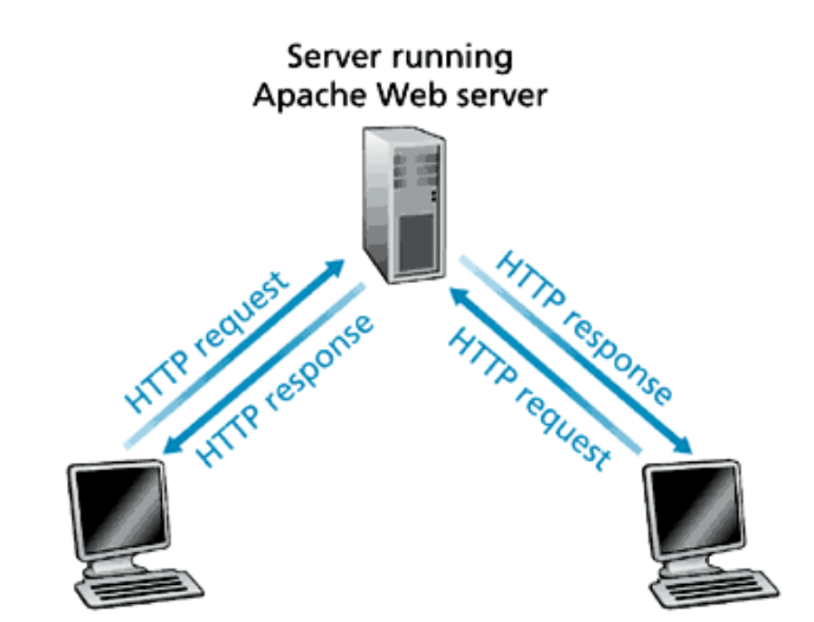
HTTP = HyperText Transfer Protocol
A PC with an Internet Explorer
A Mac with Safari

Slide 21
An HTTP Response
header
<!DOCTYPE html>
<html lang="">
<head>
<meta charset="UTF-8">
<meta name="viewport" content="width=device-width, initial-scale=1.0">
<title></title>
</head>
<body>
<h1>Welcome to CS111!</h1>
<h2>Learn about Web APIs</h2>
...
content

Slide 22
HiSTORY OF the WEB 1/2
1945
Vannevar Bush: publishes seminal article “As We May Think”
1960s
Doug Engelbart prototypes an "oNLine System" (NLS) which does hypertext browsing editing, email, and so on. He invents the mouse for this purpose.
Ted Nelson coins the word Hypertext in A File Structure for the Complex, the Changing, and the Indeterminate. 20th National Conference,
1980
TBL writes a notebook program, "Enquire", which allows links to be made between arbitrary nodes.
1989
"Information Management: A Proposal" written by TBL circulated at CERN

Slide 23
HiSTORY OF the WEB 2/2
1990
TBL writes a global hypertext system. He names it “World Wide Web”
TBL presented poster at Hypertext'91 in San Antonio, Texas (US).
1993
Commercial use of the Internet becomes allowed.
CERN declares that WWW technology would be freely usable by anyone
NCSA releases working versions of Mosaic browser for all common platforms: X, PC/Windows and Macintosh.
1994
First International WWW Conference, CERN, Geneva. Heavily oversubscribed (800 apply, 400 allowed in): the "Woodstock of the Web".

Slide 24
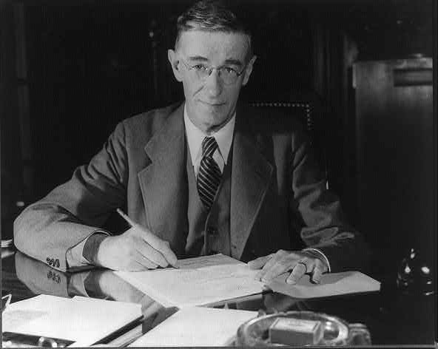
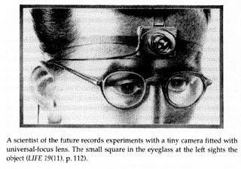
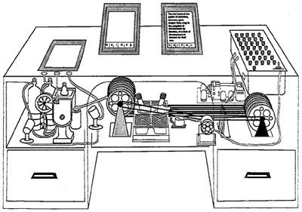
Vannevar Bush As We May Think The Atlantic Monthly 1945
Notes:
We start where WWII ends, at 1945. Vannenvar Bush was an american innovator and engineer that directed the U.S. Office of Science Research and Development. In this position He managed and coordinated the war-related activities of some six thousand U.S. scientists. As the end of the war was coming into sight, Bush saw two problems emerging: 1) how to make the huge volume of war time reports and research findings public and accessible
and 2) what new challenge to set for the scientists who would be finishing their war related work.
In his article “As We May Think” he Identified the information storage and retrieval problem: new knowledge does not reach the people who could benefit from it. And he proposed one solution for both problems.
Bush proposed the development of mechanical systems to manage and process the growing body of scientific, technical and scholarly knowledge. He was the first to propose to make Capturing, Storing, Retrieving and Sharing Information
Interactive!
Bush set a challenge: development of mechanical systems to manage and process the growing body of scientific, technical and scholarly knowledge.
But being an inventor himself he also sketched a solution: Documentation system – software that allows documents to be stored and later retrieved.
He offered as a solution a desk-like device he called “memex,” (perhaps for memory extension). Memex was a mechanized file and personal library system. It used improved microfilm to store all the books, documents, pictures, correspondence, notes, etc. that a scholar or scientist might need. The microfilm texts are created by the scholar or received in the mail from colleagues or purchased from publishers. Microfilm and mail are inexpensive so there is no practical limit to how much information could be available.
But the real innovation of the memex is in the way information is retrieved – in the way a is indexed and then can be found. So far, indexing and cataloguing were done alphabetically or numerically and searching or selecting was by tracing down from subclass to subclass. For example in consulting a dictionary, the first letter is found, then the second, and so on. Such a method Bush wrote that this was an artificial way to index information. The human brain does not work that way. According to Bush the human brain works by association.
So instead of using the traditional indexing method, Bush suggests an alternative. When a scientist insert information to the memex he gives it a code, any code that helps the scientists to remember what this piece is about. Then he writes this code in an index book. So far this works as usual.
But, in imitation of the brain, every time the scholar consults a document or item in the memex, the scholar has a mechanism to associate it with other items which come to mind (practically to create a link). So the user can annotate text with margin notes, comments... –can construct and save a trail (chain of links) through the material –acts as an external memory!
Creating trails of documents – does it sounds familiar?
True, creating trails of information that automatically select each other is the core idea behind hypertext.
But the reason I selected to tell you about vannevar bush today is not because he invented the hypertest, but because of his human-centred thinking. He was among the first inventors and thinkers that called for the development of machines that are built around users’ needs and abilities.
(write human-centred on the board, user cntered – this is one of the main ideas you will learn in this course).
Ted Nelson coined the term "hypertext" in 1965 [29].

Slide 25
Animation of the Memex
Notes:
Documentation system – software that allows documents to be stored and later retrieved.

Slide 26
History of the Internet
1975
Notes:
The Internet was nearly invisible in Europe. People there were pursuing a different set of network protocols (by ISO).
The Internet was up and running by the 1970s, but transferring information was too much of a hassle for a noncomputer expert. One would run one program to connect to another computer, and then in conversation (in a different language) with the other computer, run a different program to access the information. Even when data had been transferred back to one's own computer, decoding it might be impossible. Then electronic mail was invented. E-mail allowed messages to be sent from one person to another, but it did not form a space in which information could permanently exist and be referred to. Messages were transient

Slide 27
Brief History of the Internet
1968 - DARPA (Defense Advanced Research Projects Agency) contracts with BBN (Bolt, Beranek & Newman) to create ARPAnet
1970 - First five nodes:
UCLA
Stanford
UC Santa Barbara
U of Utah, and
BBN
1974 - TCP specification by Vint Cerf
1984 – On January 1, the Internet with its 1000 hosts converts en masse to using TCP/IP for its messaging
Notes:
Before the Internet computers were connected using dedicated cables from one to another. One computer can only be connected to a small number of computers.

Slide 28
Internet Governance
Who controls the Internet?
No one!
(or many different entities)
Notes:
http://en.wikipedia.org/wiki/Series_of_tubes

Slide 29
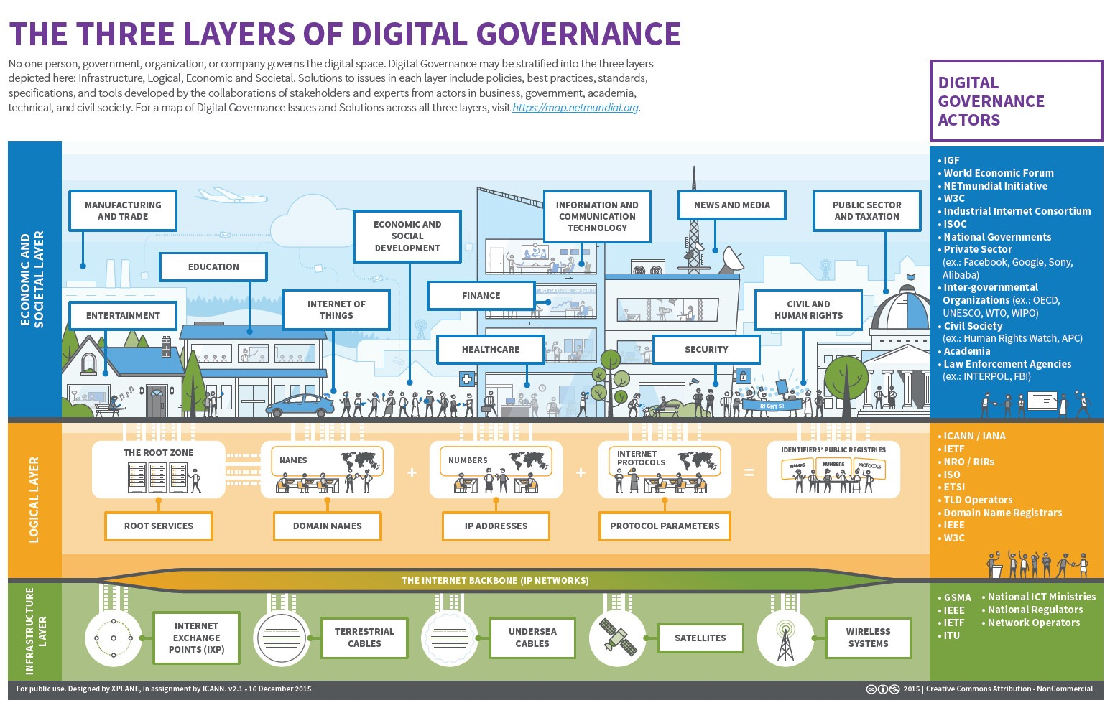
Notes:
http://en.wikipedia.org/wiki/Series_of_tubes

Slide 30
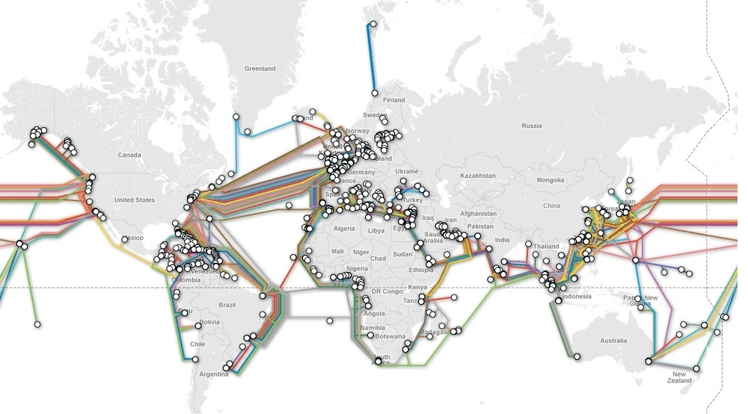
Submarine cables that make the Internet possible – Jan 2017
Notes:
http://www.submarinecablemap.com/
http://www.internetlivestats.com/

Slide 31
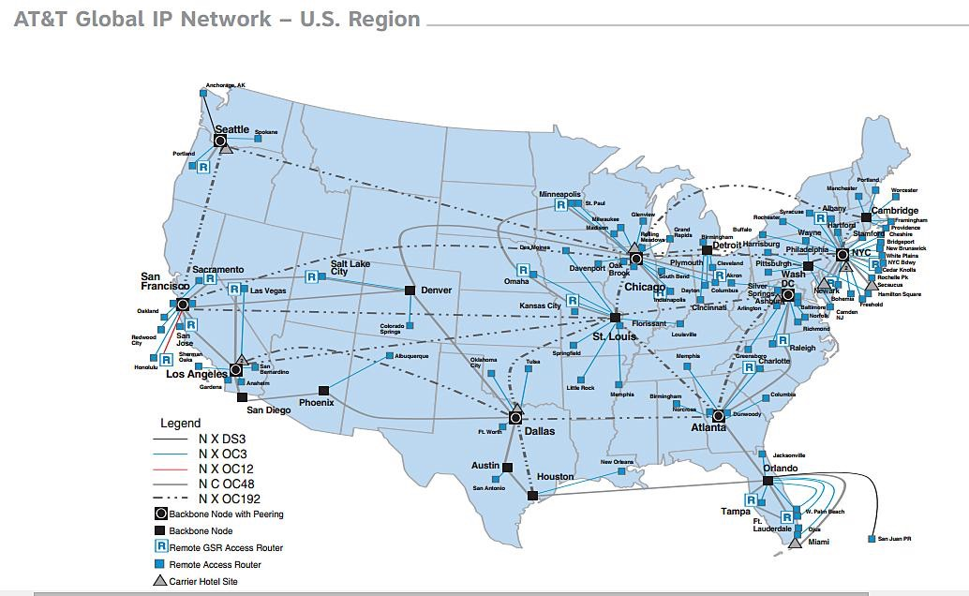
Internet Governance
Notes:
http://telecomunetwork.blogspot.com/

Slide 32
Internet Governance
Residential ISP in the USA
Altice USA
Armstrong Zoom
AT&T Internet Services
Atlantic Broadband
B2X Online - VA
Bernard Telephone Co
CenturyLink
Charter Communications
Cincinnati Bell
Comcast High Speed Internet
Comelec
Consolidated Communications
Cox Communications
CS Technologies, Inc.
Exede Internet
Google Fiber
HughesNet
Interlync Internet Services
ImOn Communications
Mediacom
Midcontinent Communications
MV Link
RCN Corporation (acquired by TPG)
Rise Broadband
Shentel
Sonic.net
South Slope
Sprint (including Clearwire)
Ting Internet
USA Communications
PenTeleData
Windstream (including Earthlink)
Verizon High Speed Internet
WideOpenWest (wow!)
https://en.wikipedia.org/wiki/List_of_broadband_providers_in_the_United_States
Notes:
http://telecomunetwork.blogspot.com/

Slide 33
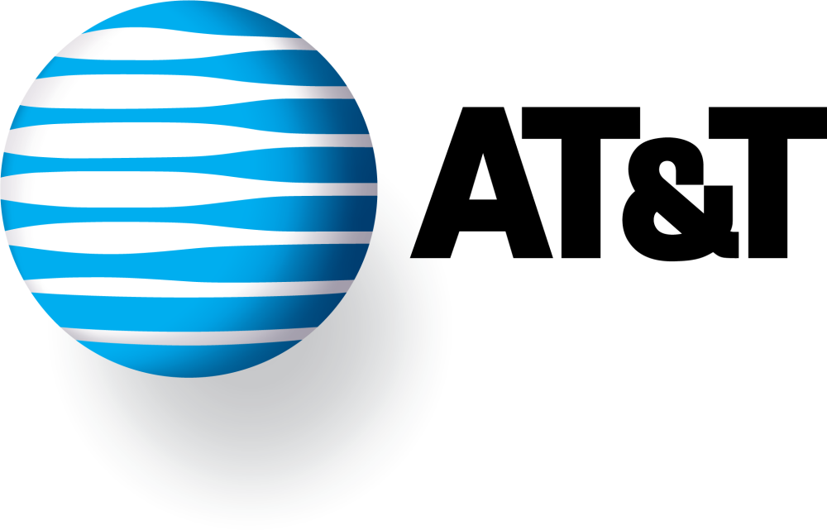
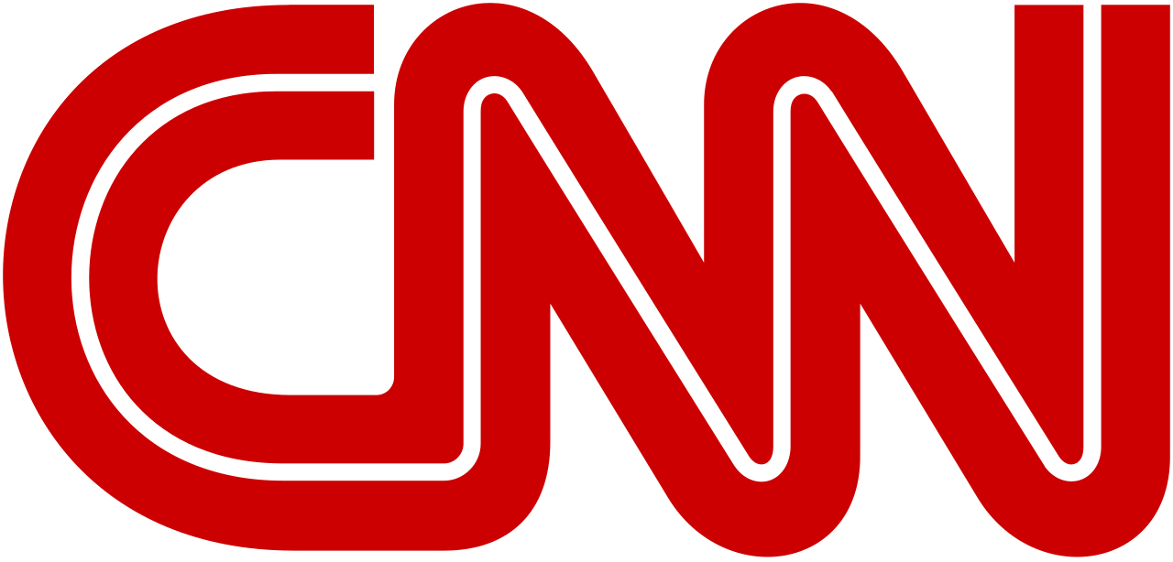
Net Neutrality
Is this true:
+
=
Notes:
Today’s version of this morality play is the debate over “net neutrality.” Providers of Internet backbone services would benefit from providing different pricing and different service guarantees to preferred cus-tomers. But what if a movie studio buys an ISP, and then gets creative with its pricing and service structure? You might discover that your movie downloads are far cheaper to watch, or arrive at your home look ing and sounding much better, if they happen to be the product of the parent content company.
June 14, 2016: The U.S. Court of Appeals for the District of Columbia fully upheld the FCC’s net neutrality rules. Today’s ruling is a victory for the open, fair, and free Internet as we know it today -- one that remains open to innovation and economic growth, without service providers serving as paid gatekeepers. Feb 2015 – FCC (communication commission) vote for strong NN.

Slide 34
Live Stats
Live stats
Traceroute - a utility that records the route through the Internet between your computer and a specified destination computer. It also calculates the amount of time each hop took.
Submarines cables: https://www.submarinecablemap.com/

