Slide 1
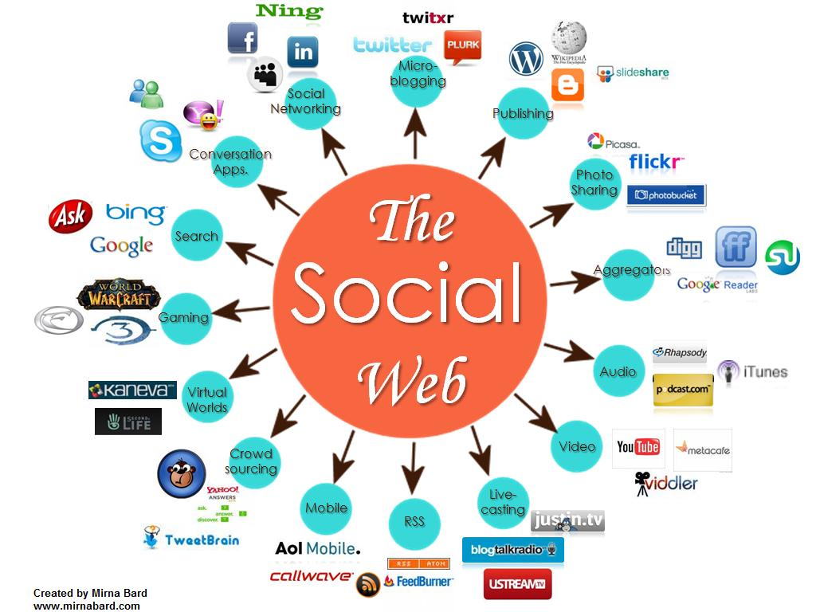
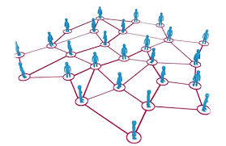
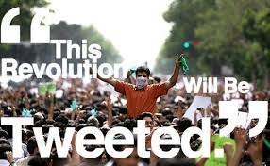
CS 115: COMPUTING FOR The Socio-Techno Web
The fun and the fear of Online Social Networks
Notes:
image source: http://www.igenii.com/blog/Social%20Media/social-media/
twitter.com
http://www.worthofweb.com/blog/case-study-this-revolution-will-be-tweeted/
http://foxwoodonlinemarketing.typepad.com/my-blog/social-media/
Topic of the days encompasses all aspects of society: communication, innovation, complexity, spread etc.

Slide 2
What is an online social network?
A set of relationships between entities
Notes:
Ask students: what is an online social network?
Is wikipedia social network? A social network of knowledge. En example of collaboration that humanity hasnever seen behavior. Difficult to believe initially but now more reliable than best encyclopedia.
Different platforms have their own culture.
Orkut – named after a Google employee – social network for people in Brazil.
My favourite is Twitter – get my own newsfeed
Linkedin – be aware when you’re loooking for a job
What are some common characteristics of these social networks?
Relationship between entities – (not only people).
What are some of the differences?

Slide 3
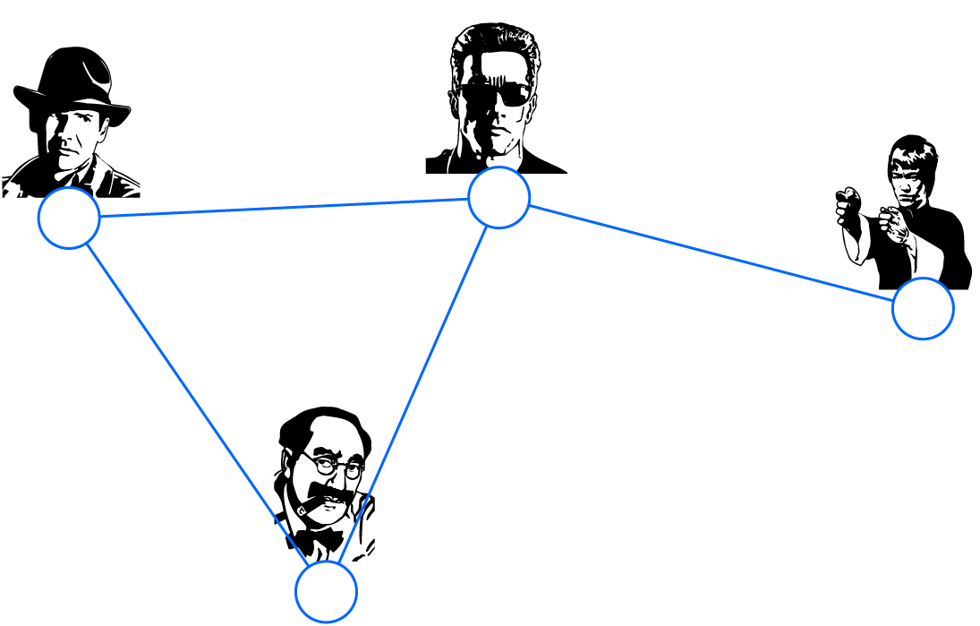
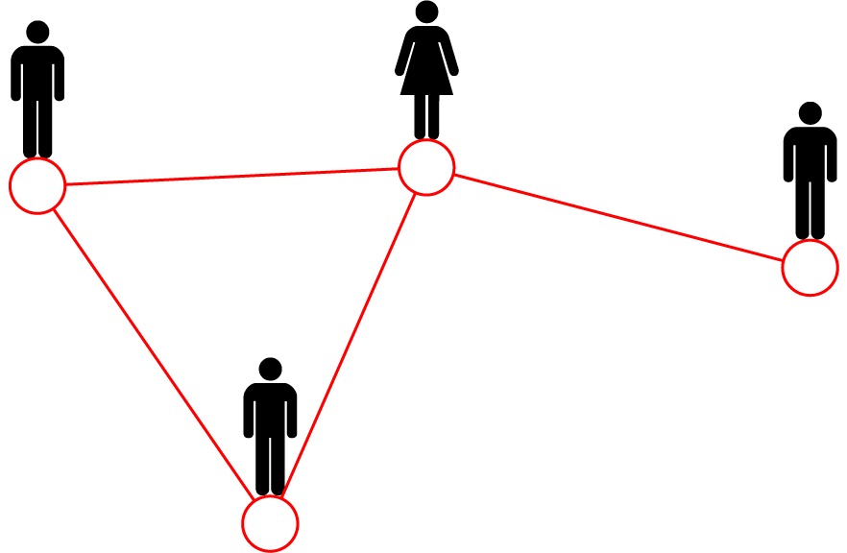
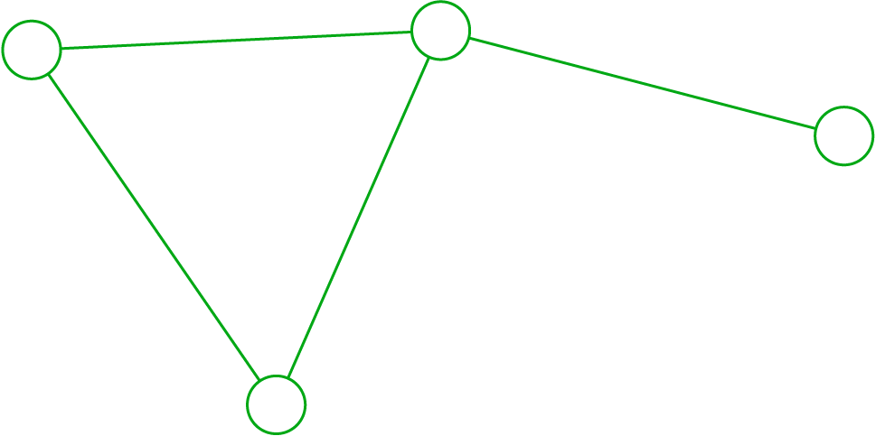
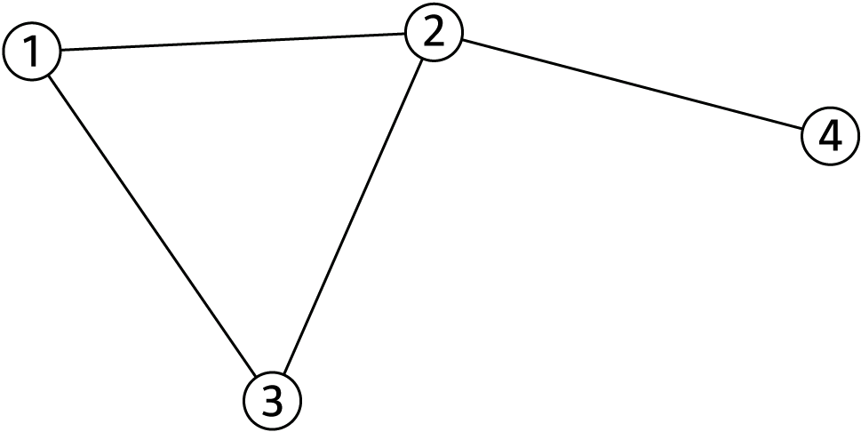
Relationships (Networks) and Graphs
friend
Movie 1
Mary
co-worker
Actor 2
Peter
Actor 1
Albert
Movie 3
Actor 4
brothers
friend
Movie 2
Albert
Actor 3
Protein 1
Protein 2
Protein 5
N=4
L=4
Protein 9
Network Science: Graph Theory 2012
Notes:
Relationships and network – different kinds of relationships.
What is common – graph – abstract essential connectivity structure, network is graph+ some explanation of the relationships
A graph is a way of specifying relationships among a collection of items. Graphs as Models of Networks. Graphs are useful because they serve as mathematical models of network structures.
A graph consists of a set of objects, called nodes, with certain pairs of these objects connected by links called edges.
We say that two nodes are neighbors if they are connected by an edge.
Can you think of other domains that could be represented using graphs? (brain, travel, map)

Slide 4
What is a (real life) social network?
Notes:
What is a real-life social network? What can we say about this social network?
If I ask you to take a few minutes and then start drawing your connection, you might start create a graph like this one.
There may be many more dense connections. We are not isolated in trees. But we are connected in denser ways.
Scientific results – whenever you find people like this (tree) with isolated connection are more vulunerable.
Can you draw your own? Is it a tree (like the above)?
How differently does it look when it is not?
How many different social networks do you participate in?
At home, through family, through HS, college, societies you belong to.

Slide 5
online social Network (fb)
Notes:
Facebook is network we use all the time.
Monitor your time.
This is a network of Alex Smith – an early employee at Facebook 2005.
Found that by looking at the density of the network you could identify subclasses of connections with special relationships.
Shows several things – isolated nodes, a huge component that is connectd – this is theh famous giant component. In each social network we find a giant component with isolated nodes.
Companies like Facebook can use this info to advertise better –
When you look for a job = bridge nodes are most important. Bridge connect two components. Why?

Slide 6
A powerful network
Notes:
Board of Directors (Yale) from http://www.theyrule.net

Slide 7
Social Network Analysis
[Social network analysis] is grounded in the observation that social actors are interdependent and that the links among them have important consequences for every individual [and for all of the individuals together]. ... [Relationships] provide individuals with opportunities and, at the same time, potential constraints on their behavior. ... Social network analysis involves theorizing, model building and empirical research focused on uncovering the patterning of links among actors. It is concerned also with uncovering the antecedents and consequences of recurrent patterns. [Linton C. Freeman, UC-Irvine]
Notes:
Prof. of Sociology and Institute for Mathematical Behavioral Sciences
School of Social Sciences, University of California, Irvine,
Different people study networks: sociology – social actors.

Slide 8
Representing a Social Network
a set V of n nodes or vertices,
usually denoted {v₁, …, v_{n}}
node v₂
1
2
3
4
5
6
7
8
a set E of m edges between nodes,
usually denoted {e_{i,j}}
un-directed or directed (arcs)
uni-directed of bi-directed
8
3
edge e_{8,3}
Notes:
Graph is a mathematical structure that could be formally defines as a set of n (nodes) and m edges.
We enumerate nodes so we can refer to them –
Unidirected – can you think of an examples
Graphs also maps – corners are nodes, streets are connections. They know whether connections are unidirections or undirections.
Joke: someone driving and listens to the Radio, hears be careful someone on Main St. drives in the opposite direction. He looks around and laughs – only one? There are 1, 2m3m so many crazy people…

Slide 9
Paths
5
7
6
8
3
2
4
Path (v₁,v₂,v₈,v₃,v₇)
1
Definition: A path is a sequence of nodes (v₁, …, v_{k}) such that for any adjacent pair v_{i} and v_{i+1}, there’s an edge e_{i,i+1} between them.
Notes:
Perhaps foremost among these is the idea that things often travel across the edges of a graph, moving from node to node in sequence — this could be a passenger taking a sequence of airline flights, a piece of information being passed from person to person in a social network, or a computer user or piece of software visiting a sequence of Web pages by following links. This idea motivates the definition of a path in a graph: a path is simply a sequence of nodes with the property that each consecutive pair in the sequence is connected by an edge
a cycle is a path with at least three edges, in which the first and last nodes are the same, but otherwise all nodes are distinct.
Path is what your GPS is telling you, How to get from point A to B.
In the high school example what is the meaning of a path?

Slide 10
Paths
“I date(d) someone who date(d) someone who date(d) you.”
Notes:
Paths represent indirect relationships.

Slide 11
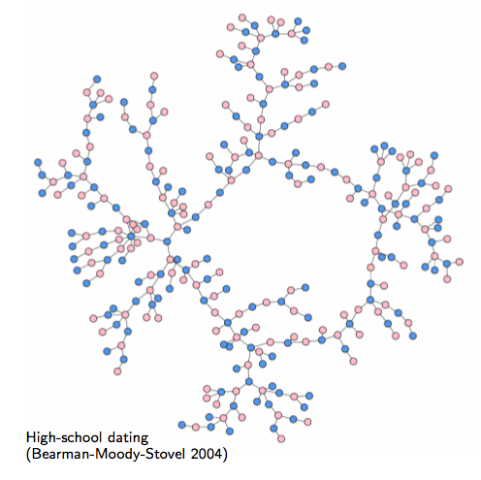
Examples of Social Networks
What do you observe?
Notes:
What do you observe – read from the paper image links to paper:
“The results showed that, unlike many adult networks, there was no core group of very sexually active people at the high school. There were not many students who had many partners and who provided links to the rest of the community.
Instead, the romantic and sexual network at the school created long chains of connections that spread out through the community, with few places where students directly shared the same partners with each other. But they were indirectly linked, partner to partner to partner. One component of the network linked 288 students – more than half of those who were romantically active at the school – in one long chain. (See figure for a representation of the network.)”
This is just the largest component – but there were 19 components,

Slide 12
Path length
5
7
6
8
3
2
4
Path (v₁,v₂,v₈,v₃,v₇)
has length 4.
1
Definition: The length of a path is the number of edges it contains.

Slide 13
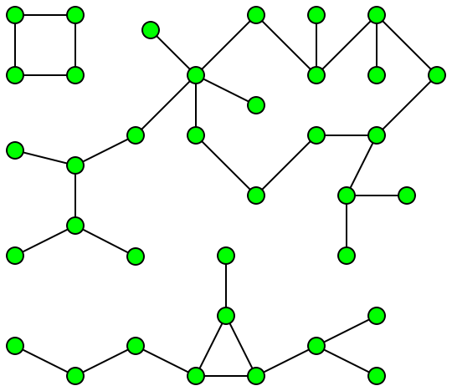
Connected GRAPH
A graph is connected when there is a path between every pair of vertices. In a connected graph, there are no unreachable vertices.
a connected component of an undirected graph is a subgraph in which any two vertices are connected to each other by paths, and which is connected to no additional vertices in the super graph.
Notes:
A graph that is not connected is disconnected.

Slide 14
Distance
5
7
6
8
3
2
4
The distance between v₁ and v₇ is 3.
1
Definition: The distance between nodes v_{i} and v_{j} is the length of the shortest path connecting them.
Notes:
Distance=shortest path
Distance concepts that embedded into popular culture

Slide 15
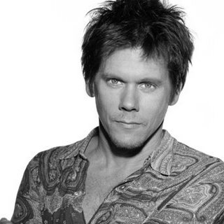
Famous distances
nodes = {actors}
edges = if two actors star in same film
Kevin Bacon number
Kevin Bacon number = distance between actor and Bacon
Notes:
If you look at the network of films and actors at the center is Kevin Bacon.
2nd rate but very busy. Not very selective.

Slide 16
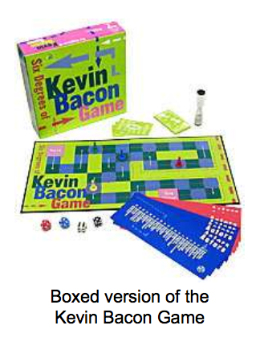
The Kevin Bacon Game
Invented by Albright College students in 1994: Craig Fass, Brian Turtle, Mike Ginelly
Goal: Connect any actor to Kevin Bacon, by linking actors who have acted in the same movie.
Oracle of Bacon website uses Internet Movie Database (IMDB.com) to find shortest link between any two actors:
http://oracleofbacon.org/

Slide 17
Title
Data
Notes:
ImDB was created by Brian’s Tjaden’s brother.

Slide 18
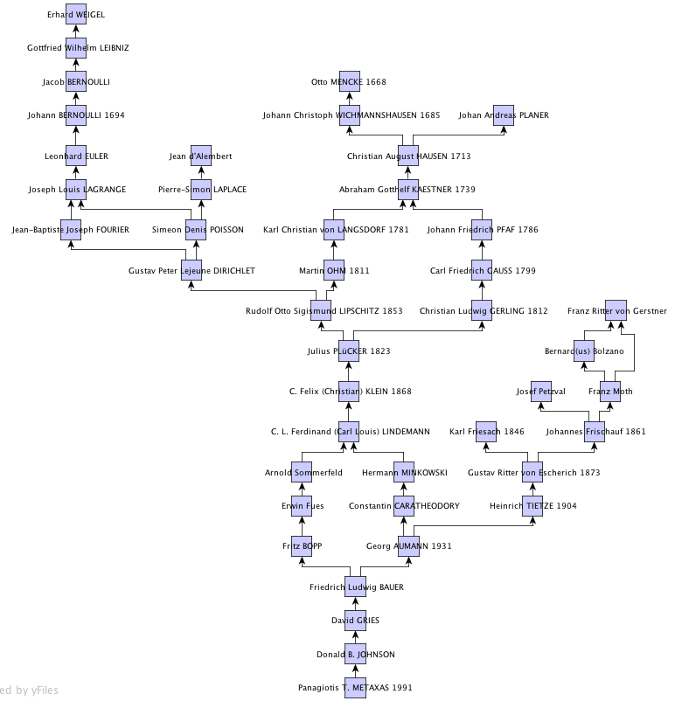
Famous distances
Math PhD genealogies
Notes:
In getting you phD there is a connection with an advisor.
14 generations to Euler!
Mostly a tree. A few weird relationships (a triangle to the mid-right, a few cycles in previous centuries. Joint advisors.)
You can divide it into countries!
Math:
The intent of this project is to compile information about ALL the mathematicians of the world. We earnestly solicit information from all schools who participate in the development of research level mathematics and from all individuals who may know desired information.

Slide 19
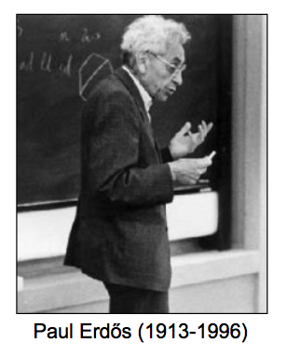
Erdős Numbers
Erdős wrote 1500+ papers with 507 co-authors.
Number of links required to connect scholars to Erdős, via co- authorship of papers
What type of graph do you expect?
Jerry Grossman (Oakland Univ.) website allows mathematicians to compute their Erdős numbers: http://www.oakland.edu/enp/
Connecting path lengths, among mathematicians only:
avg = 4.65
max = 13
Notes:
One of the greatest mathematician. Never owned an house a car – only a bag. Move from university to university spend a few weeks write a paper.
Very short humble thinking mathematics all the time.

Slide 20
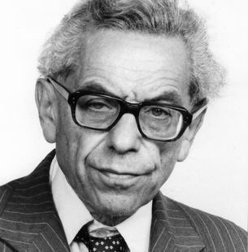
Famous distances
nodes = {mathematicians}
edges = if 2 mathematicians co-author a paper
Paul Erdős number
Erdős number = distance between mathematican and Erdos

Slide 21
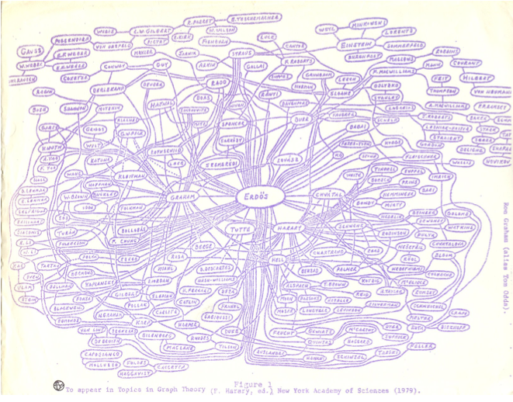
Notes:
Ron Graham’s hand-drawn picture of a part of the mathematics collaboration graph, centered on Paul Erdo ̈s [190]. (Image from http://www.oakland.edu/enp/cgraph.jpg)

Slide 22
Proud people!

Slide 23
Famous distances
Erdős number of …
= 4

Slide 24
Famous distances
Erdős number of …
= 3
Erdos
Fan Chung
F.T. Leighton
P.T. Metaxas
Notes:
What type of graph to expect?
A tree? Clustered?
Chung, F. R. K.; Erdős, P.; Graham, R. L. On the product of the point and line covering numbers of a graph. Second International Conference on Combinatorial Mathematics (New York, 1978), pp. 597--602, Ann. New York Acad. Sci., 319, New York Acad. Sci., New York, 1979.
Chung, Fan R. K.; Leighton, Frank Thomson; Rosenberg, Arnold L. Embedding graphs in books: a layout problem with applications to VLSI design. Graph theory with applications to algorithms and computer science (Kalamazoo, Mich., 1984), 175--188, Wiley-Intersci. Publ., Wiley, New York, 1985.
Andrews, Matthew; Leighton, Tom; Metaxas, P. Takis; Zhang, Lisa Automatic methods for hiding latency in high bandwidth networks (extended abstract). Proceedings of the Twenty-eighth Annual ACM Symposium on the Theory of Computing (Philadelphia, PA, 1996), 257--265, ACM, New York, 1996.

Slide 25
Famous distances
Erdős number of …
= 4
Erdos
Fan Chung
F.T. Leighton
P.T. Metaxas
Orit Shaer
Notes:
What type of graph to expect?
A tree? Clustered?
Chung, F. R. K.; Erdős, P.; Graham, R. L. On the product of the point and line covering numbers of a graph. Second International Conference on Combinatorial Mathematics (New York, 1978), pp. 597--602, Ann. New York Acad. Sci., 319, New York Acad. Sci., New York, 1979.
Chung, Fan R. K.; Leighton, Frank Thomson; Rosenberg, Arnold L. Embedding graphs in books: a layout problem with applications to VLSI design. Graph theory with applications to algorithms and computer science (Kalamazoo, Mich., 1984), 175--188, Wiley-Intersci. Publ., Wiley, New York, 1985.
Andrews, Matthew; Leighton, Tom; Metaxas, P. Takis; Zhang, Lisa Automatic methods for hiding latency in high bandwidth networks (extended abstract). Proceedings of the Twenty-eighth Annual ACM Symposium on the Theory of Computing (Philadelphia, PA, 1996), 257--265, ACM, New York, 1996.
C. Pollalis, C. Grevet, L. Westendorf, S. Finn, O. Shaer, and P. Metaxas. 2018. Classroom Activity for Critical Analysis of News Propagation Online. In Extended Abstracts of the 2018 CHI Conference on Human Factors in Computing Systems (CHI EA '18). ACM.

Slide 26
Famous distances
Erdos number of …
if you publish with Takis!
YOU = Bill Gates
Notes:
Update with my paper with takis.

Slide 27
Diameter
5
7
6
8
3
2
4
The diameter is 3.
1
Definition: The diameter of a graph is the maximum shortest-path distance between any two nodes.
Notes:
As another means of measuring network graphs, we can define the diameter of a network as the longest of all the calculated shortest paths in a network. It is the shortest distance between the two most distant nodes in the network. In other words, once the shortest path length from every node to all other nodes is calculated, the diameter is the longest of all the calculated path lengths. The diameter is representative of the linear size of a network.

Slide 28
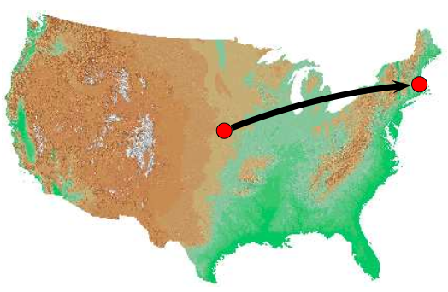
The diameter of a social network is small.
Milgram’s experiment (1960s).
Ask someone to pass a letter to another person via friends knowing only the name, address, and occupation of the target.
Notes:
Sociologist wanted to figure out what is the longest chain of people:
296 People in Omaha, NE, were given a letter, asked to try to reach a stockbroker in Sharon, MA, via personal acquaintances
This idea has been termed the small-world phenomenon — the idea that the world looks “small” when you think of how short a path of friends it takes to get from you to almost anyone else. It’s also known, perhaps more memorably, as the six degrees of separation; this phrase comes from the play of this title by John Guare [200], and in particular from the line uttered by one of the play’s characters: “I read somewhere that everybody on this planet is separated by only six other people. Six degrees of separation between us and everyone else on this planet.”

Slide 29
Small world phenomenon
Bernard, David’s cousin who went to college with
David, mayor of Bob’s town
Bob, a farmer in Nebraska
Maya, who grew up in Boston
With Lashawn
Notes:
This idea has been termed the small-world phenomenon — the idea that the world looks “small” when you think of how short a path of friends it takes to get from you to almost anyone else. It’s also known, perhaps more memorably, as the six degrees of separation; this phrase comes from the play of this title by John Guare [200], and in particular from the line uttered by one of the play’s characters: “I read somewhere that everybody on this planet is separated by only six other people. Six degrees of separation between us and everyone else on this planet.”

Slide 30
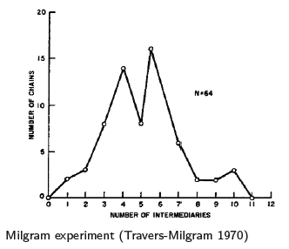
Milgram: Six Degrees of Separation
296 People in Omaha, NE, were given a letter, asked to try to reach a stockbroker in Sharon, MA, via personal acquaintances
20% reached target
average number of “hops” in the completed chains = 6.5
Why are chains so short?
I know! Exponential growth of friends!
Notes:
That’s the standard explanation is it true?
Erdos studied random graphs…
But is acquaintance-relationship just *any* random graph?
Lacking any of the massive social-network datasets we have today, and with a budget of only $680, he set out to test the speculative idea that people are really connected in the global friendship network by short chains of friends. To this end, he asked a collection of 296 randomly chosen “starters” to try forwarding a letter to a “target” person, a stockbroker who lived in a suburb of Boston. The starters were each given some personal information about the target (including his address and occupation) and were asked to forward the letter to someone they knew on a first-name basis, with the same instructions, in order to eventually reach the target as quickly as possible. Each letter thus passed through the hands of a sequence of friends in succession, and each thereby formed a chain of people that closed in on the stockbroker outside Boston
, the existence of all these short paths has substantial consequences for the potential speed with which information, diseases, and other kinds of contagion can spread through society, as well as for the potential access that the social network provides to opportunities and to people with very different characteristics from one’s own.
One of the largest such computational studies was performed by Jure Leskovec and Eric Horvitz [273]. They analyzed the 240 million active user accounts on Microsoft Instant Messenger, building a graph in which each node corresponds to a user, and there is an edge between two users if they engaged in a two-way conversation at any point during a month-long observation period. As employees of Microsoft at the time, they had access to a complete snapshot of the system for the month under study, so there were no concerns about missing data. This graph turned out to have a giant component containing almost all of the nodes, and the distances within this giant component were very small. Indeed, the distances in the Instant Messenger network closely corresponded to the numbers from Milgram’s experiment, with an estimated average distance of 6.6, and an estimated median
In this case, enormous as the Microsoft IM study was, it remains some distance away from Milgram’s goal: it only tracks people who are technologically-endowed enough to have access to instant messaging, and rather than basing the graph on who is truly friends with whom, it can only observe who talks to whom during an observation period.

Slide 31
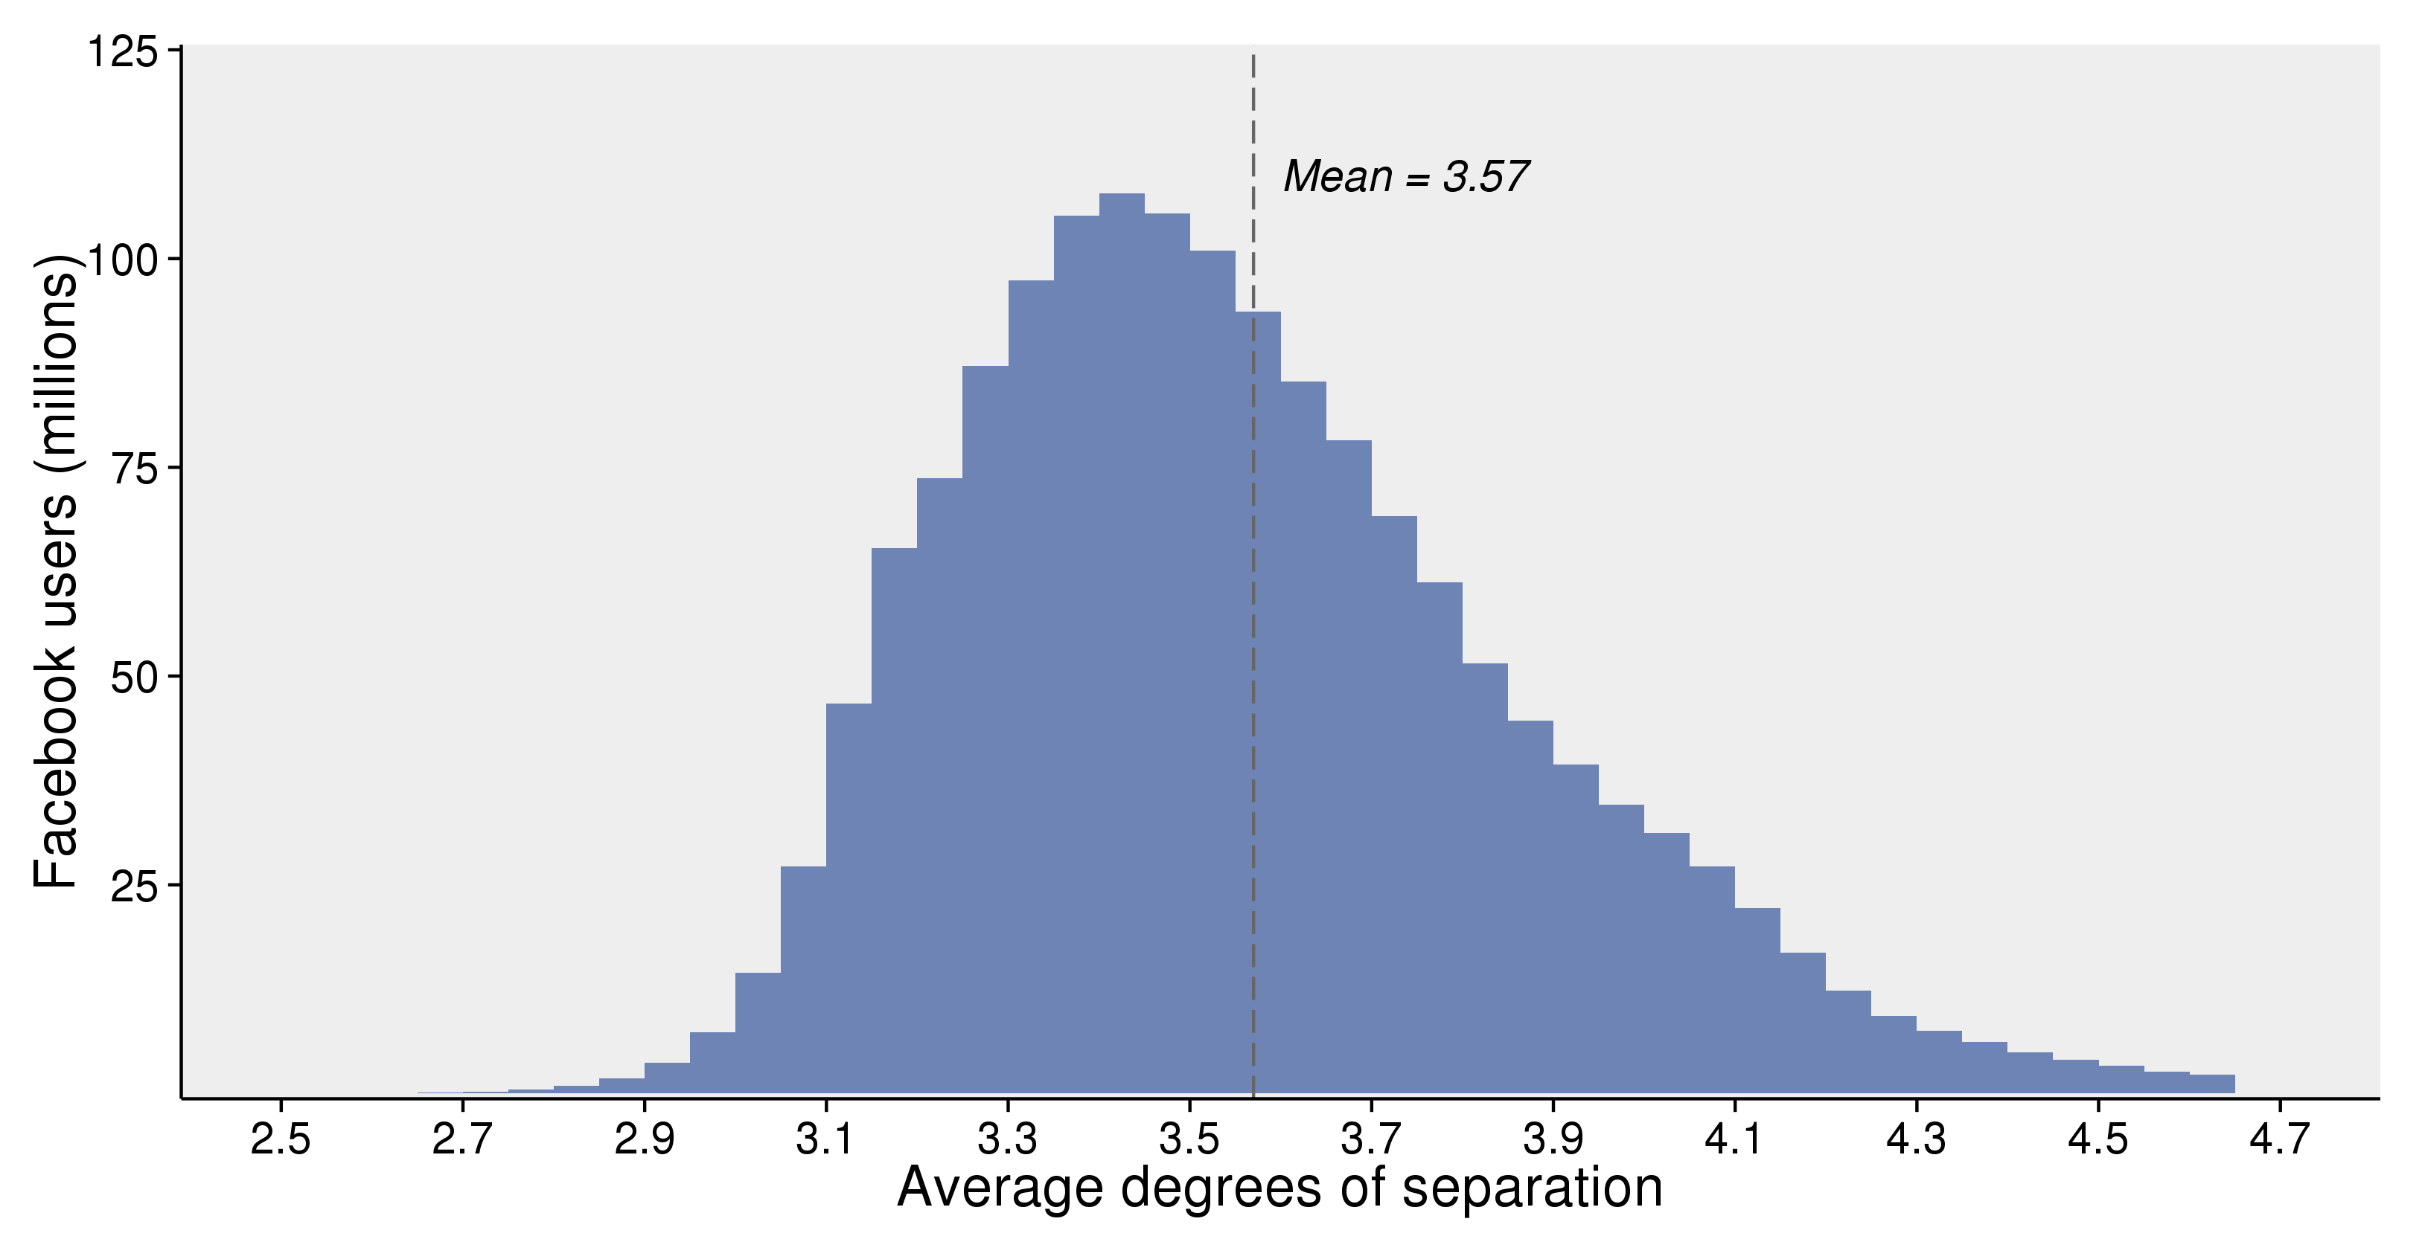
Today we can measure this with 2 billion people
The majority of Facebook users (~2 billion people) have an average between 3 and 4 steps.
Notes:
https://research.fb.com/three-and-a-half-degrees-of-separation/

Slide 32
Why are Chains so Short?
If I count my friends’ friends’ friends…
1
2
2²
+
2^{d}
2^{d+1} - 1
→ diameter = log n
Notes:
The number that typically comes up from the digital world is 4
There is a movie 6 degress of separation. First time in a novel by an Hungarian writer.
First reaction: exponential growth of our network.

Slide 33
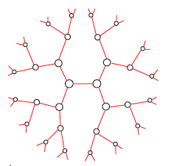
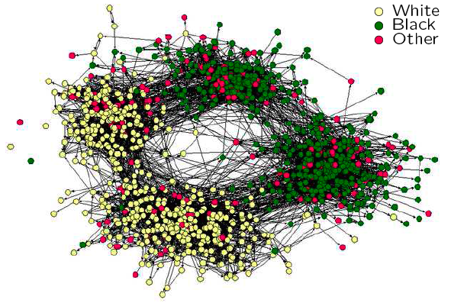
Not so fast…
Your friends mostly know each other…
In high school self-reported friendships, clusters based on race (left-right) and age (top-bottom)
Homophily: Your friends are similar to you!
Pr [two of your friends are friends] is high
Social networks have vertices with high clustering coefficient (how much its neighborhood resembles a clique)
So, exponential growth does not explain it
We want a model with small diameter and large clustering coefficient
Notes:
Not write because this is not how the world looks like.
Here is the friemdships of the same highscool – it is very densed. Also observed that cluster. Interesting role that the red nodes play.
Self-reported high school friendships [Moody 2001]
A racially diverse student body in American high schools may not lead to more friendships between students of different races, according to a new national study.
Results showed teens tend to choose same-race friends, even as the opportunity to choose friends from different races increases.
However, school practices regarding academic tracking, extracurricular activities and student mixing by grade can help promote friendships among students of different races, the research found.
Probability of your friends being friends is based on number of links in your neighborhood over all possible links (the size of your neighborhood - choose - 2
The clustering coefficient of a vertex in a graph quantifies how close the vertex and its neighbors are to being a clique (complete graph).
Why – we still do not know the answers very well. In acquatances the world is not that large. The answer that seems to come close – is that each one of us is a member of different networks (work, school, college, profession),

Slide 35
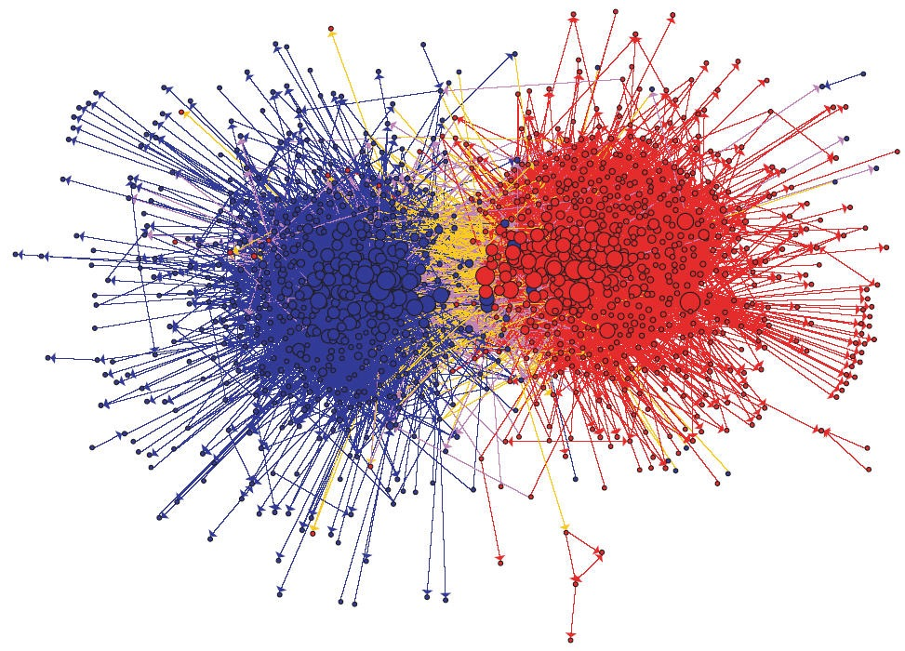
Birds of a feather flock together... Homophily
Adamic, L. A., & Glance, N. (2005, August). The political blogosphere and the 2004 US election: divided they blog. In Proceedings of the 3rd international workshop on Link discovery (pp. 36-43). ACM.
Notes:
Homophily refers to the tendency for people to have (non-negative) ties with people who are similar to themselves in socially significant ways. The term itself (due to Lazarsfeld) specifically refers to an internal preference.

Slide 37
Polarity

Slide 38
Huge Echo Chamber
Notes:
https://www.youtube.com/watch?v=Zk1o2BpC79g

Slide 39
Social Algorithms
Notes:
https://www.youtube.com/watch?time_continue=23&v=5kXYC265yn8

Slide 40
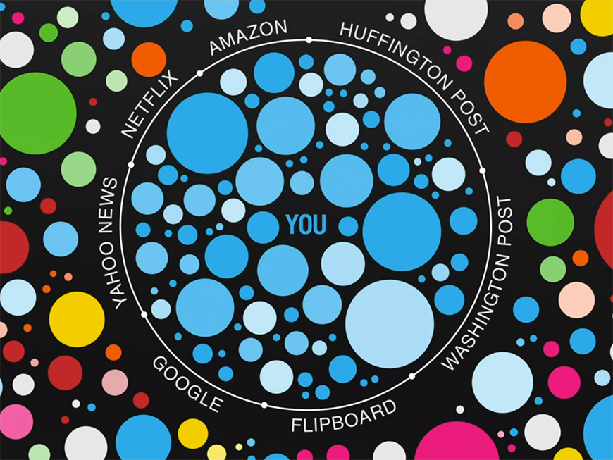
Filter Bubble
Notes:
-the social media platforms are proactively adjusting algorithms and trying to make sure they always deliver users the content that matters most to them. But, clearly, this definition of "what matters most" varies by channel.

