Slide 1

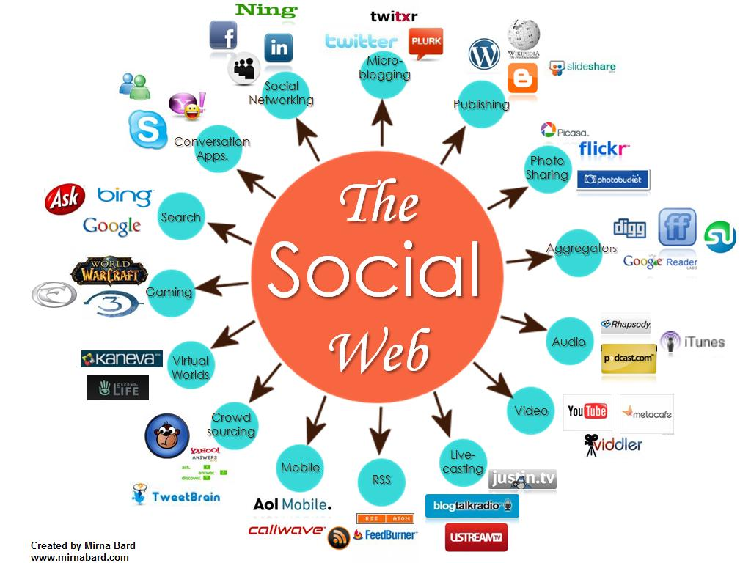
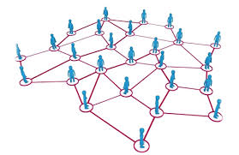


CS 115: COMPUTING FOR The Socio-Techno Web
Search Engines And Ranking Algorithms
Notes:
image source: http://www.igenii.com/blog/Social%20Media/social-media/
twitter.com
http://www.worthofweb.com/blog/case-study-this-revolution-will-be-tweeted/
http://foxwoodonlinemarketing.typepad.com/my-blog/social-media/

Slide 2

“The first-ever World Wide Web site went online in 1991, although this doesn’t seem that long ago, it is hard to imagine the world before Sir Tim Berners-Lee’s invention. In many ways, the colossal impact of the World Wide Web is obvious. Many people, however, may not fully appreciate the underlying technical contributions that make the Web possible. Sir Tim Berners-Lee not only developed the key components, such as URIs and web browsers that allow us to use the Web, but offered a coherent vision of how each of these elements would work together as part of an integrated whole.”
ACM President Vicki L. Hanson

Slide 3
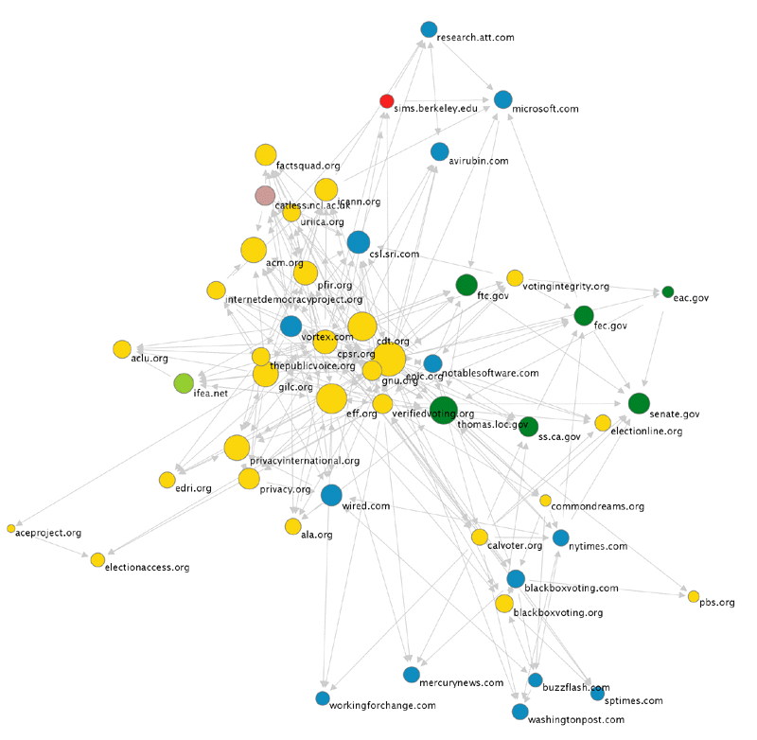
The Web is a Directed Graph
Like a map of a country
with cities and
one-way roads
Directed Graph of
Nodes and
Arcs (one-way connections)
  Nodes = web pages
  Arcs = hyperlinks from a page to another
Why is this cool?
Because…
  it can be explored
  it can be indexed

Slide 4
Questions about the Web
How big is the Web?
How many people use search engines?
How do search engines work?
What is the shape of the Web?
What is an algorithm?
Notes:
http://www.internetlivestats.com/total-number-of-websites/
http://www.internetlivestats.com/

Slide 5
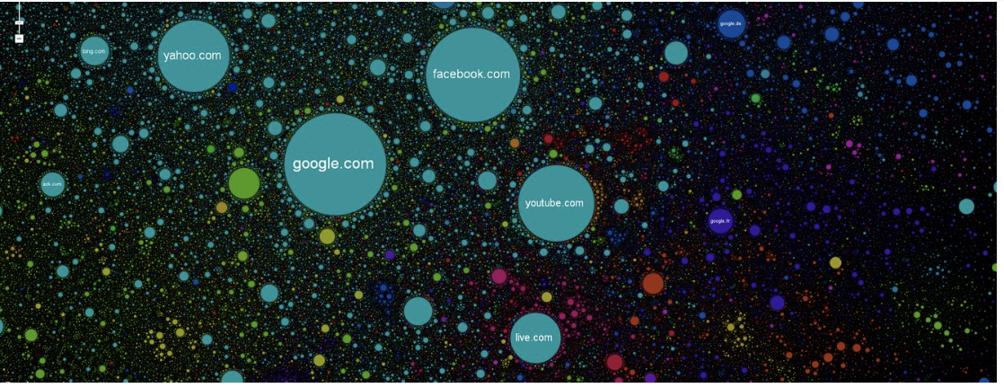
What is the shape of the web?

Slide 6
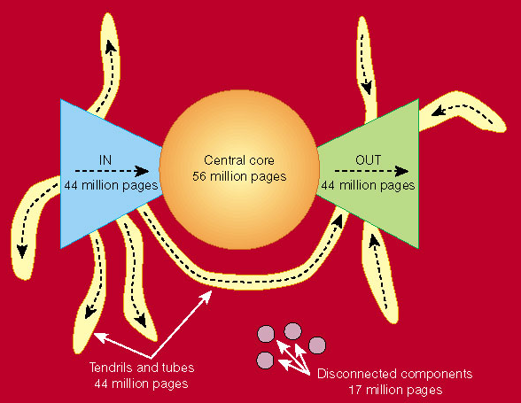
What is the shape of the web?
Bow-tie shape of the web
Notes:
There is a rational explanation on how the bow-tie appears!
In 1999, after the Web had been growing for the better part of a decade, Andrei Broder and his colleagues set out to build a global map of the Web, using strongly connected components
A Giant Strongly Connected Component. A “map” of the Web clearly can’t resemble a map of the physical world in any serious sense, given the scale and complexity of the network being analyzed. Rather, what Broder et al. [80] wanted was something more conceptual — an abstract map dividing the Web into a few large pieces, and showing in a stylized way how these pieces fit together.
Their first finding was that the Web contains a giant strongly connected component. Recall from our discussions in Chapter 2 that many naturally occuring undirected graphs have a giant connected component — a single component containing a significant fraction of all the nodes.
Given that this SCC contains (at least) the home pages of many of the major commercial, governmental, and non-profit organizations in the world, it is easy to believe that it is a giant SCC.
From here, we can invoke an argument — familiar from the undirected case as well — that there is almost surely at most one giant SCC. For if there were two giant SCCs — call themX andY —allitwouldtakeisasinglelinkfromanynodeinX toanynodeY,and another link from any node in Y to any node in X, and X and Y would merge to become part of a single SCC.
(1) IN: nodes that can reach the giant SCC but cannot be reached from it — i.e., nodes that are “upstream” of it.
(2) OUT: nodes that can be reached from the giant SCC but cannot reach it — i.e., nodes are “downstream” of it.
Tendrils: The “tendrils” of the bow-tie consist of (a) the nodes reachable from IN that cannot reach the giant SCC, and (b) the nodes that can reach OUT but cannot be reached from the giant SCC.

Slide 7
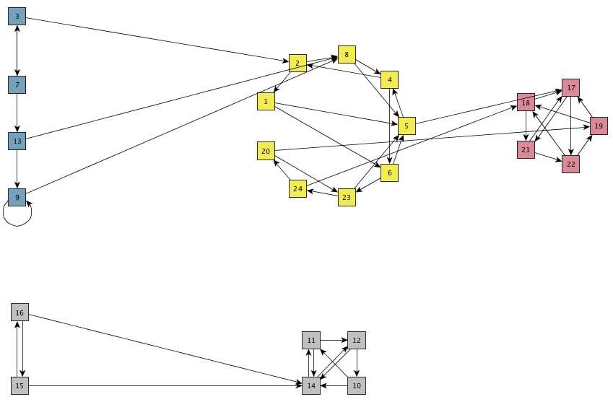
Strongly Connected Component
strongly connected component (SCC) in a directed graph is a subset of the nodes such that:
(i) every node in the subset has a path to every other; and
(ii) the subset is not part of some larger set with the property that every node can reach every other.
Notes:
The connectivity of undirected graphs was defined in terms of paths: two nodes are linked by a path if we can follow a sequence of edges from one to the other; a graph is connected if every pair of nodes is linked by a path; and we can break up a disconnected graph into its connected components. Now that we’re dealing with a directed graph, we’re going to try following the same general strategy for talking about connectivity;
First, a path from a node A to a node B in a directed graph is a sequence of nodes, beginning with A and ending with B, with the property that each consecutive pair of nodes in the sequence is connected by an edge pointing in the forward direction. This “pointing in the forward direction” condition makes the definition of a path in a directed graph different from the corresponding definition for undirected graphs, where edges have no direction.
We say that a directed graph is strongly connected if there is a path from every node to every other node. So for example, the directed graph of Web pages in Figure 13.5 is not strongly connected, since as we’ve just observed, there are certain pairs of nodes for which there’s no path from the first to the second.

Slide 8
Bowtie terminology: Largest SCC,
Core, In, Out, Islands, tendrils

Slide 9

How Search Engines Work
A
User
B
Web spider
E
C
Search
Indexer
D
The Web
Indexes
Ad indexes

Slide 10
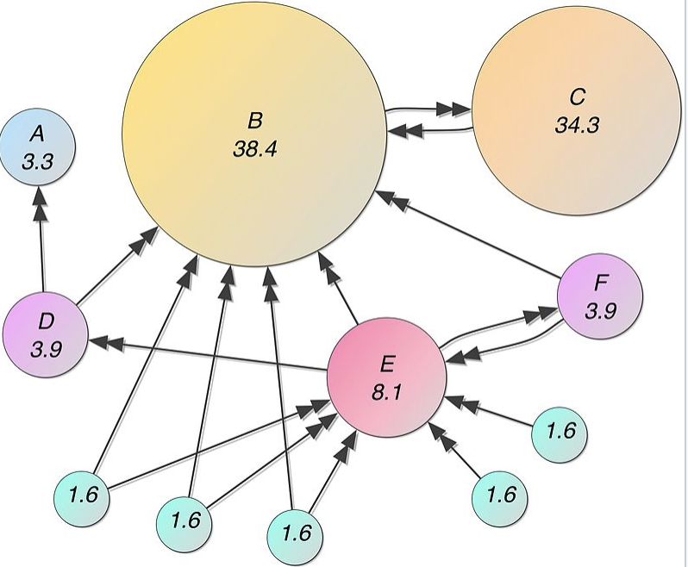
Page Rank
“PageRank works by counting the number and quality of links to a page to determine a rough estimate of how important the website is. The underlying assumption is that more important websites are likely to receive more links from other websites.”

Slide 11
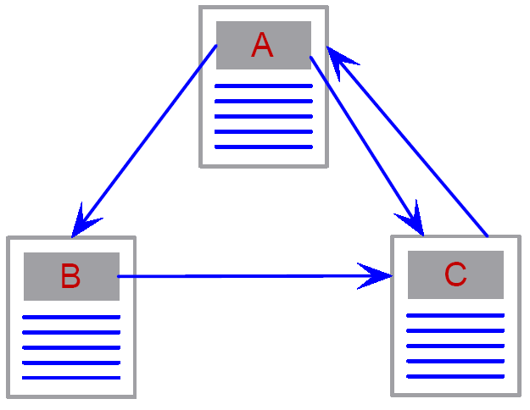
PageRank: Google’s pride
The reputation “PageRank” PR(W) of a page W =
the sum
of a fair fraction of the reputations PR(W_{j})
of all pages W_{j} that point to W
Beautiful Math behind it
  PR equivalent to the chance
  of randomly surfing to the page
PR idea similar to academic co-citations
How to compute PR:
Each page starts with some basic “reputation” (e.g., = 1)
and repeatedly distributes
fair (equal) fractions of “reputation” to its linked pages
(while receiving fair fractions from others)
until “equilibrium”(no further changes occur)
W1
W2
W .
W3

Slide 12
PageRank: Iterative Computation
Set initial PR values to 1
Solve the following equations iteratively:
Notes:
Each repetition of the process is a single iteration
the outcome of each iteration is then the starting point of the next iteration

Slide 13
It is Slightly more complicated
The reputation “PageRank” PR(W) of a page W =
t/N + (1-t) * the sum
of a fair fraction of the reputations PR(W_{j})
of all pages W_{j} that point to W
W1
W is a web page
Wi are the web pages that have a link to W
O(Wi) is the number of out-links from Wi
t is the teleportation probability (the chance that we may visit a page randomly)
N is the size of the Web (that we have seen)
W .
W2
W3
Notes:
The truth is that PR is slightly more complicated…
If web surfers who start on a random page have an 85% likelihood of choosing a random link from the page they are currently visiting, and a 15% likelihood of jumping to a page chosen at random from the entire web, they will reach Page E 8.1% of the time. (The 15% likelihood of jumping to an arbitrary page corresponds to a damping factor of 85%.) Without damping, all web surfers would eventually end up on Pages A, B, or C, and all other pages would have PageRank zero.

Slide 14
PageRank: Iterative Computation
t is normally set to 0.15,
but for this example, for simplicity let’s set it to 0.5
Set initial PR values to 1
Solve the following equations iteratively:

Slide 15
What are you trying to find?
Types of queries:
  Informational – want to learn about something
  Navigational – want to go to that page
  Transactional – want to do something (web-mediated)
    Access a service
    Downloads
    Shop
  Gray areas
    Find a good hub (resource collection)
    Exploratory search “see what’s there”
Peripheral neuropathy
Wellesley College
Wellesley weather
Mars surface images
Nikon SLR camera
car rental Boston
morality of abortion

Slide 16
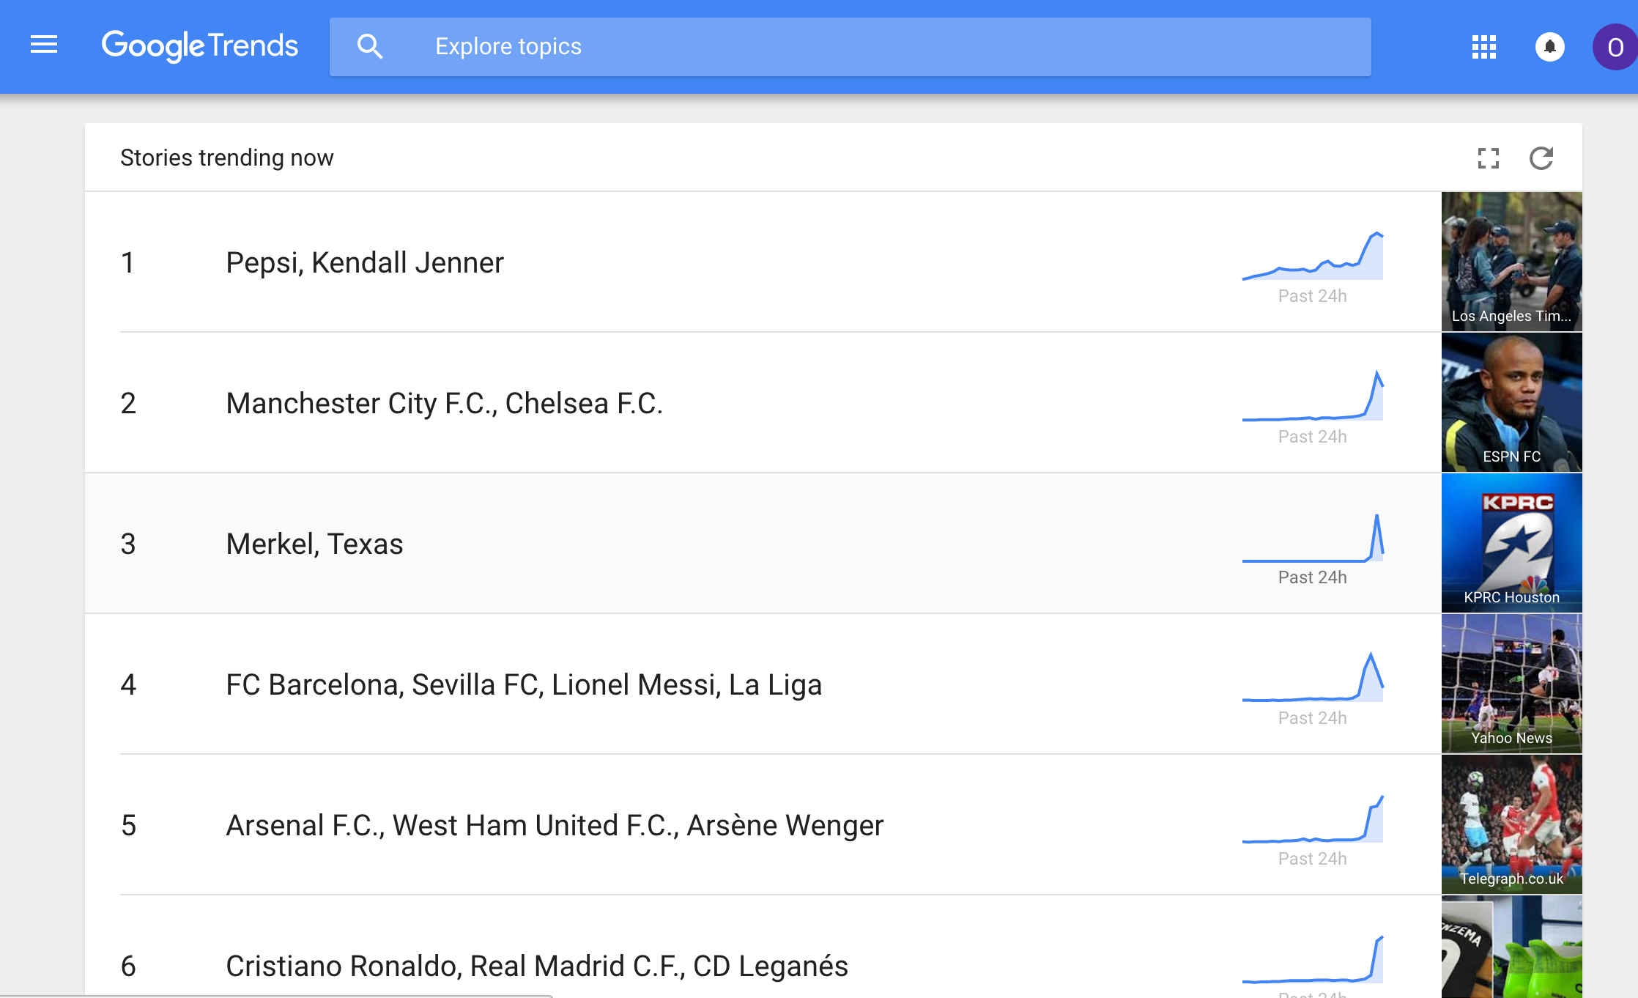
Trending Topics
Notes:
https://duckduckgo.com/?q=google+trends&atb=v57-7aa&ia=web

Slide 17
What is an Algorithm?
A set of instructions
A list of rules
A recipe
Uses calculations, relational operators !, &&, || and loops
What are some examples of algorithms that you interact with in your day to day?

Slide 18
Resume Filtering algorithm
Imagine you are hired for Moople, a well-known tech company that receives thousands of job applications from students every year.
You are asked to create an algorithm that selects the applications that are worth a second look.
Moople claims that algorithms will reduce costs and help negate the biases that result from tired application readers (will it?).
Notes:
Based on https://medium.com/bucknell-hci/ethical-design-in-cs-1-building-hiring-algorithms-in-1-hour-41d8c913859f

Slide 19
Discussion
What criteria did you select? Why?
What kind of applicants were you trying to make sure got through?
Who did you miss?
What if someone misinterprets the instructions?
[4, 3.9, 4, 4, 3.95, 4, 3.9]
[‘A’, ‘A’, ‘A’, ‘A’, ‘A’, ‘A’, ‘A’]
What if someone skipped CS 1 and thought that putting a -1 would make that obvious?
[-1, 95, 99, 94, 96, 98, 95]
What if someone makes an error in their entry?
[100, 100, 100, 100, 100, 100, 10]
[681, 68, 73, 70, 81, 91, 59]
How should we compare two students with different trajectories?
[65, 75, 85, 95, 100, 100, 80]
[100, 100, 95, 85, 75, 65, 80]
What about a student who dealt with a personal trauma one semester?
[95, 93, 50, 91, 98, 90, 90]
Notes:
https://hbr.org/2016/12/hiring-algorithms-are-not-neutral
Algorithms deployed on the front line of HR decision making may cut costs and streamline vetting in busy departments or companies with large hiring needs, but the risk is that they end up excluding applicants based on gender, race, age, disability, or military service — all protected classes under employment law.
In other words, algorithms are not neutral. When humans build algorithmic screening software, they may unintentionally determine which applicants will be selected or rejected based on outdated information — going back to a time when there were fewer women in the workforce, for example — leading to a legally and morally unacceptable result.

