Slide 1
CAPTCHA,
THE ESP GAME, AND OTHER STUFF
LUIS VON AHN
CARNEGIE MELLON UNIVERSITY

Slide 3
CAPTCHA
A PROGRAM THAT CAN TELL WHETHER ITS USER IS A HUMAN OR A COMPUTER

Slide 4
CAPTCHA
A PROGRAM THAT CAN GENERATE AND GRADE TESTS THAT:
A. MOST HUMANS CAN PASS
B. CURRENT COMPUTER PROGRAMS CANNOT PASS

Slide 5
EXAMPLE
PICKS RANDOM STRING OF LETTERS
RENDERS IT INTO A DISTORTED IMAGE
oamg

Slide 6
…AND GENERATES A TEST:
TYPE THE CHARACTERS THAT APPEAR IN THE IMAGE

Slide 7
COMPLETELY AUTOMATED PUBLIC TURING TEST TO TELL COMPUTERS AND HUMANS APART

Slide 8
EXAMPLES OF CAPTCHAS

Slide 9
PIX
WHAT ARE THESE PICTURES OF?
THE IMAGES NEED TO BE RANDOMLY DISTORTED

Slide 10
The ESP GAME

Slide 11
LABELING IMAGES WITH WORDS
MARTHA STEWART
FLOWERS
SUPER EVIL

Slide 12
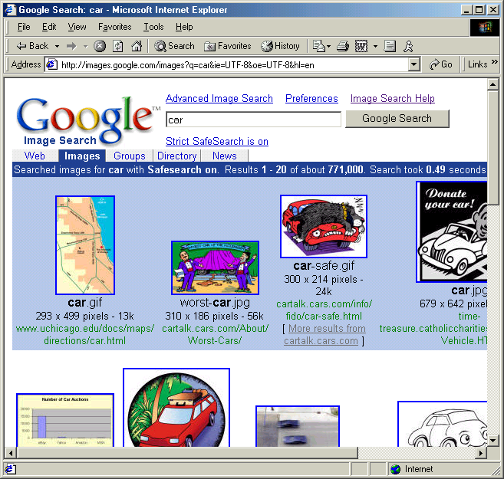
IMAGE SEARCH ON THE WEB
USES FILENAMES AND HTML TEXT

Slide 13
ACCESSIBILITY
LESS THAN 10% OF THE WEB IS ACCESSIBLE TO THE VISUALLY IMPAIRED
REASON:
MOST IMAGES DON’T HAVE PROPER CAPTIONS

Slide 14
THE ESP GAME
TWO-PLAYER ONLINE GAME
PARTNERS DON’T KNOW EACH OTHER AND CAN’T COMMUNICATE
OBJECT OF THE GAME:
TYPE THE SAME WORD
THE ONLY THING IN COMMON IS AN IMAGE

Slide 15
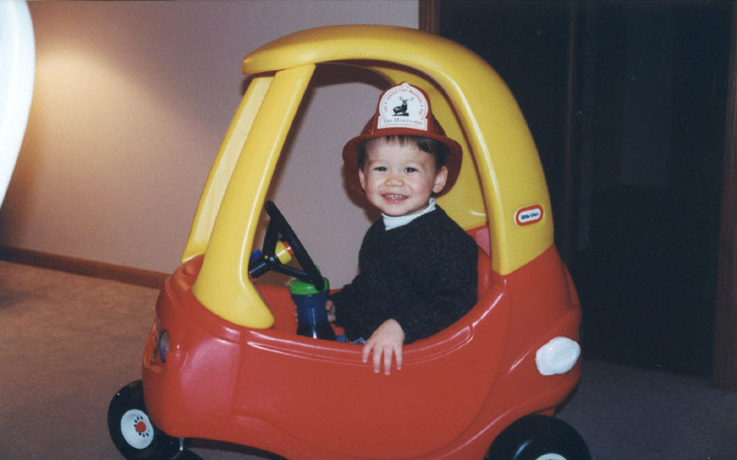
THE ESP GAME
PLAYER 1
PLAYER 2
GUESSING: CAR
GUESSING: BOY
GUESSING: HAT
GUESSING: CAR
GUESSING: KID
SUCCESS!
YOU AGREE ON CAR
SUCCESS!
YOU AGREE ON CAR

Slide 16
© 2004 Carnegie Mellon University, all rights reserved. Patent Pending.

Slide 17
THE ESP GAME IS FUN
4.1 MILLION LABELS WITH 23,000 PLAYERS
THERE ARE MANY PEOPLE THAT PLAY OVER 20 HOURS A WEEK

Slide 18
LABELING THE ENTIRE WEB
5000 PEOPLE PLAYING SIMULTANEOUSLY CAN LABEL ALL IMAGES ON GOOGLE IN 30 DAYS!
INDIVIDUAL GAMES IN YAHOO! AND MSN AVERAGE OVER 5,000 PLAYERS AT A TIME

Slide 19
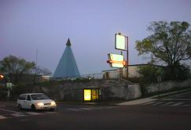
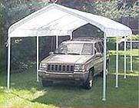
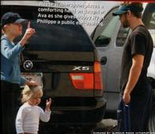
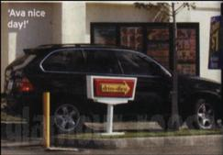
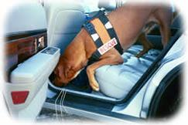
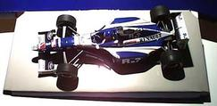
SEARCH RESULTS

Slide 20
SAMPLE LABELS
BEACH CHAIRS SEA PEOPLE MAN
WOMAN PLANT OCEAN
TALKING WATER PORCH

Slide 21
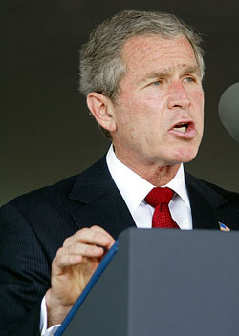
SAMPLE LABELS
SADDAM
MR. WILSON
MAN
FACE
MOUSTACHE
COMING SOON:
MEET YOUR SOUL MATE THROUGH THE GAME!
BUSH
PRESIDENT
DUMB
YUCK
YUCK

Slide 22
OTHER GAMES

Slide 23
LOCATING OBJECTS IN IMAGES
THE ESP GAME TELLS US IF AN IMAGE CONTAINS A SPECIFIC OBJECT, BUT DOESN’T SAY WHERE IN THE IMAGE THE OBJECT IS
SUCH INFORMATION WOULD BE EXTREMELY USEFUL FOR COMPUTER VISION RESEARCH

Slide 24
PAINTBALL GAME
PLAYERS SHOOT AT OBJECTS ON THE IMAGE
SHOOT THE:
CAR
WE GIVE POINTS AND CHECK ACCURACY BY GIVING PLAYERS IMAGES FOR WHICH WE ALREADY KNOW WHERE THE OBJECT IS

Slide 25
PAINTBALL GAME
X% OF IMAGES
(100-X)% OF IMAGES
DON’T
KNOW

Slide 26
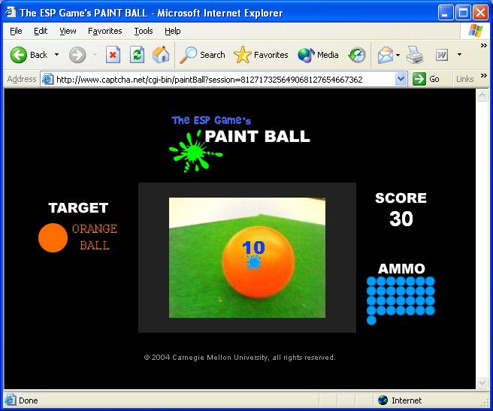
BALL

Slide 27
REVEALING IMAGES
GUESSER
REVEALER
CAR
BRUSH
BRUSH
CAR
CAR
GUESS
PARTNER’S
GUESS

Slide 28
