Slide 1
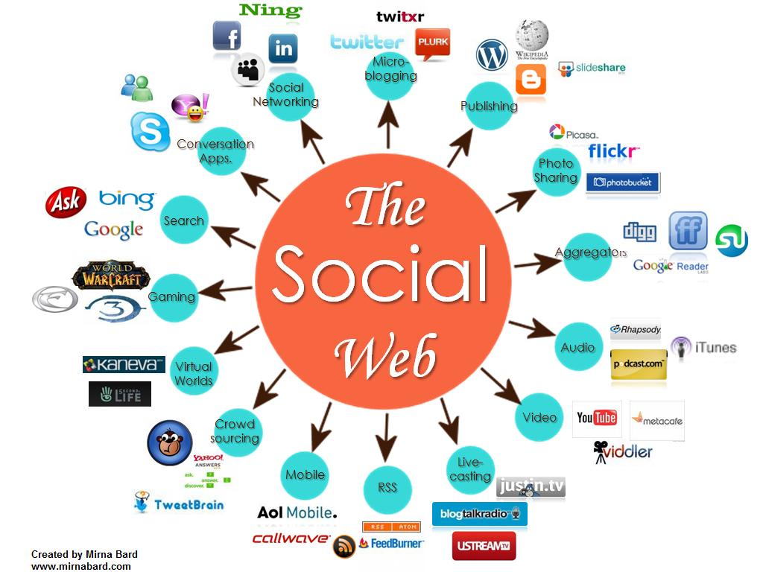
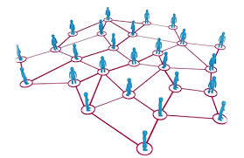
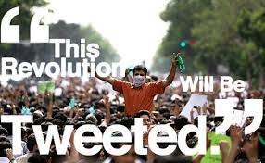
CS 115: COMPUTING FOR THE SOCIO-TECHNO WEB
TwitterTrails
Notes:
image source: http://www.igenii.com/blog/Social%20Media/social-media/
twitter.com
http://www.worthofweb.com/blog/case-study-this-revolution-will-be-tweeted/
http://foxwoodonlinemarketing.typepad.com/my-blog/social-media/

Slide 2
Please complete
bit.ly/115S2018PRE

Slide 3
Twitter Primer
Twitter is a short message service
It allows you to:
Tweet =
send a message to those who follow what you say
Re-tweet =
send to your followers something you received
Reply =
send a specific user a message, also seen by your followers (@user)
Direct-message =
send a specific user a message, no one else sees it

Slide 4
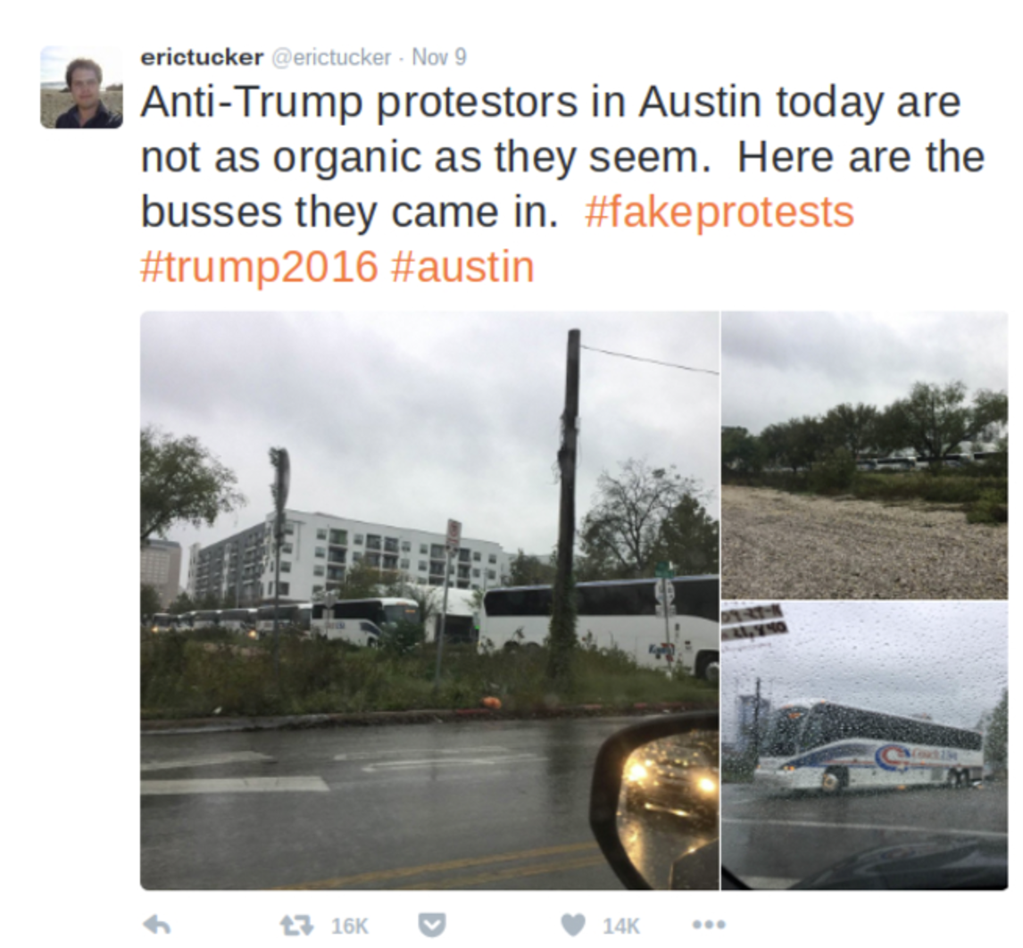
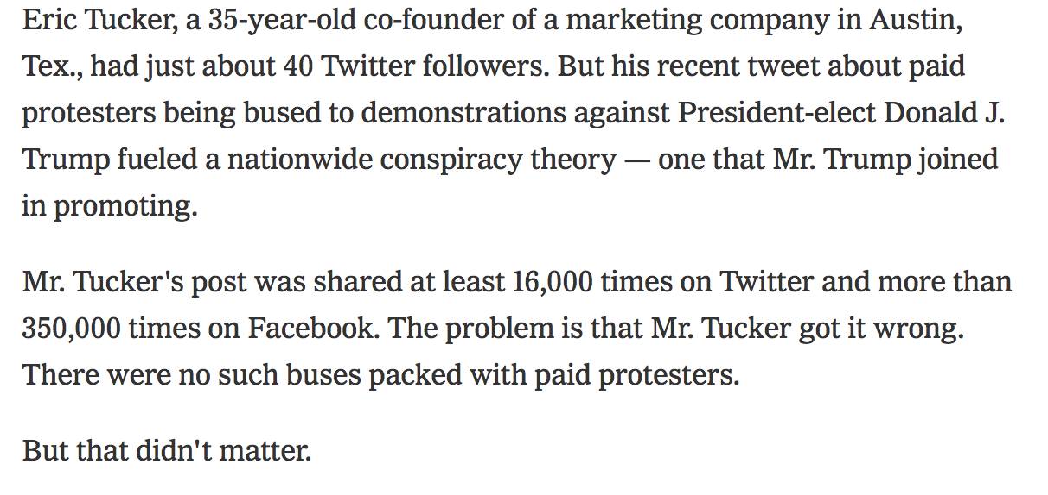
(Mis) Information in Social Media
Notes:
Look at the number of retweets and likes!

Slide 5
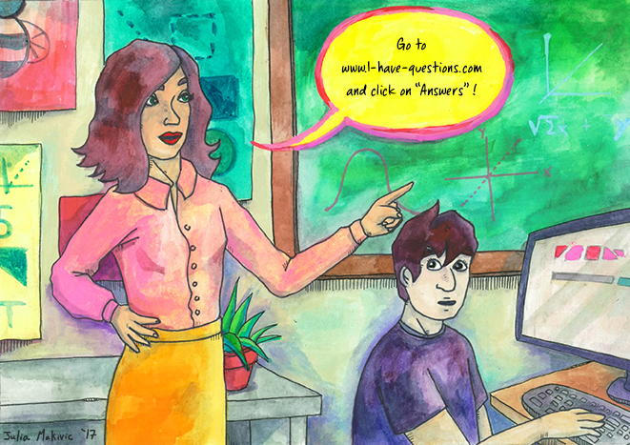
Can we solve the problem through technology?
Go to IS_IT_TRUE.com
and click on ANSWERS
Notes:
You have asked Computer Scientists to discuss the topic, I think that’s what you hope we would tell you.
It’s more tricky than that.
It’s not a matter of AI.
Facebook fired editors and replaced them with AI, and humans ridiculed AI within 2 days!

Slide 6
Can Technology help in solving the problem ?
Go to TWITTERTRAILS.com
and run an investigation
Notes:
You have asked Computer Scientists to discuss the topic, I think that’s what you hope we would tell you.
It’s more tricky than that.
It’s not a matter of AI.
Facebook fired editors and replaced them with AI, and humans ridiculed AI within 2 days!

Slide 7
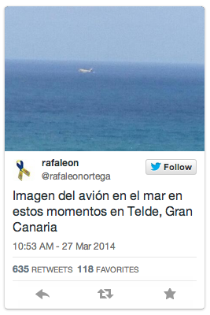
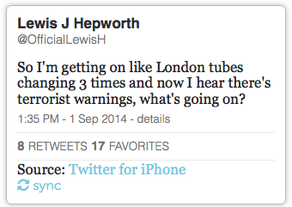
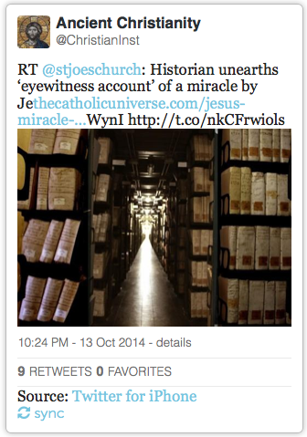
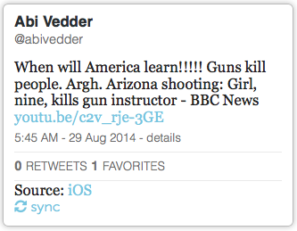
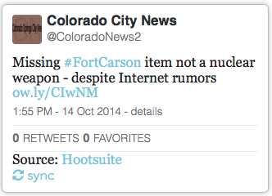
Technology can help investigate stories
Story = Tweets in last 10 days collected through keywords. Could be related to a rumor, some event, or a meme

Slide 8
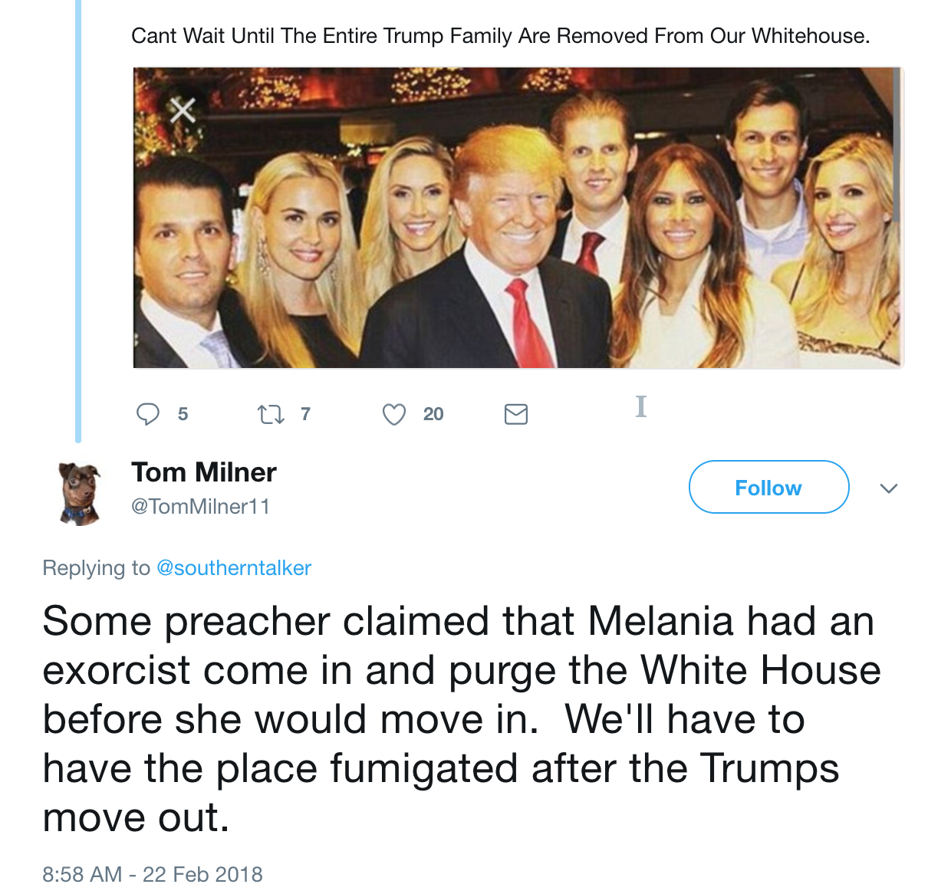
Claim: Melania Trump had an exorcist in the White House

Slide 9
Check the TwitterTrails Story
bit.ly/115S2018TT

