Slide 1
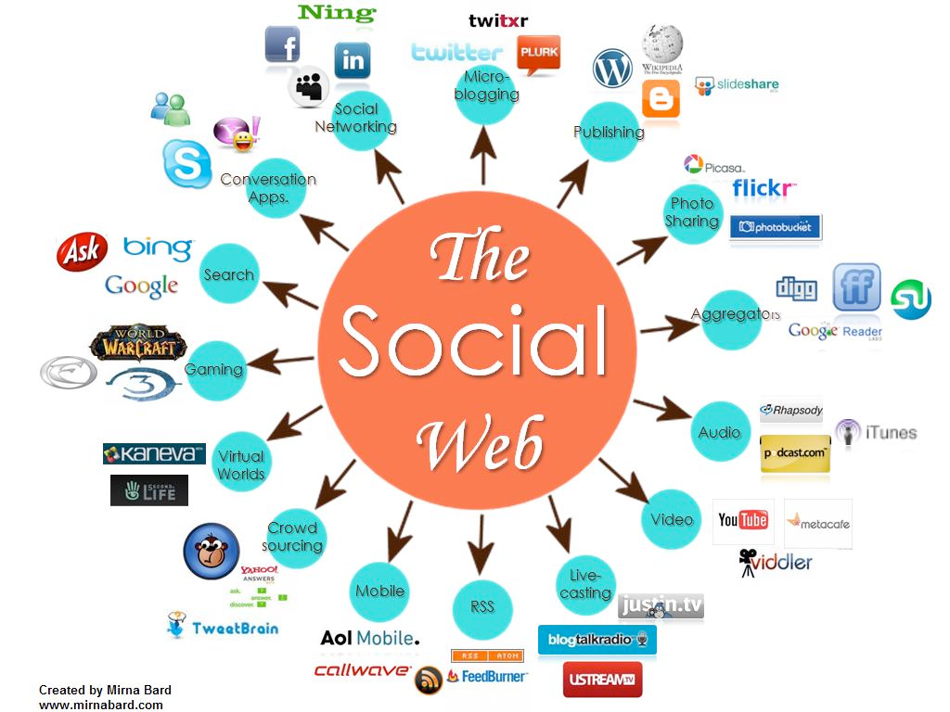
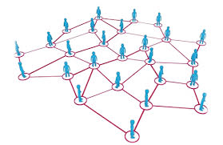
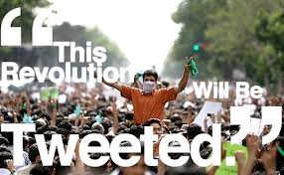
CS 115: COMPUTING FOR The Socio-Techno Web
Cryptography and Cryptanalysis
Notes:
image source: http://www.igenii.com/blog/Social%20Media/social-media/
twitter.com
http://www.worthofweb.com/blog/case-study-this-revolution-will-be-tweeted/
http://foxwoodonlinemarketing.typepad.com/my-blog/social-media/

Slide 2
Why do you need Cryptography?
https://mail.google.com/

Slide 3
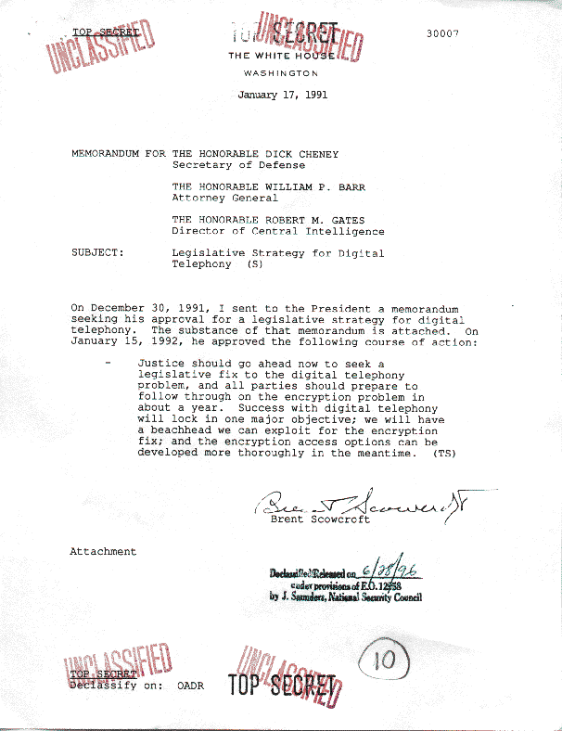
Cryptography is essential for National Security
Notes:
NSA is the largest employer of Mathematicians

Slide 4
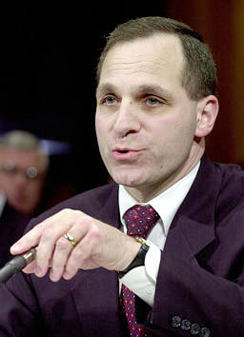
Unless the issue of encryption is resolved soon, criminal conversations over the telephone … will become indecipherable by law enforcement. This, as much as any issue, jeopardizes the public safety and national security of this country.
Louis Freeh,
FBI Director
March 30, 1995

Slide 5
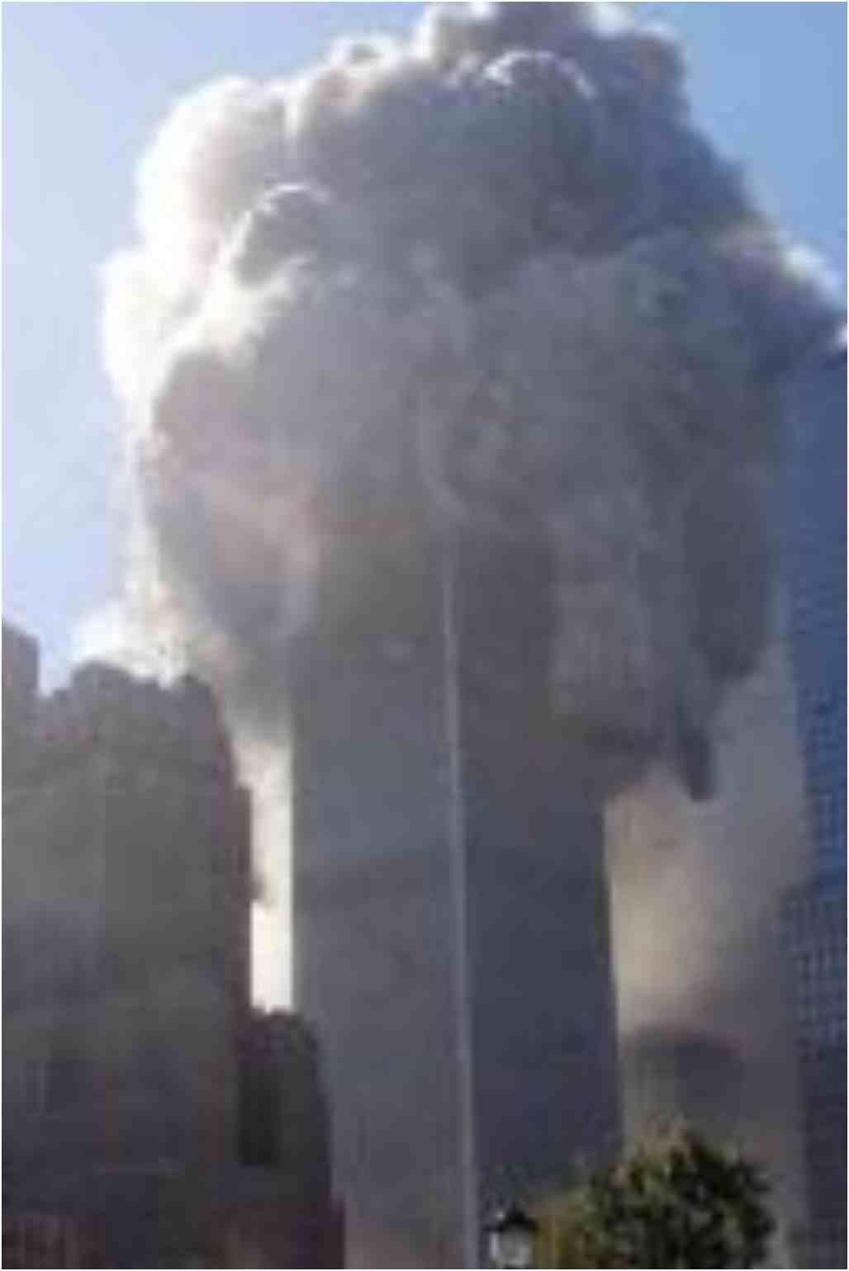
The Stakes Rise After 9/11
Sept. 13, 2001: Sen. Judd Gregg (NH) calls for encryption regulations, saying encryption makers should be required to include decryption methods for government agents.
US market force would be used to constrain foreign makers of encryption products
Selling encryption software to foreigners should be considered treason!
Notes:
FBI’s most serious problem was “the encryption capability of the people who have an intention to hurt America.” “It used to be,” the senator went on, “that we had the capability to break most codes because of our sophistication.” No more. “The technology has outstripped the code breakers,” he warned.

Slide 6
A month later…
October 24, 2001: USA PATRIOT Act passes
Vastly enhanced authorization for government surveillance in the interest of national security
What does it say about encryption?
Why did US Congress drop its efforts to control encryption, barely a month after the attack on the US?
Notes:
E-commerce had taken over the discussion

Slide 7
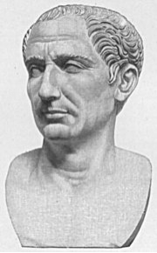
(WKH IXQ DQG WKH IHDU RI…) FUBSWRJUDSKB LQ WKH VRFLDO ZHE HUD
“If Caesar had anything confidential to say, he wrote it in cipher, that is, by so changing the order of the letters of the alphabet, that not a word could be made out. If anyone wishes to decipher these, and get at their meaning, he must substitute the fourth letter of the alphabet, namely D, for A, and so with the others.”
Notes:
Note that WKH appears 3 times, (THE)

Slide 8
Caesar cipher
Replace each letter by the letter that comes some fixed distance before or after it in the alphabet.
A | B | C | D | E | F | G | H | I | J | K | L | M | N | O | P | Q | R | S | T | U | V | W | X | Y | Z
D | E | F | G | H | I | J | K | L | M | N | O | P | Q | R | S | T | U | V | W | X | Y | Z | A | B | C
Shift = 3
GALLIA EST OMNIS DIVISA IN PARTES TRES
JDOOLD HVW RPQLV GLYLVD LQ SDUWHV WUHV
Notes:
With Shift = -1, IBM -> HAL
Caesar’s narrative on the Gallic wars, “All of Gaul is divided into three parts”

Slide 9
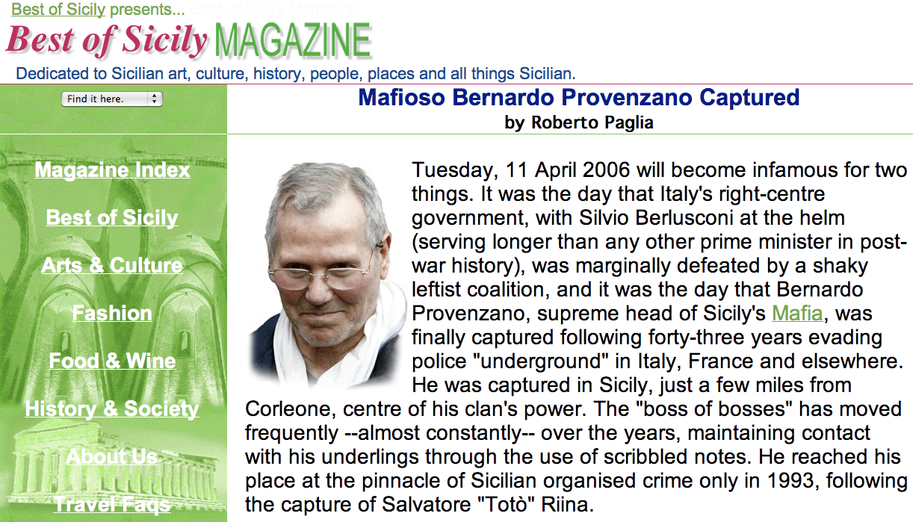
Still in use fairly recently…
Il capo di capi was using Caesar’s cipher to encrypt everything, even his laundry list.
Notes:
“The so-called Binnu code assigns a number in order to each letter in the Italian alphabet and adds three to that number in the ciphertext so that "A" is 4, "B" is 5 and so on.” -- The Register
Il capo di capi was using Caesar’s cipher to encrypt everything, even his laundry list.

Slide 10
Can you do better than Caesar?
Substitute letters using scrambled mapping
Example of “substitution ciphers”
A | B | C | D | E | F | G | H | I | J | K | L | M | N | O | P | Q | R | S | T | U | V | W | X | Y | Z
L | S | K | P | C | T | O | A | I | W | E | J | V | B | R | M | Z | D | Y | N | Q | X | H | U | G | F
Arbitrary mapping
TOUGH TO READ
NRQOA NR DCLP

Slide 11
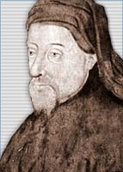
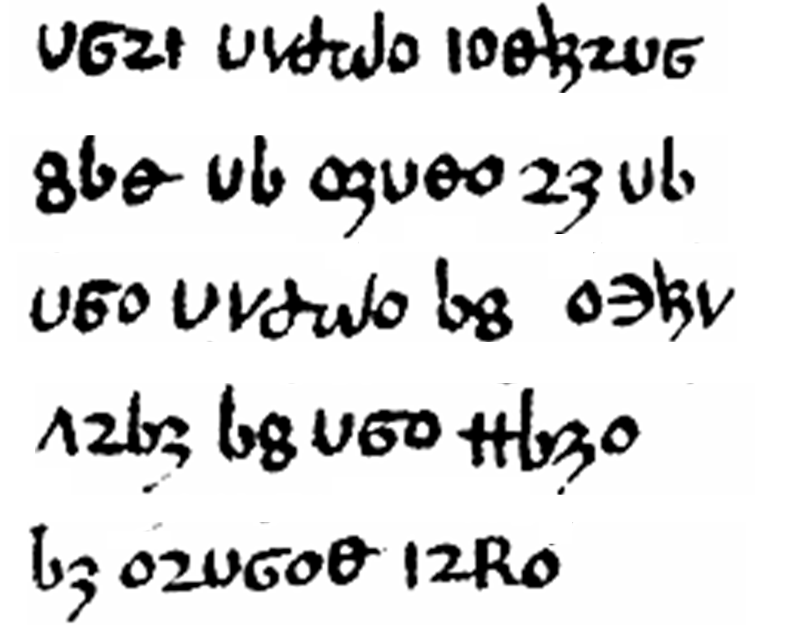
Geoffrey Chaucer, Treatise on the Astrolabe, 1391
Notes:
In about 1392, an English author—once thought to be the great English poet Geoffrey Chaucer, although that is now disputed—wrote a manual for use of an astronomical instrument. Parts of this manual, which was entitled The Equatorie of the Planetis, were written in a substitution cipher

Slide 12
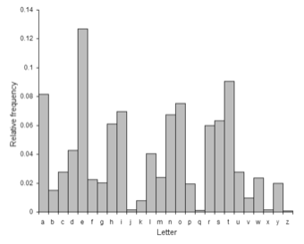
Letter Frequencies can break substitution ciphers
E
T
Source: Wikipedia
Notes:
Most common letters: E, T

Slide 13
Geoffrey Chaucer, Treatise on the Astrolabe, 1391
Notes:
Put up frequency table

Slide 14
Geoffrey Chaucer, Treatise on the Astrolabe, 1391
Notes:
12 o’s

Slide 15
e
e
e
e
e
e
e
e
e
e
e
e
Geoffrey Chaucer, Treatise on the Astrolabe, 1391
Notes:
And 10 v’s

Slide 16
t
t
e
e
t
t
e
t
e
t
t
e
t
e
e
t
e
e
e
t
e
e
Geoffrey Chaucer, Treatise on the Astrolabe, 1391
Notes:
Pattern: V6o = t_e appears twice => 6=h, THE

Slide 17
t
h
t
e
e
t
h
t
e
t
e
t
t
h
e
t
e
e
t
h
e
e
e
t
h
e
e
Geoffrey Chaucer, Treatise on the Astrolabe, 1391
Notes:
Ub = t_ appears twice => b=o, TO

Slide 18
t
h
t
e
e
t
h
o
t
o
e
t
e
t
o
t
h
e
t
e
o
e
o
o
t
h
e
o
e
o
e
t
h
e
e
Geoffrey Chaucer, Treatise on the Astrolabe, 1391

Slide 19
t
h
i
s
t
e
s
e
i
t
h
o
t
o
e
t
e
i
t
o
t
h
e
t
e
o
e
i
o
o
t
h
e
o
e
o
e
i
t
h
e
s
i
e
Geoffrey Chaucer, Treatise on the Astrolabe, 1391

Slide 20
t
h
i
s
t
e
s
e
r
i
t
h
o
r
t
o
e
t
r
e
i
t
o
t
h
e
t
e
o
e
i
o
o
t
h
e
o
e
o
e
i
t
h
e
r
s
i
e
Geoffrey Chaucer, Treatise on the Astrolabe, 1391

Slide 21
t
h
i
s
t
a
b
l
e
s
e
r
v
i
t
h
f
o
r
t
o
e
n
t
r
e
i
n
t
o
t
h
e
t
a
b
l
e
o
f
e
q
u
a
c
i
o
n
o
f
t
h
e
m
o
n
e
o
n
e
i
t
h
e
r
s
i
d
e
Geoffrey Chaucer, Treatise on the Astrolabe, 1391

Slide 22
Review: Substitution ciphers
Replace each character of the message by another character
Terminology
Plaintext: Original message
Ciphertext: Encrypted result
Substitution ciphers easily cracked by frequency analysis

Slide 23
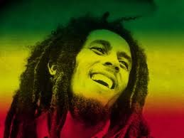
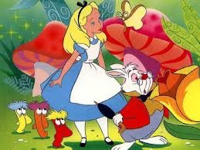
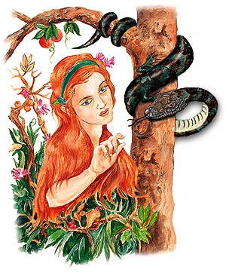
Introducing…
Private Message
Bob
Alice
Eavesdropping
Eve

Slide 24
Private key
shhhh… the key is xcgcvdvhjve
Got it! I’ll protect this with my life
Alice and Bob “meet” somewhere

Slide 25
The Solution…
Retreat at dawn
Retreat at dawn
Encryption
Decryption
Scrambled Message
Bob
Alice
Eavesdropping
Eve

Slide 26
We’ll look at a few private key encryptions….
Caesar, Substitution cryptosystems.
Problems?
Notes:
They need to meet
It can be broken by frequency analysis

Slide 27
Private key
shhhh… the key is xcgcvdvhjve
Got it! I’ll protect this with my life
Alice and Bob “meet” somewhere

Slide 28
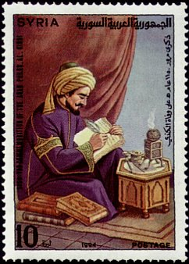
Substitution cipher cracked in 850
Frequency analysis has been known since the 9th century.
Al Kindi’s Manuscript on Deciphering Cryptographic Messages
Yaqub Ibn Ishaq al-Kindi (801-873) from Baghdad
Notes:
This idea was first described by the Arabic philosopher and mathematician Al-Kindi, who lived in Baghdad in the ninth century.

Slide 29
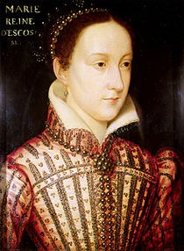
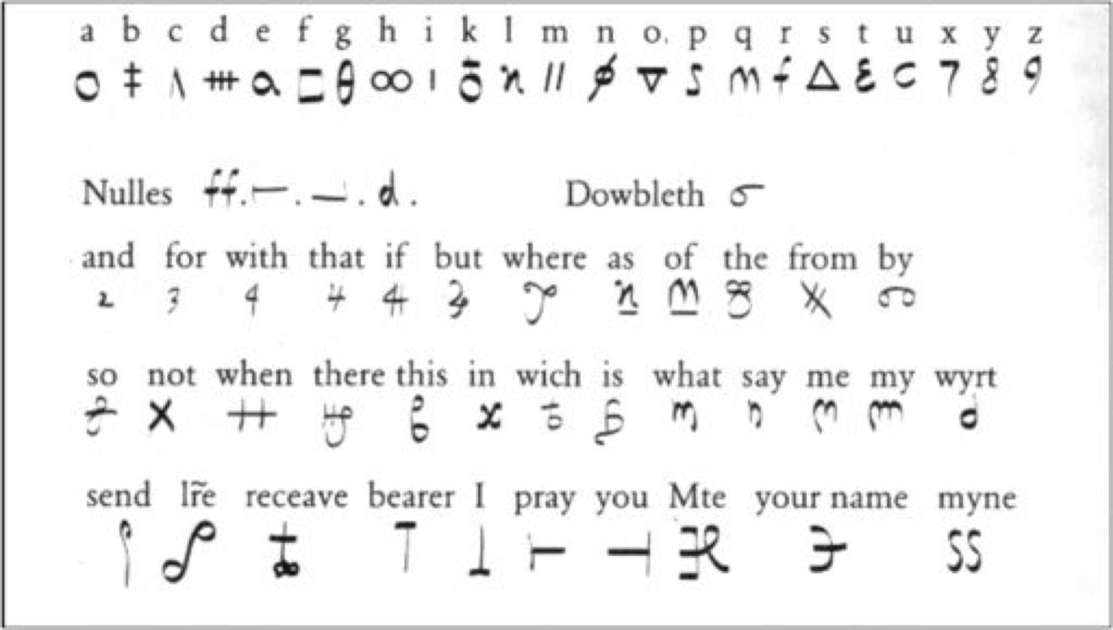
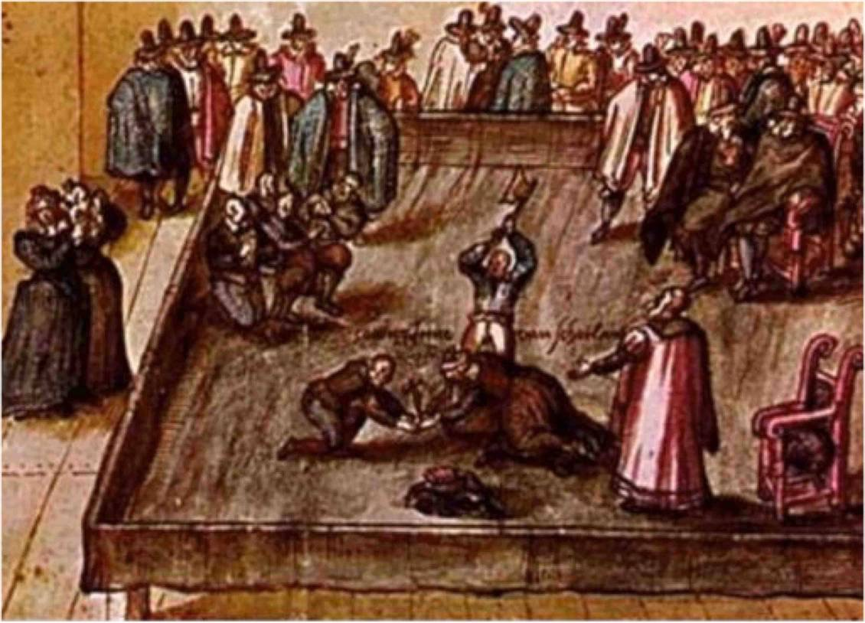
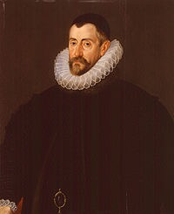
Mary Stuart did not know in 1587
Notes:
Mary, Queen of Scots (in France, as Marie Stuart) (8 December 1542 – 8 February 1587) Mary was put on trial for treason after being implicated in the Babington Plot by her own letters, which Sir Francis Walsingham had arranged to come straight to his hands.
http://www.simonsingh.net/The_Black_Chamber/maryqueenofscots.html

Slide 30
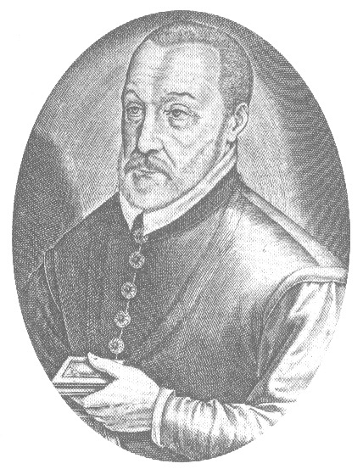
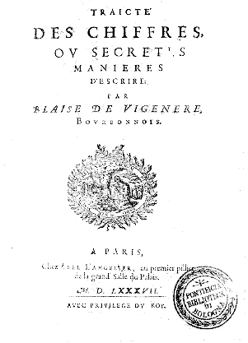
Vigenère Encryption: Better!
Blaise de Vigenere (1523-1596)
Use several Caesar substitutions and cycle through them
Sequence of substitutions determined by a secret key
Published in MDLXXXVII …
Notes:
Published in MDLXXXVII, the year Mary was executed…
Yet, they were used later too: Edgar Allen Poe’s mystery story The Gold Bug (1843) and A. Conan Doyle’s Sherlock Holmes mystery Adventure of the Dancing Men (1903) both turn on the decryption of substitution ciphers.

Slide 31
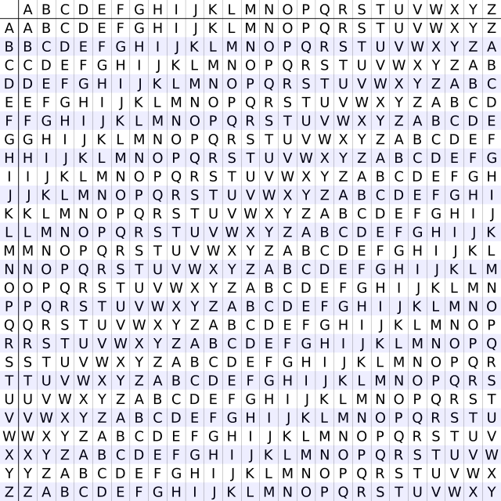
Vigenère: The Tabula Recta

Slide 32
a | b | c | d | e | f | g | h | i | j | k | l | m | n | o | p | q | r | s | t | u | v | w | x | y | z
S | T | U | V | W | X | Y | Z | A | B | C | D | E | F | G | H | I | J | K | L | M | N | O | P | Q | R
O | P | Q | R | S | T | U | V | W | X | Y | Z | A | B | C | D | E | F | G | H | I | J | K | L | M | N
N | O | P | Q | R | S | T | U | V | W | X | Y | Z | A | B | C | D | E | F | G | H | I | J | K | L | M
G | H | I | J | K | L | M | N | O | P | Q | R | S | T | U | V | W | X | Y | Z | A | B | C | D | E | F
B | C | D | E | F | G | H | I | J | K | L | M | N | O | P | Q | R | S | T | U | V | W | X | Y | Z | A
I | J | K | L | M | N | O | P | Q | R | S | T | U | V | W | X | Y | Z | A | B | C | D | E | F | G | H
R | S | T | U | V | W | X | Y | Z | A | B | C | D | E | F | G | H | I | J | K | L | M | N | O | P | Q
D | E | F | G | H | I | J | K | L | M | N | O | P | Q | R | S | T | U | V | W | X | Y | Z | A | B | C
f i g h t f iercely!
Due to a password (songbird)
a letter is mapped onto different letters!
X
W
T
N
U
N
Z

Slide 33
Breaking Vigenère – (1)
If the key has length K, then ciphertext letters that are K positions apart are specified by the same character in the key …
And thus is the result of a simple substitution
And thus can be attacked by frequency analysis
Example: Suppose the key length is three:
DJBK FJWO VJSW FKDS GFJD RKEM CNEJ JKSJ FKDJ SJSS
So the decryption reduces to doing frequency analysis K times – provided we know K

Slide 34
Breaking Vigenère – (2)
To find the length of the key:
Try different values for K, looking at every Kth letter of the ciphertext, and pick the one for which the frequency distribution looks like the frequency distribution for English.
Clever methods to do this by hand:
Babbage, Kasiski: counting double letters (1850s, 1860s)
Friedman: Index of Coincidence (1920s)
With computers, we don’t need to be clever: We can try brute-force substitutions

Slide 35
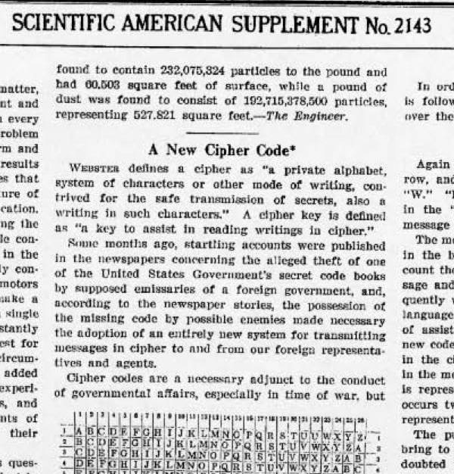
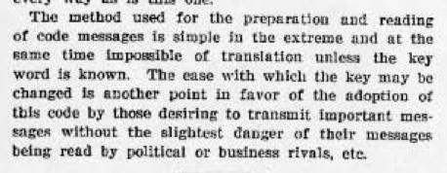
But it was still considered “new” in 1917

Slide 36
Cryptologic lessons
Breakthroughs in cryptography can render previously reliable cryptographic methods insecure
News of cryptanalytic breakthroughs travels slowly
Making strong encryption systems available does not guarantee they will be used

Slide 37
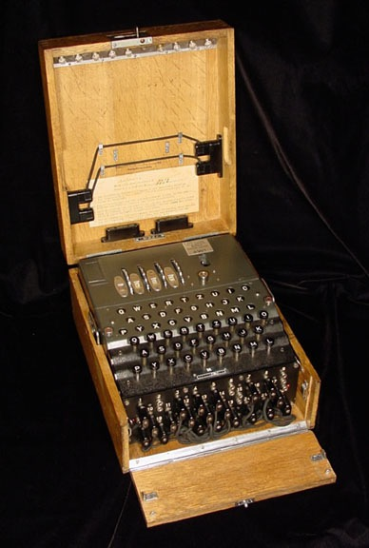
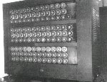
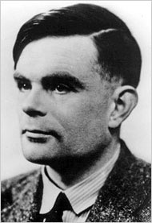
The Enigma Machine
Every time you strike a letter, the cipher rotates to a new position
Impossible to decipher if you do not have an identical machine
Very hard, if you do have one
Accomplished by Alan Turing, “father of Computer Science” who built the first Bombe machine
BTW, remember the “Turing test”?
Notes:
http://thelede.blogs.nytimes.com/2009/09/14/posthumous-apology-to-gay-code-breaker-who-helped-defeat-nazi-germany/?scp=1&sq=turing&st=cse
https://www.youtube.com/watch?v=mcX7iO_XCFA (Click to watch video)

Slide 38
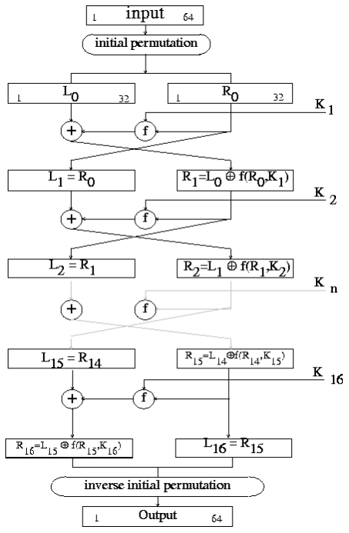
DES: The Data Encryption Standard
A 1976 public standard
56 bit key – has to be kept secret!
Key was long enough in 1976
With today’s more powerful computers brute force search through possible keys takes only a day
Superseded by Advanced Encryption Standard or “AES”: 128 (or 192,256) bit key – still needs to be secret
Used today in every https communication
AES not cracked as far as we know

Slide 39
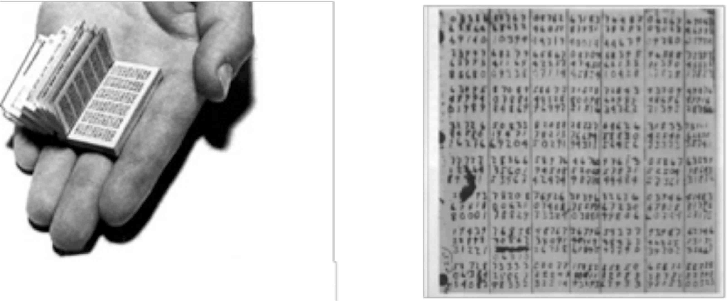
One-Time Pad: Key is as long as the plaintext!
The Only Provably Secure Cryptosystem – in theory
“In theory, there is no difference between theory and practice. In practice, there is” – Yogi Berra
No patterns, so nothing to analyze
But getting the key from Alice to Bob securely is just as hard as getting an unencrypted message!
Unsuitable for e-commerce
“Meet” Amazon to get a key?
Notes:
The photo has the one-time pads that was found on Che Guevara and Kim Philby.

