Slide 1

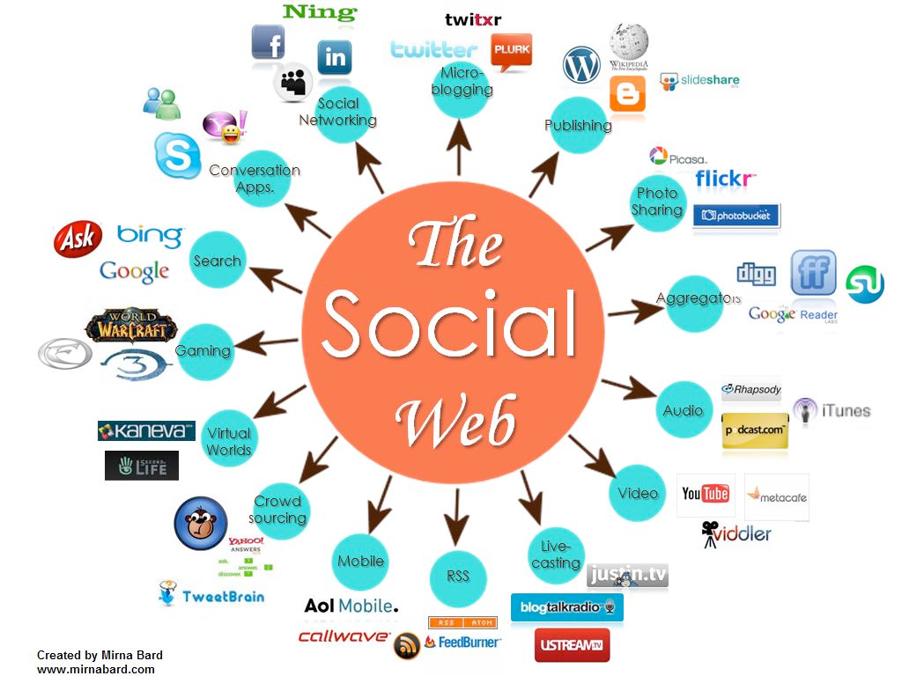
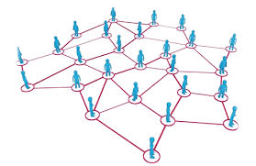

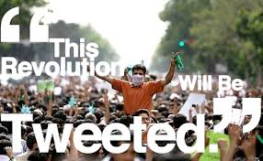
CS 115: COMPUTING FOR The Socio-Techno Web
Cryptography and Cryptanalysis
Notes:
image source: http://www.igenii.com/blog/Social%20Media/social-media/
twitter.com
http://www.worthofweb.com/blog/case-study-this-revolution-will-be-tweeted/
http://foxwoodonlinemarketing.typepad.com/my-blog/social-media/

Slide 2
Private key encryption
One time pad – provably secure!
  Cannot be “cracked”
  But key is very big
AES
  Fast, efficient, small key
  No one (?) knows how to crack

Slide 3
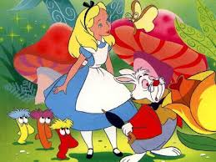
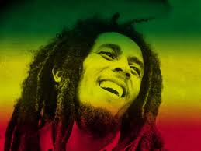
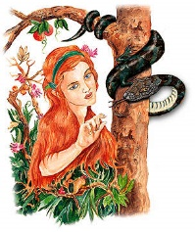
Private Key Encryption
Sf&*&3vv*+@@Q
1324-5465-2255-9988
1324-5465-2255-9988
AES ciphertext
RECEIVER
SENDER
key
key
(Alice’s Credit Card #)
The Internet
(Alice’s Credit Card #)
Alice
(You)
Bob
(An on-line store)
ATTACKER
(Identity thief)
Eve

Slide 4
Private key
shhhh… the key is xcgcvdvhjve
Got it! I’ll protect this with my life
Alice and Bob “meet” somewhere
But this doesn’t work very well for online shopping!

Slide 5
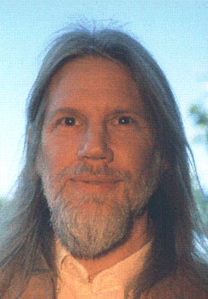
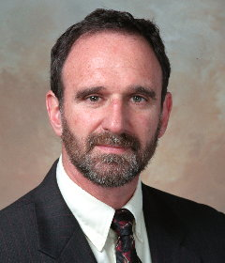
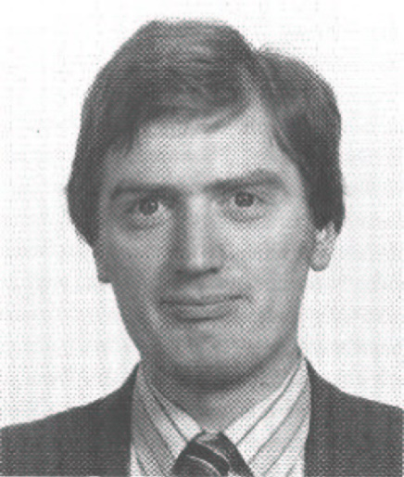
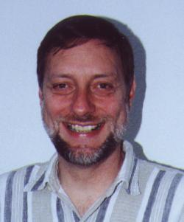
Public-Key Cryptography:
a way for Alice and Bob to agree on a secret key
without ever meeting and
through messages that are completely public!
Whit Diffie and Marty Hellman, New Directions in Cryptography, 1976
Clifford Cocks and Malcolm Williamson,
secret work in the British GCHQ, 1973-74, revealed in 1997

Slide 6


Our friends…
Alice and Bob “meet” somewhere
(B) PUBLIC
(A) PUBLIC
(b) PRIVATE
(a) PRIVATE

Slide 7
Diffie-Hellman key agreement
Arrange things so that
  Alice has a secret number a that only Alice knows
  Bob has a secret number b that only Bob knows
  Alice and Bob then communicate something publicly
  They somehow compute the same number Κ
  Only they know the shared number Κ -- that’s their Κey!
  No one else can compute this number Κ
  without knowing Alice’s secret or Bob’s secret
  But Alice’s secret number is still hers alone,
  and Bob’s is Bob’s alone
Sounds impossible …

Slide 8
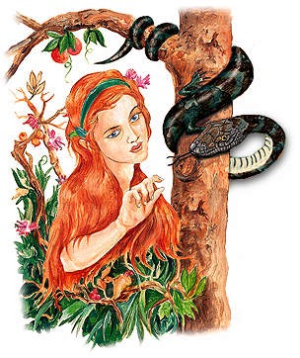


Activity
Split into 3 groups: Alice, Bob, and Eve (we’ll alternate)
Goal: Use public key cryptography to agree on a secret color
Eve doesn’t know the secret color

Slide 9

Step 1: create a secret color
Any color you want. Make 3 pieces of it.
Don’t show it to group Eve!

Slide 10
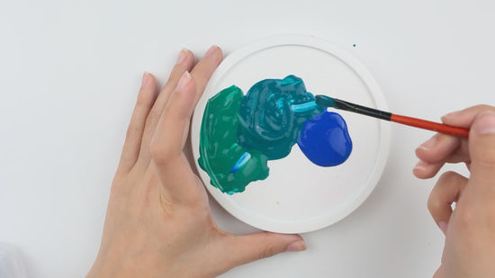
Step 2: mix your secret color with the public color
Make sure it is in equal parts
Keep one of your 3 pieces unmixed. Mix the other two.
This mixture is your public key!

Slide 11
Step 3: send your mixture to the other group
Over the “network”---meaning through Eve!
Eve can see the mixture (and take a piece)
She can’t add to the mixture or modify it

Slide 12
Step 4: combine the other group’s mixture with your secret mixture
What does your mixture consist of now?
1 part your secret mixture
1 part the other group’s secret mixture
1 part the public color
The other group has the same final mixture!

Slide 13
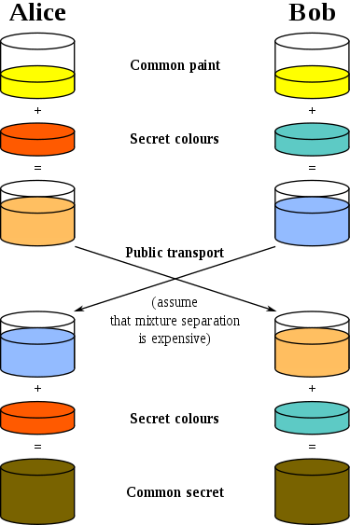
Diagram of what we did

Slide 14
activity
Create a secret color
Mix your secret color with the public color
  (this is your public key)
Send this public key mixture to the other group
  Eve can steal some!
Receive the other group’s mixture. Combine it with your secret color.

Slide 15
How it works in practice
Instead of colors, we have numbers
Rather than mixing, we use “modular exponentiation”
  raise to a power and then take a modulo (like % in Javascript)
Diffie-Hellman was the first public “key exchange” system. It works exactly like our class activity, with these changes!

Slide 16
Why does this work?
Can’t unmix paint!
Even though Eve knows that what you sent was a combination of your secret color, mixed with the public color, she can’t “unmix” it to get your secret color
Does anyone have ideas for what Eve can do to try to get the shared secret mixture? Do they work?

Slide 17
Instead of paint:
One-Way Computation
Easy to compute,
Hard to reverse computation
Easy: What is 28487532223 * 72342452989?
  Easy on a computer -- about 100 digit-by-digit multiplications
Hard: What are the factors of 206085796112139733547?
  Seems to require vast numbers of trial divisions
NOTE: https does not use simple multiplication,
it uses exponentiation in modulo arithmetic
f(a) = qª (mod p)
Notes:
The crucial invention was the concept of a one-way computation—a compu- tation with two important properties: It can be done quickly, but it can’t be undone quickly. To be more precise, the computation quickly combines two numbers x and y to produce a third number, which we’ll call x ∗ y. If you know the value of x ∗ y, there is no quick way to figure out what value of y was used to produce it, even if you also know the value of x. That is, if you know the values of x and the result z, the only way to find a value of y so that z = x ∗ y is trial and error search. Such an exhaustive search would take time that grows exponentially with the number of digits of z—practically impossible, for numbers of a few hundred digits. Diffie and Hellman’s one- way computation also has an important third property: (x ∗ y) ∗ z always pro- duces the same result as (x ∗ z) ∗ y.
Exploiting this difference in computational effort was Diffie, Hellman, and Merkle’s breakthrough. They showed how to create shared secret keys, with- out requiring secure channels.

Slide 18
Our friends…
Alice and Bob “meet” somewhere
(B) PUBLIC
(A) PUBLIC
(b) PRIVATE
(a) PRIVATE
Notes:
Suppose Alice wants to have a way for anyone in the world to send her encrypted messages that only she can decrypt. She can do this with a small
variation of the key-agreement protocol. All the computations are the same as in the key agreement protocol, except they take place in a slightly differ- ent order.
Alice picks a secret key a and computes the corresponding public key A. She publishes A in a directory.
If Bob (or anyone) now wants to send Alice an encrypted message, he gets Alice’s public key from the directory. Next, he picks his own secret key b and computes B as before. He also uses Alice’s public key A from the directory to compute an encryption key K just as with the key-agreement protocol: K = A ∗ b. Bob uses K as a key to encrypt a message to Alice, and he sends Alice the ciphertext, along with B. Because he uses K only once, K is like a one- time pad.
When Alice receives Bob’s encrypted message, she takes the B that came with message, together with her secret key a, just as in the key agreement protocol, and com- putesthesameK=B∗a.AlicenowusesK as the key for decrypting the message. Eve can’t decrypt it, because she doesn’t know the secret keys.
With public-key encryption, anyone can send encrypted mail to anyone over an insecure, publicly exposed communication path. The only thing on which they need to agree is to use the Diffie-Hellman-Merkle method—and knowing that is of no use to an adversary trying to decipher an intercepted message.
anyone can encrypt a message, but only the person with the secret key can decrypt it.
Diffie and Hellman introduced the concept of digital signatures in their 1976 paper. They suggested an approach to designing signatures, but they did not present a concrete method. The problem of devising a practical digital signa- ture scheme was left as a challenge to the computer science community.
The challenge was met in 1977 by Ron Rivest, Adi Shamir, and Len Adleman of the MIT Laboratory for Computer Science. Not only was the RSA (Rivest-Shamir-Adleman) algorithm a practical digital signature scheme, but it could also be used for confidential messaging. With RSA, each person generates a pair of keys—a public key and a secret key. We’ll again call Alice’s public key A and her secret key a. The public and private keys are inverses: If you transform a value with a, then transforming the result with A recovers the original value. If you transform a value with A, then transforming the result with a recovers the original value.
Here’s how RSA key pairs are used. People publish their public keys and keep their secret keys to themselves. If Bob wants to send Alice a message, he picks a standard algorithm such as DES and a key K, and transforms K using Alice’s public key A. Alice transforms the result using her secret key a to recover K. As with all public-key encryption, only Alice knows her secret key, so only Alice can recover K and decrypt the message.

Slide 19
If you have f(a), a one-way function…
A
B
Alice
(you)
Bob
(Amazon)
Pick a secret number a
Pick a secret number b
Compute A = f(a)
Compute B = f(b)
Shout out publicly: A
Shout out publicly: B
Compute B*a
Compute A*b
Main point: Alice and Bob have computed the same number,
because it turns out that
B*a = A*b
Use this number as the encryption Key (= A*b = a*B) !

Slide 20
… Eve has a major headache
A
B
Alice
(you)
Key = B*a = A*b
Bob
(Amazon)
a
b
Eve
Alice and Bob can now use the shared Key for encrypted communication
Eve the eavesdropper knows A and B
Eve also knows what method used to compute them.
But going from these back to a or b requires reversing a one-way computation
(and this is not doable with current technology).

Slide 21


https: Secure Internet Communication
Your browser makes an HTTPS request to the server, just like requesting any web page,
plus its public key A.
The server responds by sending
its public key B as a digital "trunk."
The browser makes up a secret code,
K = a*B, and encodes its message using K
The server computes secret code,
K = b*A, and decodes the message
using K
From now on, the server and browser can now communicate in both directions
using the secret code K, and no one else can read their conversation.

