Slide 1
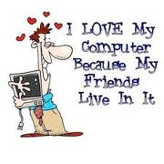
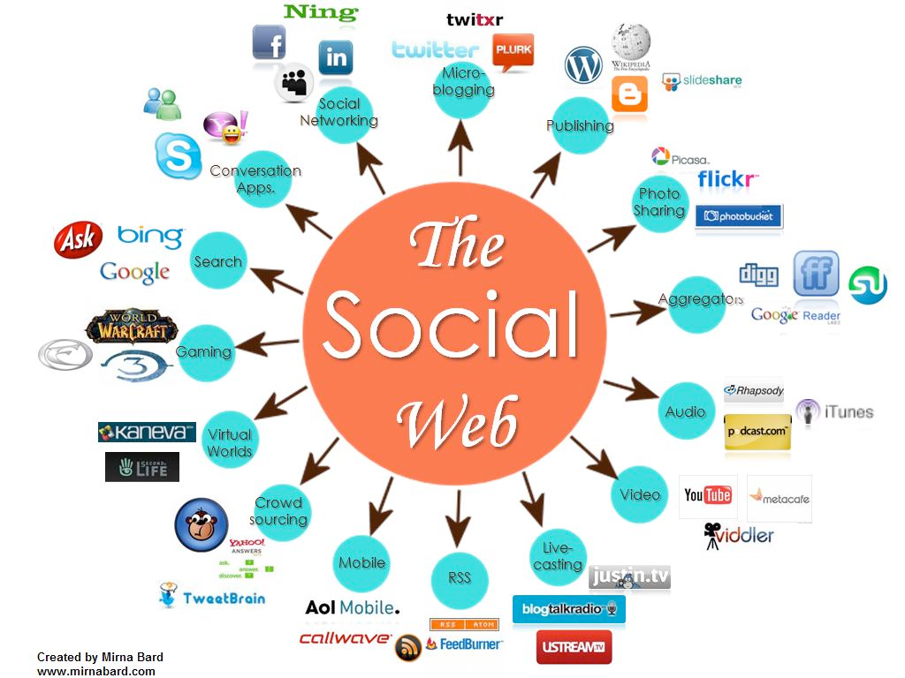
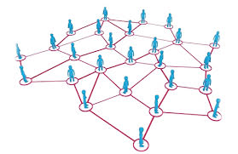
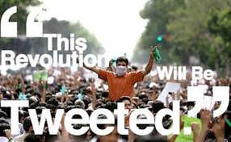
CS 115: COMPUTING FOR The Socio-Techno Web
Intellectual Property and the Web
Notes:
image source: http://www.igenii.com/blog/Social%20Media/social-media/
twitter.com
http://www.worthofweb.com/blog/case-study-this-revolution-will-be-tweeted/
http://foxwoodonlinemarketing.typepad.com/my-blog/social-media/

Slide 2
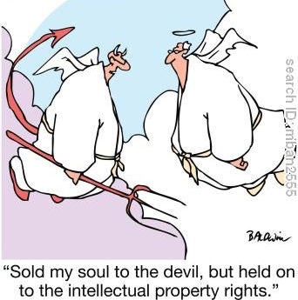

Slide 3
How many things do you own the copyright for?
A) None
B) 1-20
C) 20-50
D) 50+

Slide 4
Do you recogniZe this brand?
A) Yes
B) No

Slide 5
Have you ever signed an NDA?
A) Yes
B) No

Slide 6
Intellectual Property Issues
Copyright
Trademarks
Patents
Trade Secrets

Slide 7
Intellectual Property Issues
Copyright
Legal right given to the author of an original work.
Requires permission from the copyright holder to download, copy, distribute.
Trademarks
Recognizable sign, design, expression which identifies a brand or a product.
Patents
Rights granted to an inventor of a product or process.
A patent excludes others from developing the subject of the patent.
Trade Secrets
Confidential information usually protected under an NDA.

Slide 8
Intellectual Property Issues
Copyright
Assume everything on the web is copyrighted including text, images, sound, video. Requires permission from the copyright holder to download, copy, distribute.
Trademarks
All famous marks are registered and watched by web crawlers, including logos and design Domain names that confuse origin or dilute the value of the mark will be challenged by owners.
Patents
Obviously. But for the web might be confusing
Compton’s patent on a search method failed but many e-commerce patents are issued.
Trade Secrets

Slide 9
Copyright Basics
What is copyrightable?
An original work of authorship that is fixed in a tangible form of medium.
Copyright is automatic (since 1974)
© symbol is advised but not required
Ignorance is no defense against copyright infringement
Not copyrightable: Facts, ideas, titles, short phrases, public domain information
Who owns the copyright?
The author or publisher
How long does the copyright lasts?
By author: life+70 years
By employer: 95 years from publication or 125 from creation

Slide 10
The 5 rights of copyright holder
To reproduce
To prepare derivative work
To distribute
To display publicly
To perform publicly

Slide 11
Fair Use: exemption to copyright monopoly
The right of the public to reproduce and distribute without permission for:
Criticism and commentary
News reporting
Teaching, scholarship, research
Home use
Determining Fair Use is subject to a 4-factor test:
Non-profit vs. Commercial Use
Number of copies made
Amount of text copied
Effect on market potential

Slide 12
Remix
https://www.youtube.com/yt/about/copyright/fair-use/#yt-copyright-resources
Notes:
https://vimeo.com/211521384

Slide 13
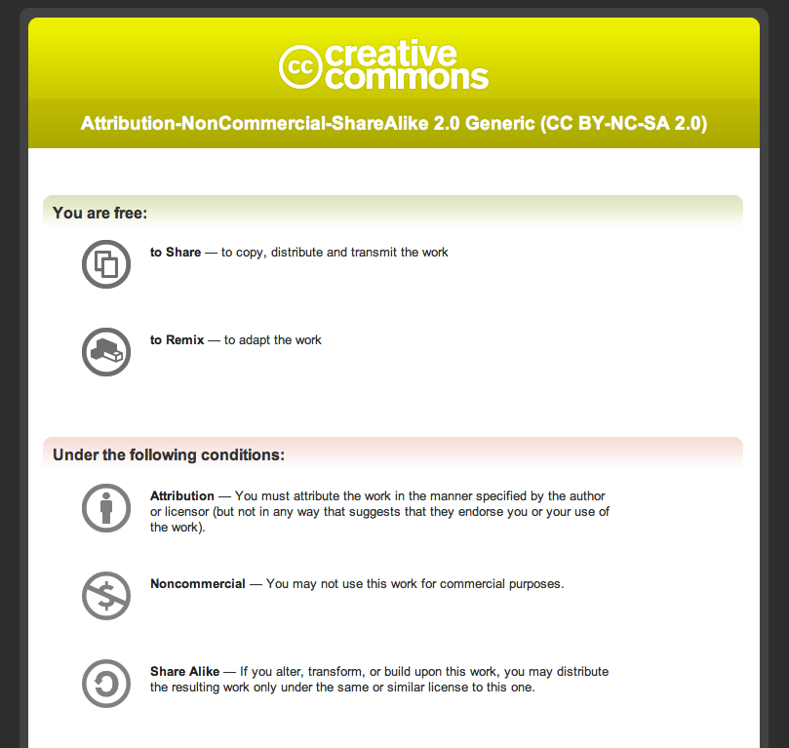
Share, Remix, Reuse — Legally
Notes:
https://creativecommons.org/licenses/

Slide 14
Copyright Basics
How long does the copyright lasts?
By author: life+70 years
By employer: 95 years from publication or 125 from creation
Mickey Mouse effect

Slide 15
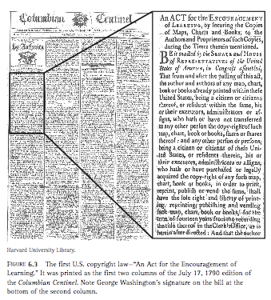
History of Copyright
Article I, Section 8, Clause 8, gave Congress the power to:
“To promote the progress of science and useful arts, by securing for limited times to authors and inventors the exclusive right to their respective writings and discoveries.”

Slide 16
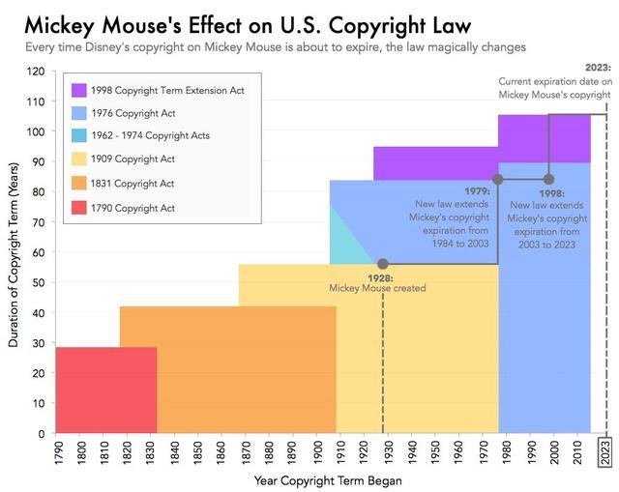
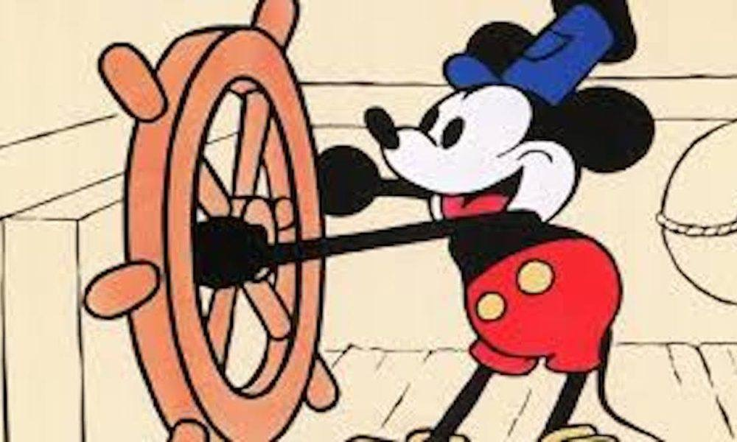
Expansion of US copyright law
life + 70
or 95 after publication
or 120 after creation
life + 50
28 + 28
28 + 14
14 + 14

Slide 17
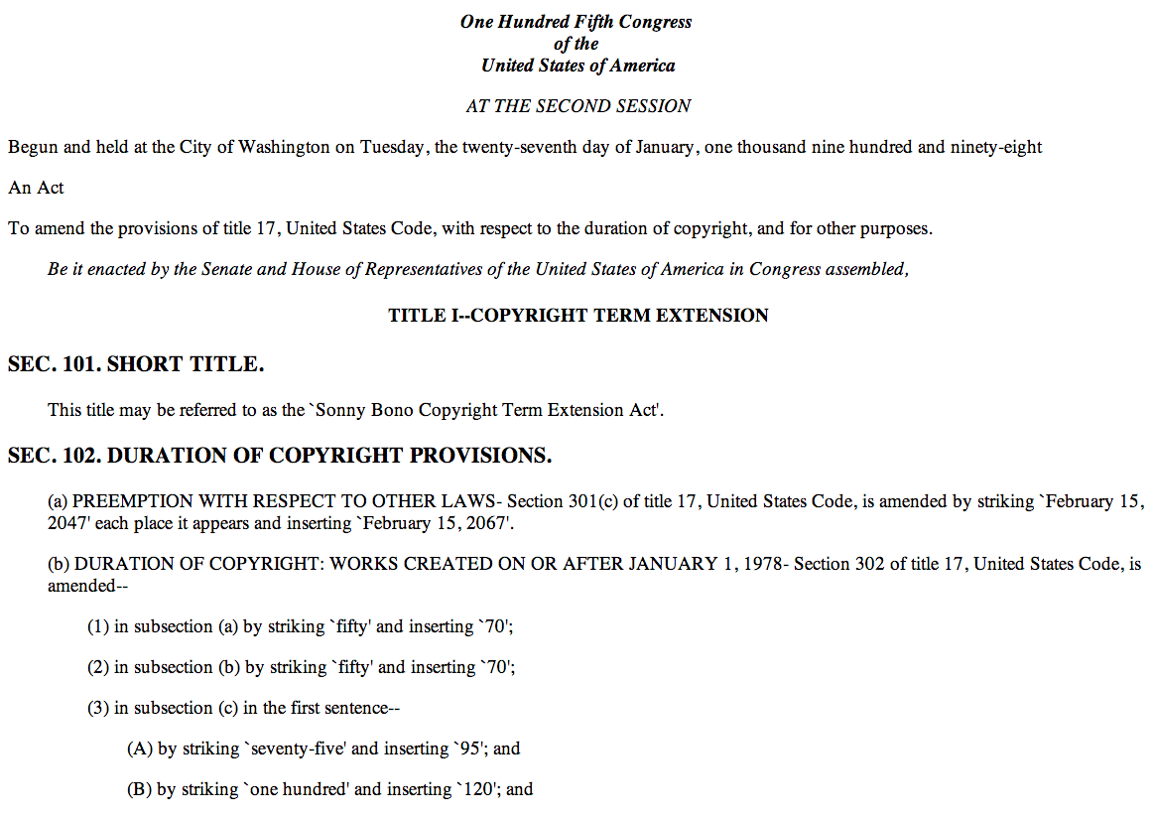

Slide 18
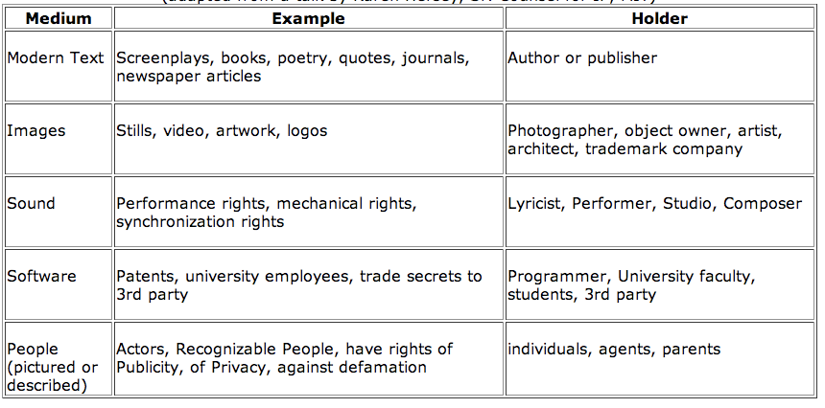
Copyright on the Web

Slide 19
Types of Infringement
Direct infringement
Secondary infringement:
Contributory infringement:
There has been a direct infringement by someone
The infringer knew or should have known about the underlying infringement
The infringer induced, caused, or materially contributed to the direct infringement
Example: peer-to-peer file sharing software
Vicarious infringement
There has been a direct infringement by someone
The infringer had the right or ability to control or supervised the underlying direct infringement
Example: ebay used for selling infringing goods

Slide 20
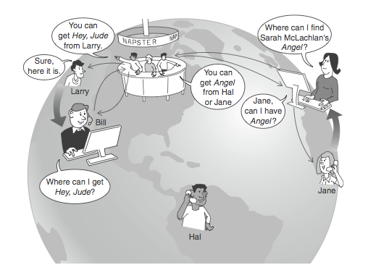
Peer-to-peer sharing
1999: Napster created by NEU student Sean Fanning. Every client becomes a server – no central server.

Slide 21
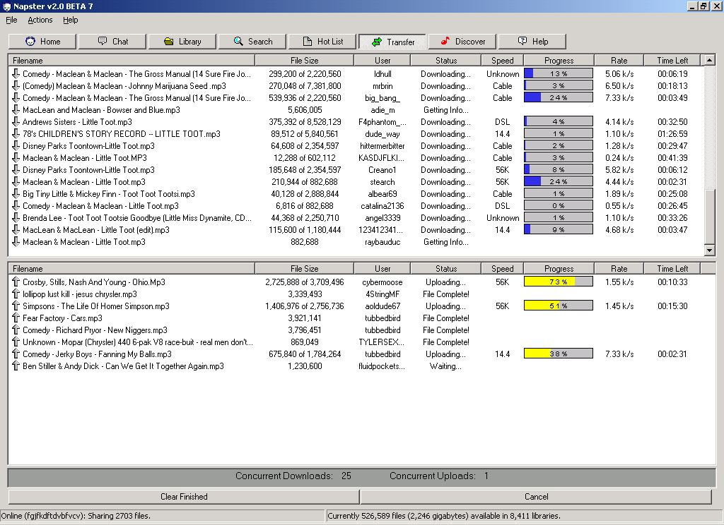

Slide 22
In 2000, a judge finds Napster guilty of secondary copyright infringement:
Enabling others to infringe and not preventing them.

Slide 23
Napster vs. HTTP
Technically
Culturally
More efficient – no server overload
More reliable – many machines could crash and the system will operate fine
Only maintains a directory of files, stores no files at all!
“The universal juke box”
Napster parties
26M users in 2 years
26M copyright violators?
In 2000, a judge finds Napster guilty of secondary copyright infringement:
Enabling others to infringe and not preventing them

Slide 24
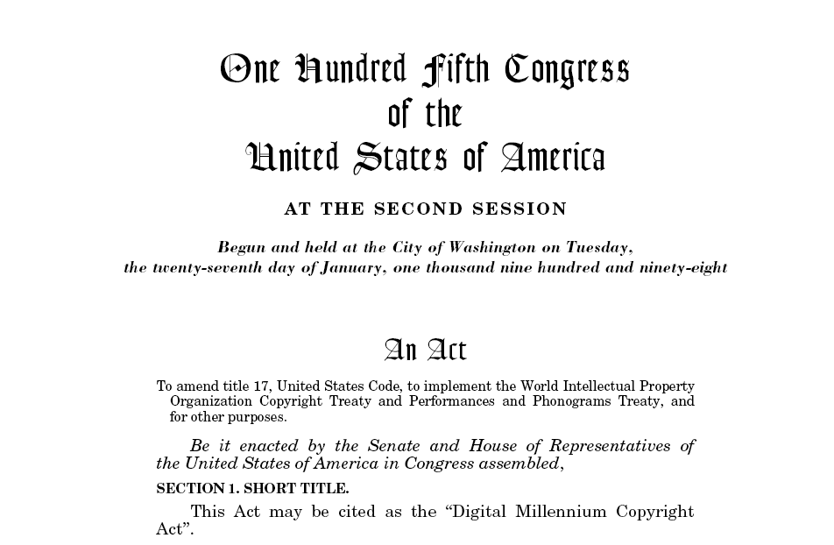

Slide 25
What changes happened in the music industry since 2000?

Slide 26
The Digital Millennium Copyright Act sec. 1201:
“No person shall manufacture, import, offer to the public, provide, or otherwise traffic in any technology, product, service, device, component, or part thereof, that –
(A) is primarily designed or produced for the purpose of circumventing protection afforded by a technological measure that effectively protects a right of a copyright owner under this title in a work or a portion thereof;
(B) has only limited commercially significant purpose or use other than to circumvent protection afforded by a technological measure that effectively protects a right of a copyright owner under this title in a work or a portion thereof; or
(C) is marketed by that person or another acting in concert with that person with that person's knowledge for use in circumventing protection afforded by a technological measure that effectively protects a right of a copyright owner under this title in a work or a portion thereof.

Slide 27
SOPA: Stop Online Piracy Act
Section 102(a)(2) permits the attorney general to take action against foreign sites (i.e., sites that do not fall under U.S. jurisdiction) if “the owner or operator of such Internet site is facilitating the commission of [copyright infringement].”
Section 103 An `Internet site is dedicated to theft of U.S. property’ if [a portion of the site is US-directed] and is used by users within the United States and is primarily designed or operated for the purpose of offering services in a manner that enables or facilitates [copyright violation or circumvention of copyright protection measures].
Payment providers (section 103 (b)(1)) and ad networks ((b)(2)) are required, upon receiving a claim against a site by a copyright holder (section (4)(A)(i)), to cut off all services to the accused site within five days, unless they receive a counter-notification from the operator of the accused site. Note that there is no requirement that the accused be notified of said accusation, and thus, they would have no opportunity to provide a counter-notice. In practice, you’d probably find out about it when you notice that the money stops coming in, maybe a week or two later.
2011
Notes:
https://en.wikipedia.org/wiki/Stop_Online_Piracy_Act

Slide 28
Notes:
https://en.wikipedia.org/wiki/Stop_Online_Piracy_Act

Slide 29
Notes:
https://en.wikipedia.org/wiki/Stop_Online_Piracy_Act

Slide 30
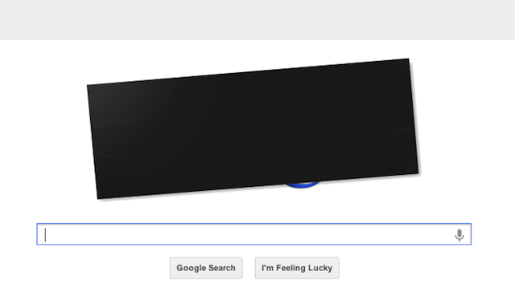
Notes:
https://en.wikipedia.org/wiki/Stop_Online_Piracy_Act

Slide 31
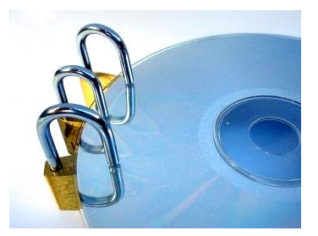
Digital Rights Management (DRM)

Slide 32
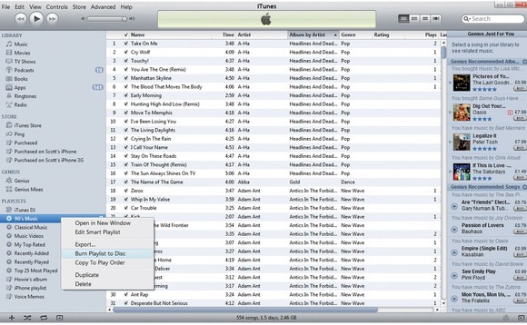
Itunes: single file download

Slide 33
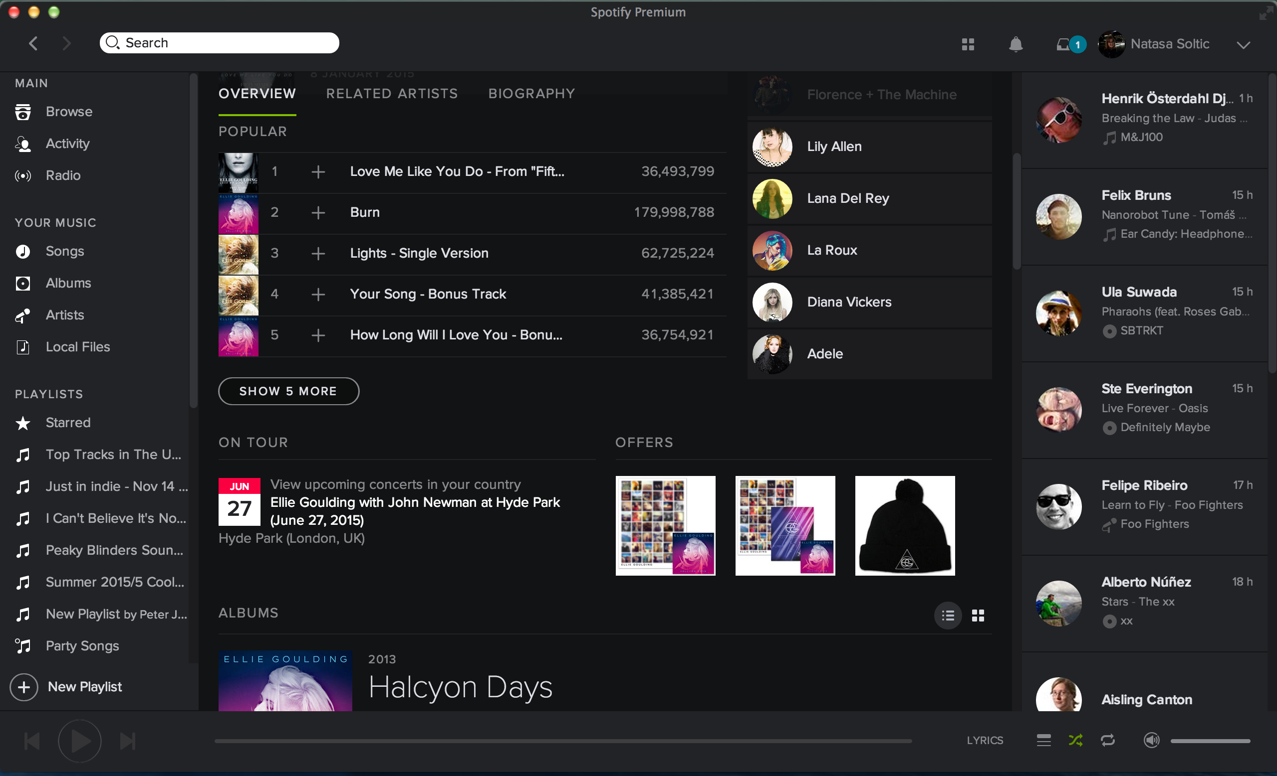
Spotify: music streaming

Slide 34
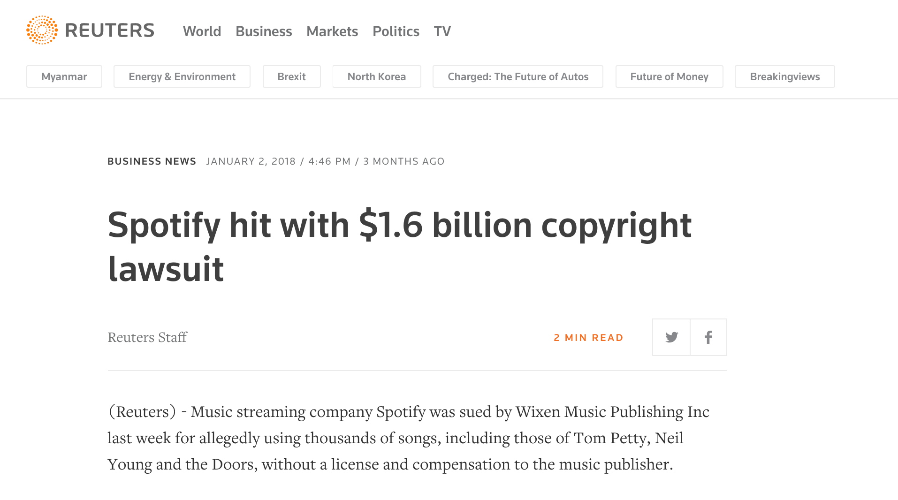
Spotify: music streaming

Slide 35
Legal Differences of Atom vs. Bits
When you buy a book you can:
Read it
Lend it out
Resell it
Copy a portion and quote in a paper
Donate it
Open it without asking for permission
How about an ebook?

Slide 36
Copyrighted on the Web
Medium | Example | Holder
Modern Text | Screenplays, books, poetry, quotes, journals, newspaper articles | Author or publisher
Images | Stills, video, artwork, logos | Photographer, object owner, artist, architect, trademark company
Sound | Performance rights, mechanical rights, synchronization rights | Lyricist, Performer, Studio, Composer
Software | Patents, university employees, trade secrets to 3rd party | Programmer, university, faculty, students, 3rd party
People (pictured or described) | Actors, Recognizable People, have rights of Publicity, of Privacy, against defamation | Individuals, agents, parents

Slide 37
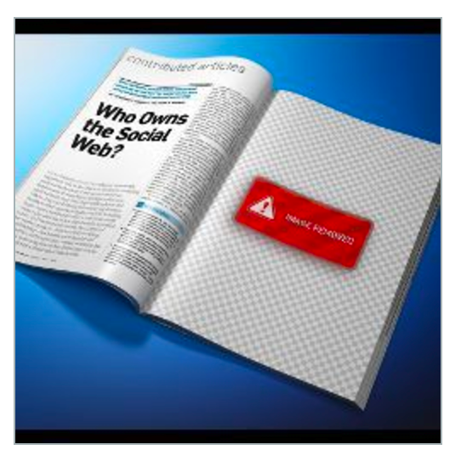
Who OWNS The SOCIAL Web
Notes:
https://vimeo.com/211521384

Slide 38
Intellectual Property Issues
Copyright
Legal right given to the author of an original work.
Requires permission from the copyright holder to download, copy, distribute.
Trademarks
Recognizable sign, design, expression which identifies a brand or a product.
Patents
Rights granted to an inventor of a product or process.
A patent excludes others from developing the subject of the patent.
Trade Secrets
Confidential information usually protected under an NDA.

Slide 39
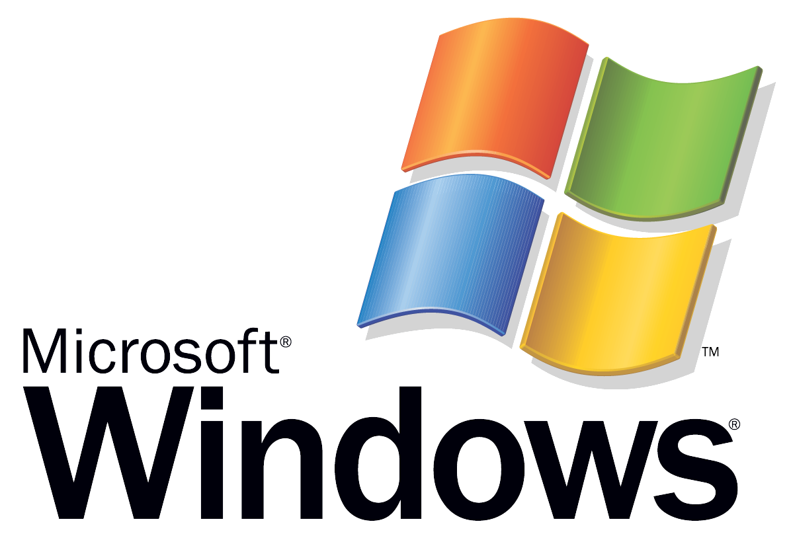
Trademark

Slide 40
RGB #E20074

Slide 41
RGB #81D8D0
Pantone 1837

Slide 42
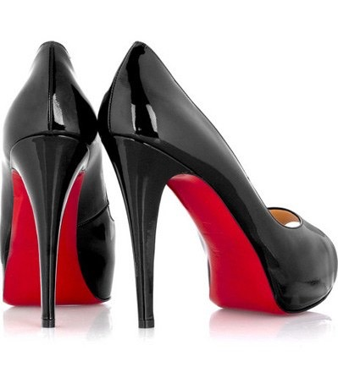
Trademark

Slide 43
Trademark ON THE WEB
Domain names that confuse origin or dilute the value of the mark will be challenged by owners.
MikeRoweSoft.com
gooogle.com or gooooogle.com

Slide 44
Intellectual Property Issues
Copyright
Legal right given to the author of an original work.
Requires permission from the copyright holder to download, copy, distribute.
Trademarks
Recognizable sign, design, expression which identifies a brand or a product.
Patents
Rights granted to an inventor of a product or process.
A patent excludes others from developing the subject of the patent.
Trade Secrets
Confidential information usually protected under an NDA.

Slide 45
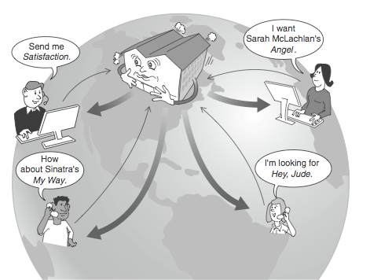
Types of Infringement: the Napster case
P2P: Peer to Peer protocol compared to HTTP protocol

Slide 46
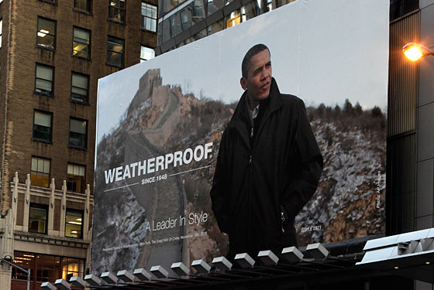
Is there anything wrong with this picture?

