Slide 1
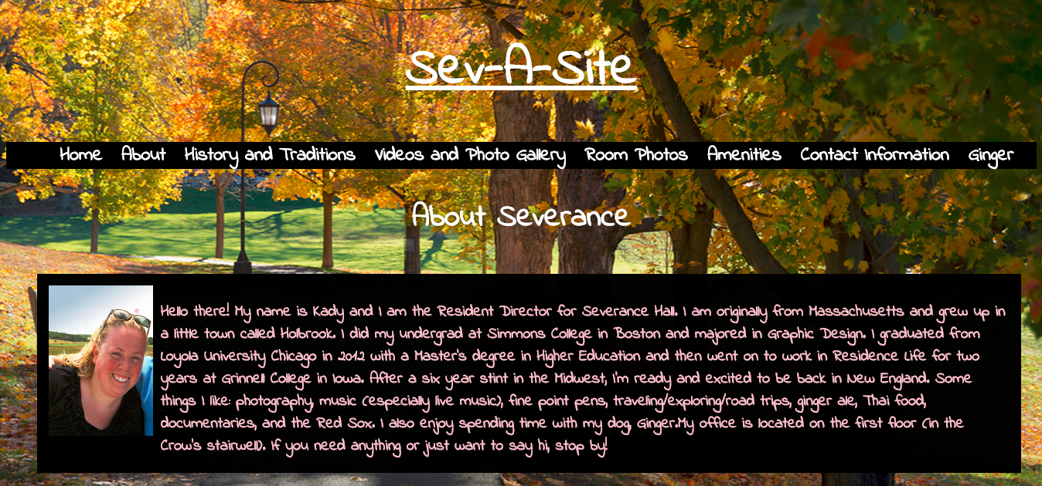
Sev-A-Site
By: Kayla Jang and Manuela Molina

Slide 2
Purpose, Goals, and Audience
Purpose:
Keep current students up to date
Give prospective students a glimpse of residential life at Wellesley
Goals:
Share news and events
Explain history and traditions
Provide prospective students with a resource and images
Audience:
Current residents
Prospective students
Notes:
The Severance website aims to serve both current and prospective students. The site’s goals include sharing news and events with the community, sharing the history and traditions of Severance hall, as well as providing prospective students with a resource where they get to see where they’ll be living for the next year. The “sev-a-site” will provide biographies of the residential staff, a tab with pictures of room floorplans, a social media feed to keep people updated among other things that will further discussed in the content section. The intended audience for our website is current and prospective residents of Severance Hall. This will help current students living in Severance Hall to keep up to date with events and find all information regarding specific information of the residential hall in one platform. Furthermore, any Wellesley College student or faculty will be able to find contact information as well as service information provided by the hall, such as request-space arrangements and policies, right in one place. The site is also a resource for incoming or prospective students and their families to explore the hall before arrival.

Slide 3
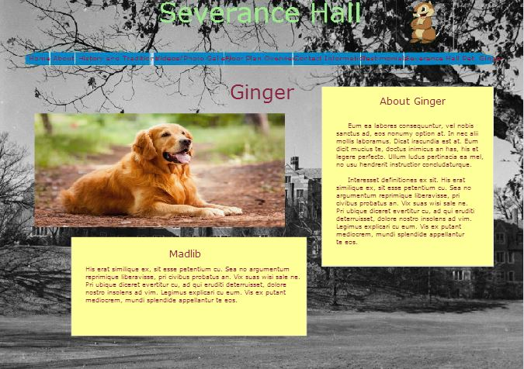
Mockup
Notes:
This is the ginger page from the Mockup. We used a maroon font color because our client wanted maroon to be a color throughout the site. They also stated that they wanted a page of our website dedicated to Ginger, Kady’s dog. This page is a similar to most of the other pages we included in our website. Although some would argue that Ginger herself is not necessary for incoming students to know about, the page layout is what we wanted to focus on from the mockup. It contains an image as well as text that is not overwhelming yet contains the pertinent information for prospective and current students.

Slide 4
Accomplishments
8 html pages
Over 30 pictures
4 JavaScript applications
http://cs.wellesley.edu/~severance/beta/index.html
Notes:
Our website includes 8 html pages (the homepage, the about page, History and Traditions, Videos and Photo Gallery, Rooms, Amenities, Contact Information, and Ginger). Within these 8 pages, we have over 30 pictures displayed in the Video and Photo Gallery page and the Amenities page. We also included 4 javascript applications: 1) when you click on the thumbnails in the Video and Photo Gallery page, the images get larger; 2) the Amenities page contains a slideshow that changes between 4 pictures every 2.5 seconds; 3) the Contact Information page provides a form that users can fill out to easily send to the Sev HP; 4) Ginger’s page includes a Madlib story that is fun for anyone who is looking to procrastinate and get to know a little more about Ginger.

Slide 5
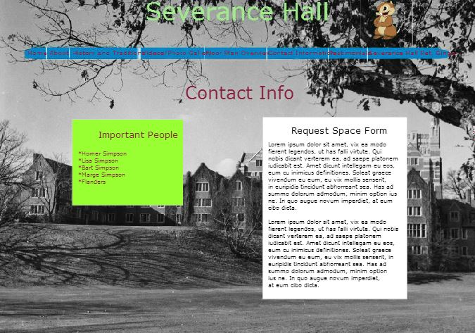
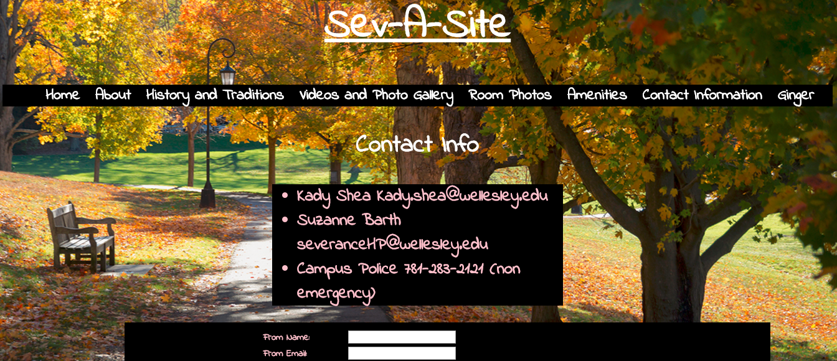
Achievements
On-click JavaScript function
Slideshow JavaScript function
Change of appearance from Mockup to current website
Improve on image-loading time
Notes:
Our proudest achievements are probably implementing the on-click javascript function to make the thumbnail images larger and the slideshow javascript application that we learned about outside of class. Another big improvement was the change from what our design looked like in the mockups to what our actual site looks like right now. I think we can all agree that our mockup designs were not as aesthetically pleasing and were not as consistent -- the website we have now is more lively. After the semester, with more time, one aspect of our website we’d probably improve on is the image-loading time.

